Slide 1
Aerosol Particle Deposition Analysis Using LAPD Dataset
Wanjun Gu
Chantal Darquenne Lab
UCSD School of Medicine

Slide 2
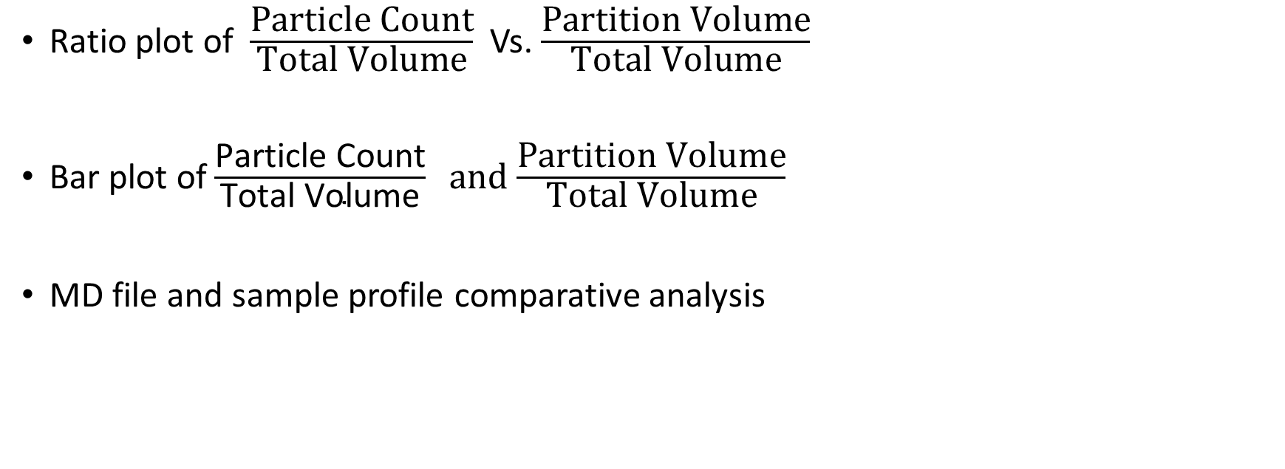
Data Representation
Ratio plot of $\frac{\text{Particle} \text{Count}}{\text{Total} \text{Volume}}$Vs. $\frac{\text{Partition} \text{Volume}}{\text{Total} \text{Volume}}$
Bar plot of $\frac{\text{Particle} \text{Count}}{\text{Total} \text{Volume}} and$ $\frac{\text{Partition} \text{Volume}}{\text{Total} \text{Volume}}$
MD file and sample profile comparative analysis

Slide 3
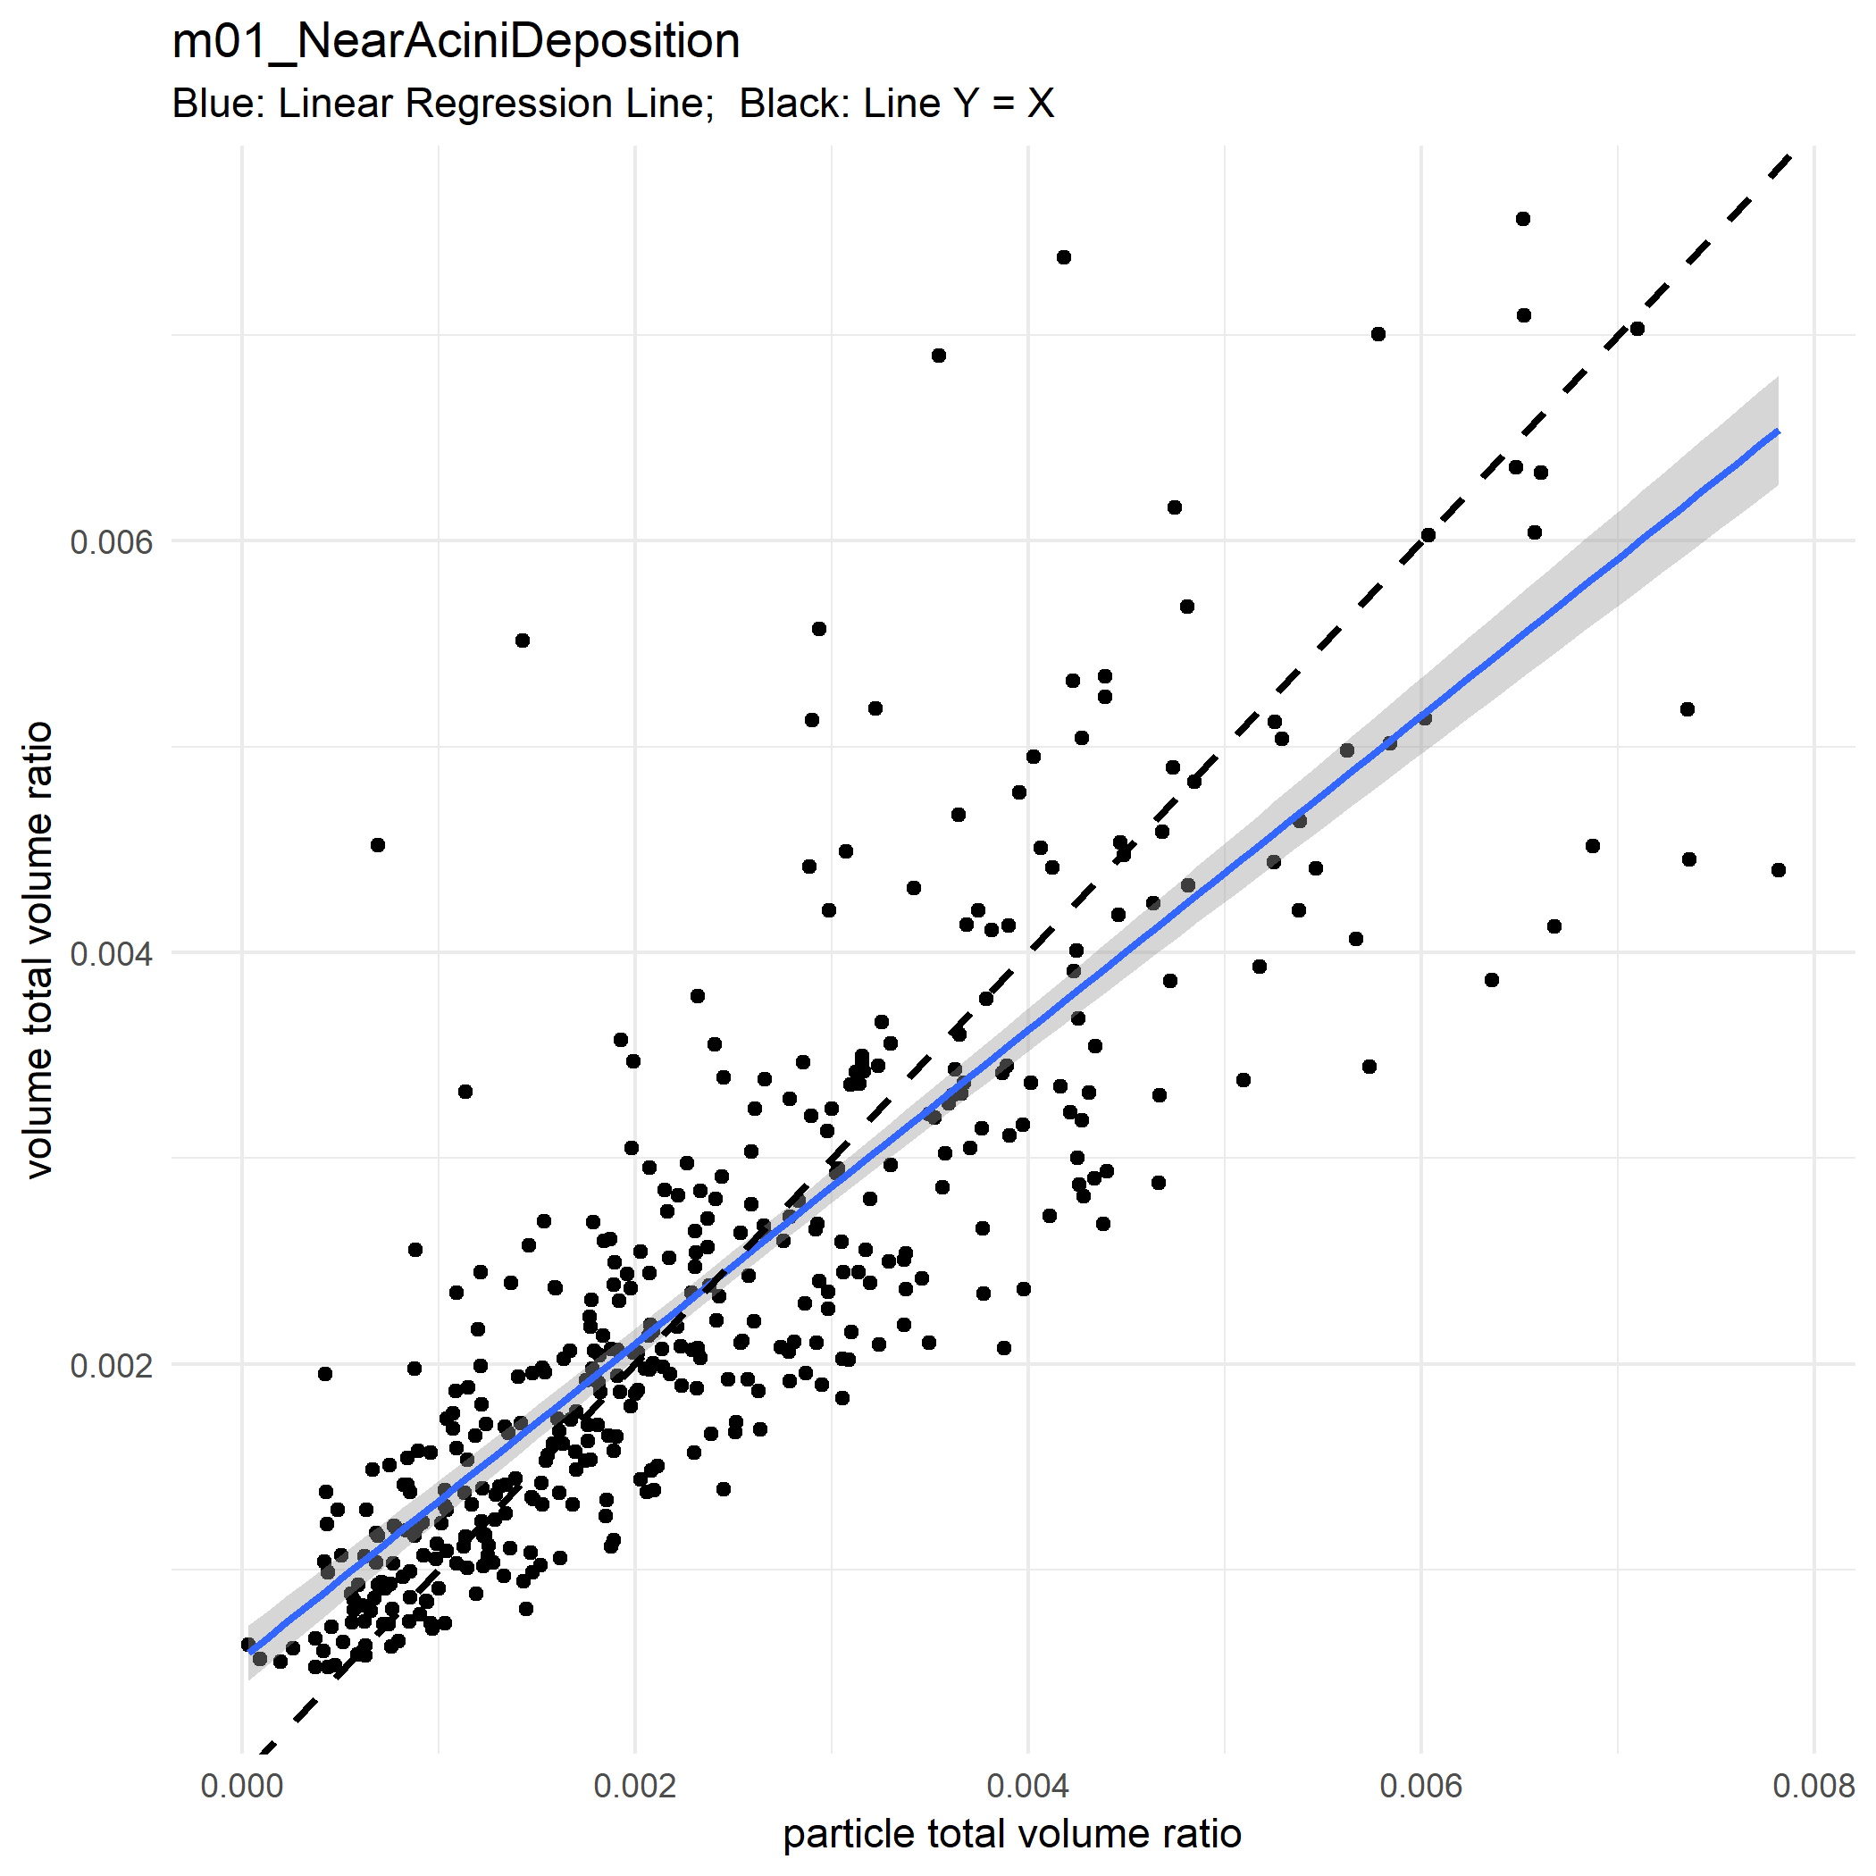
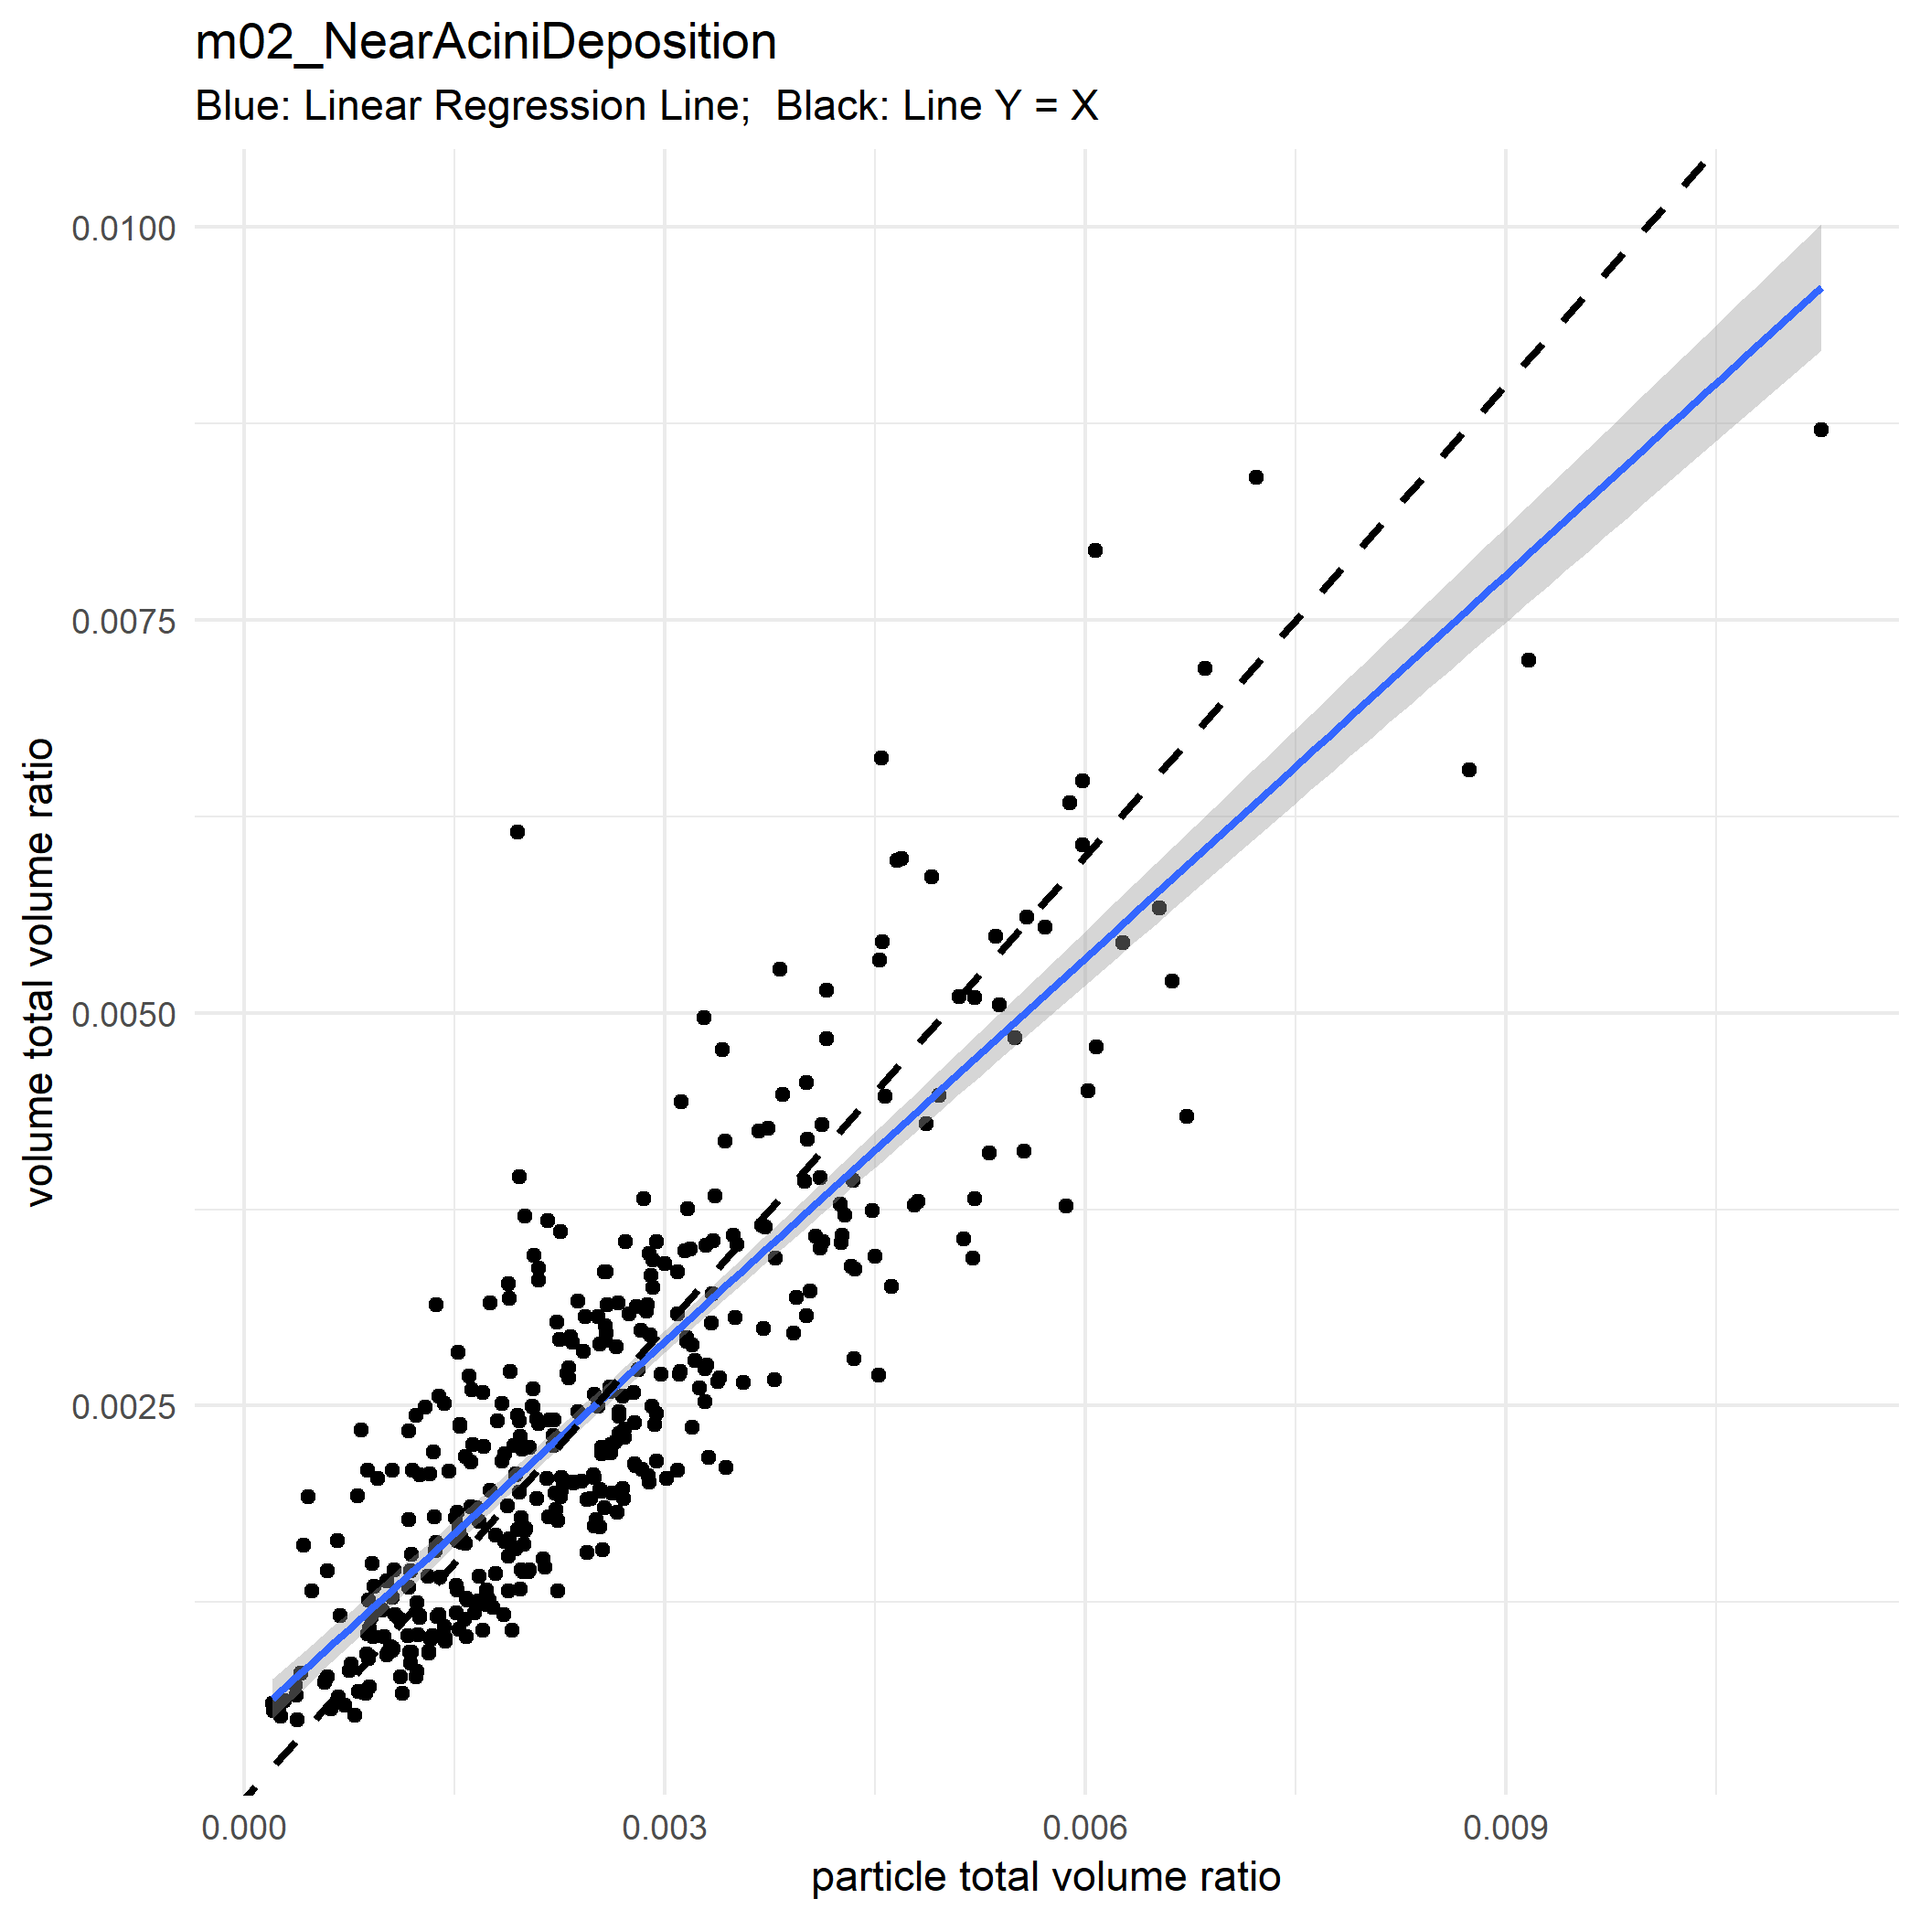
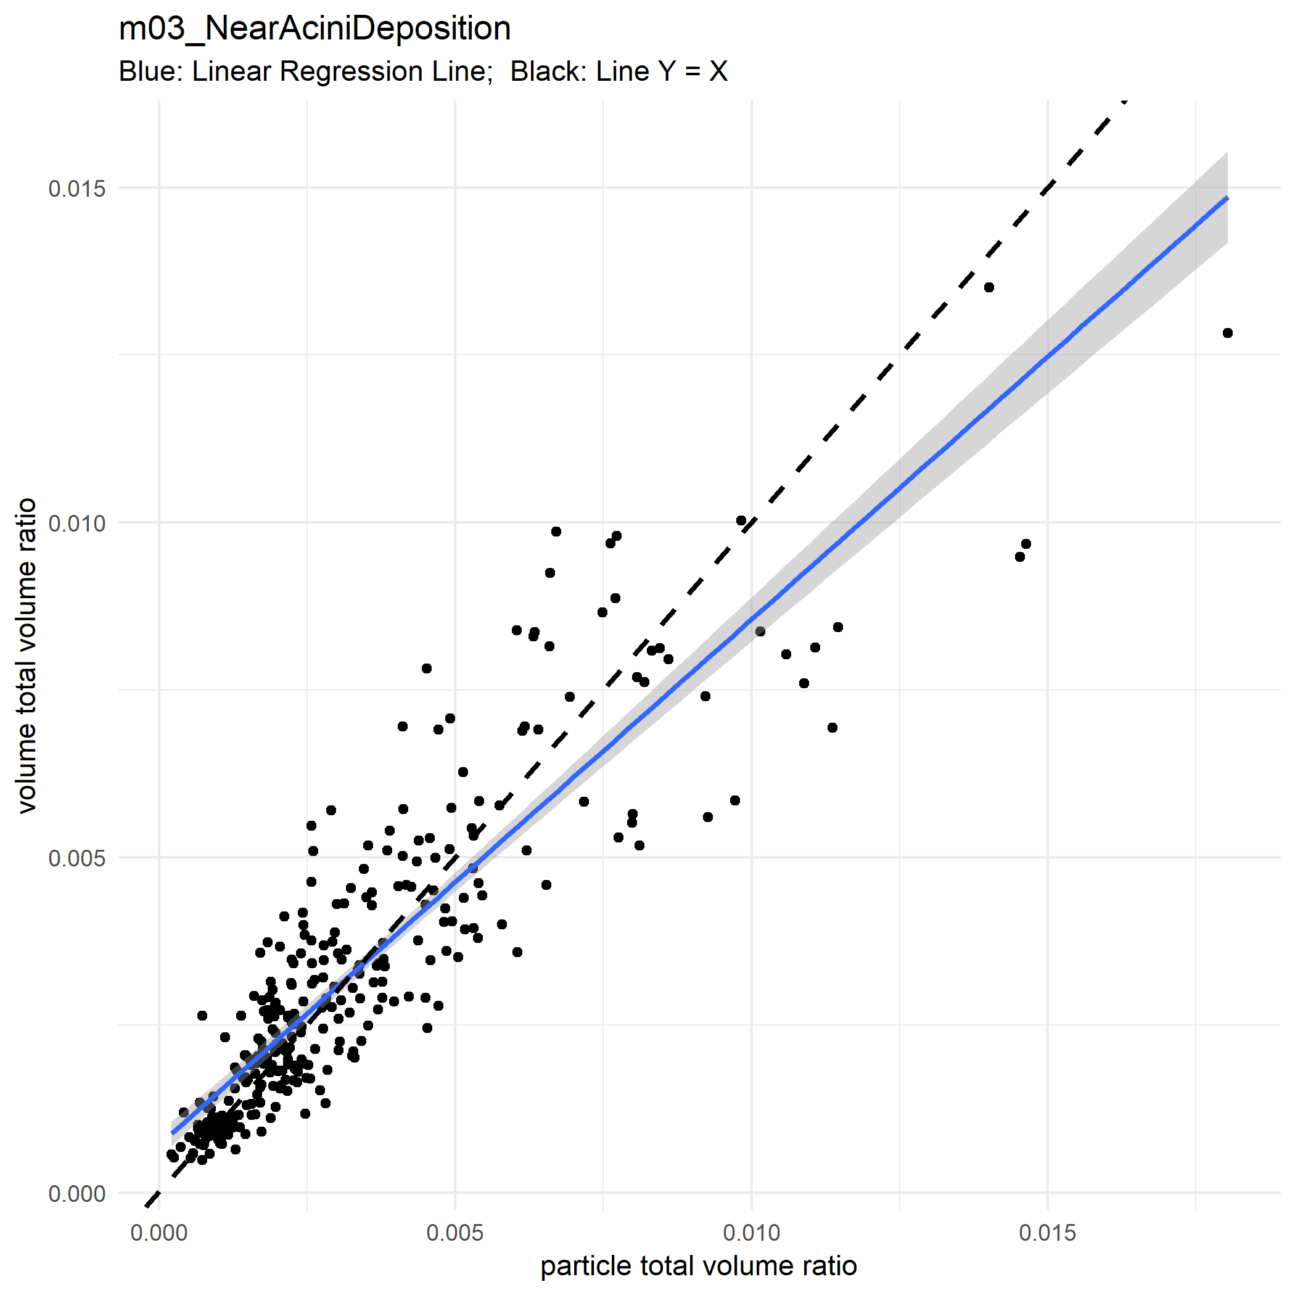
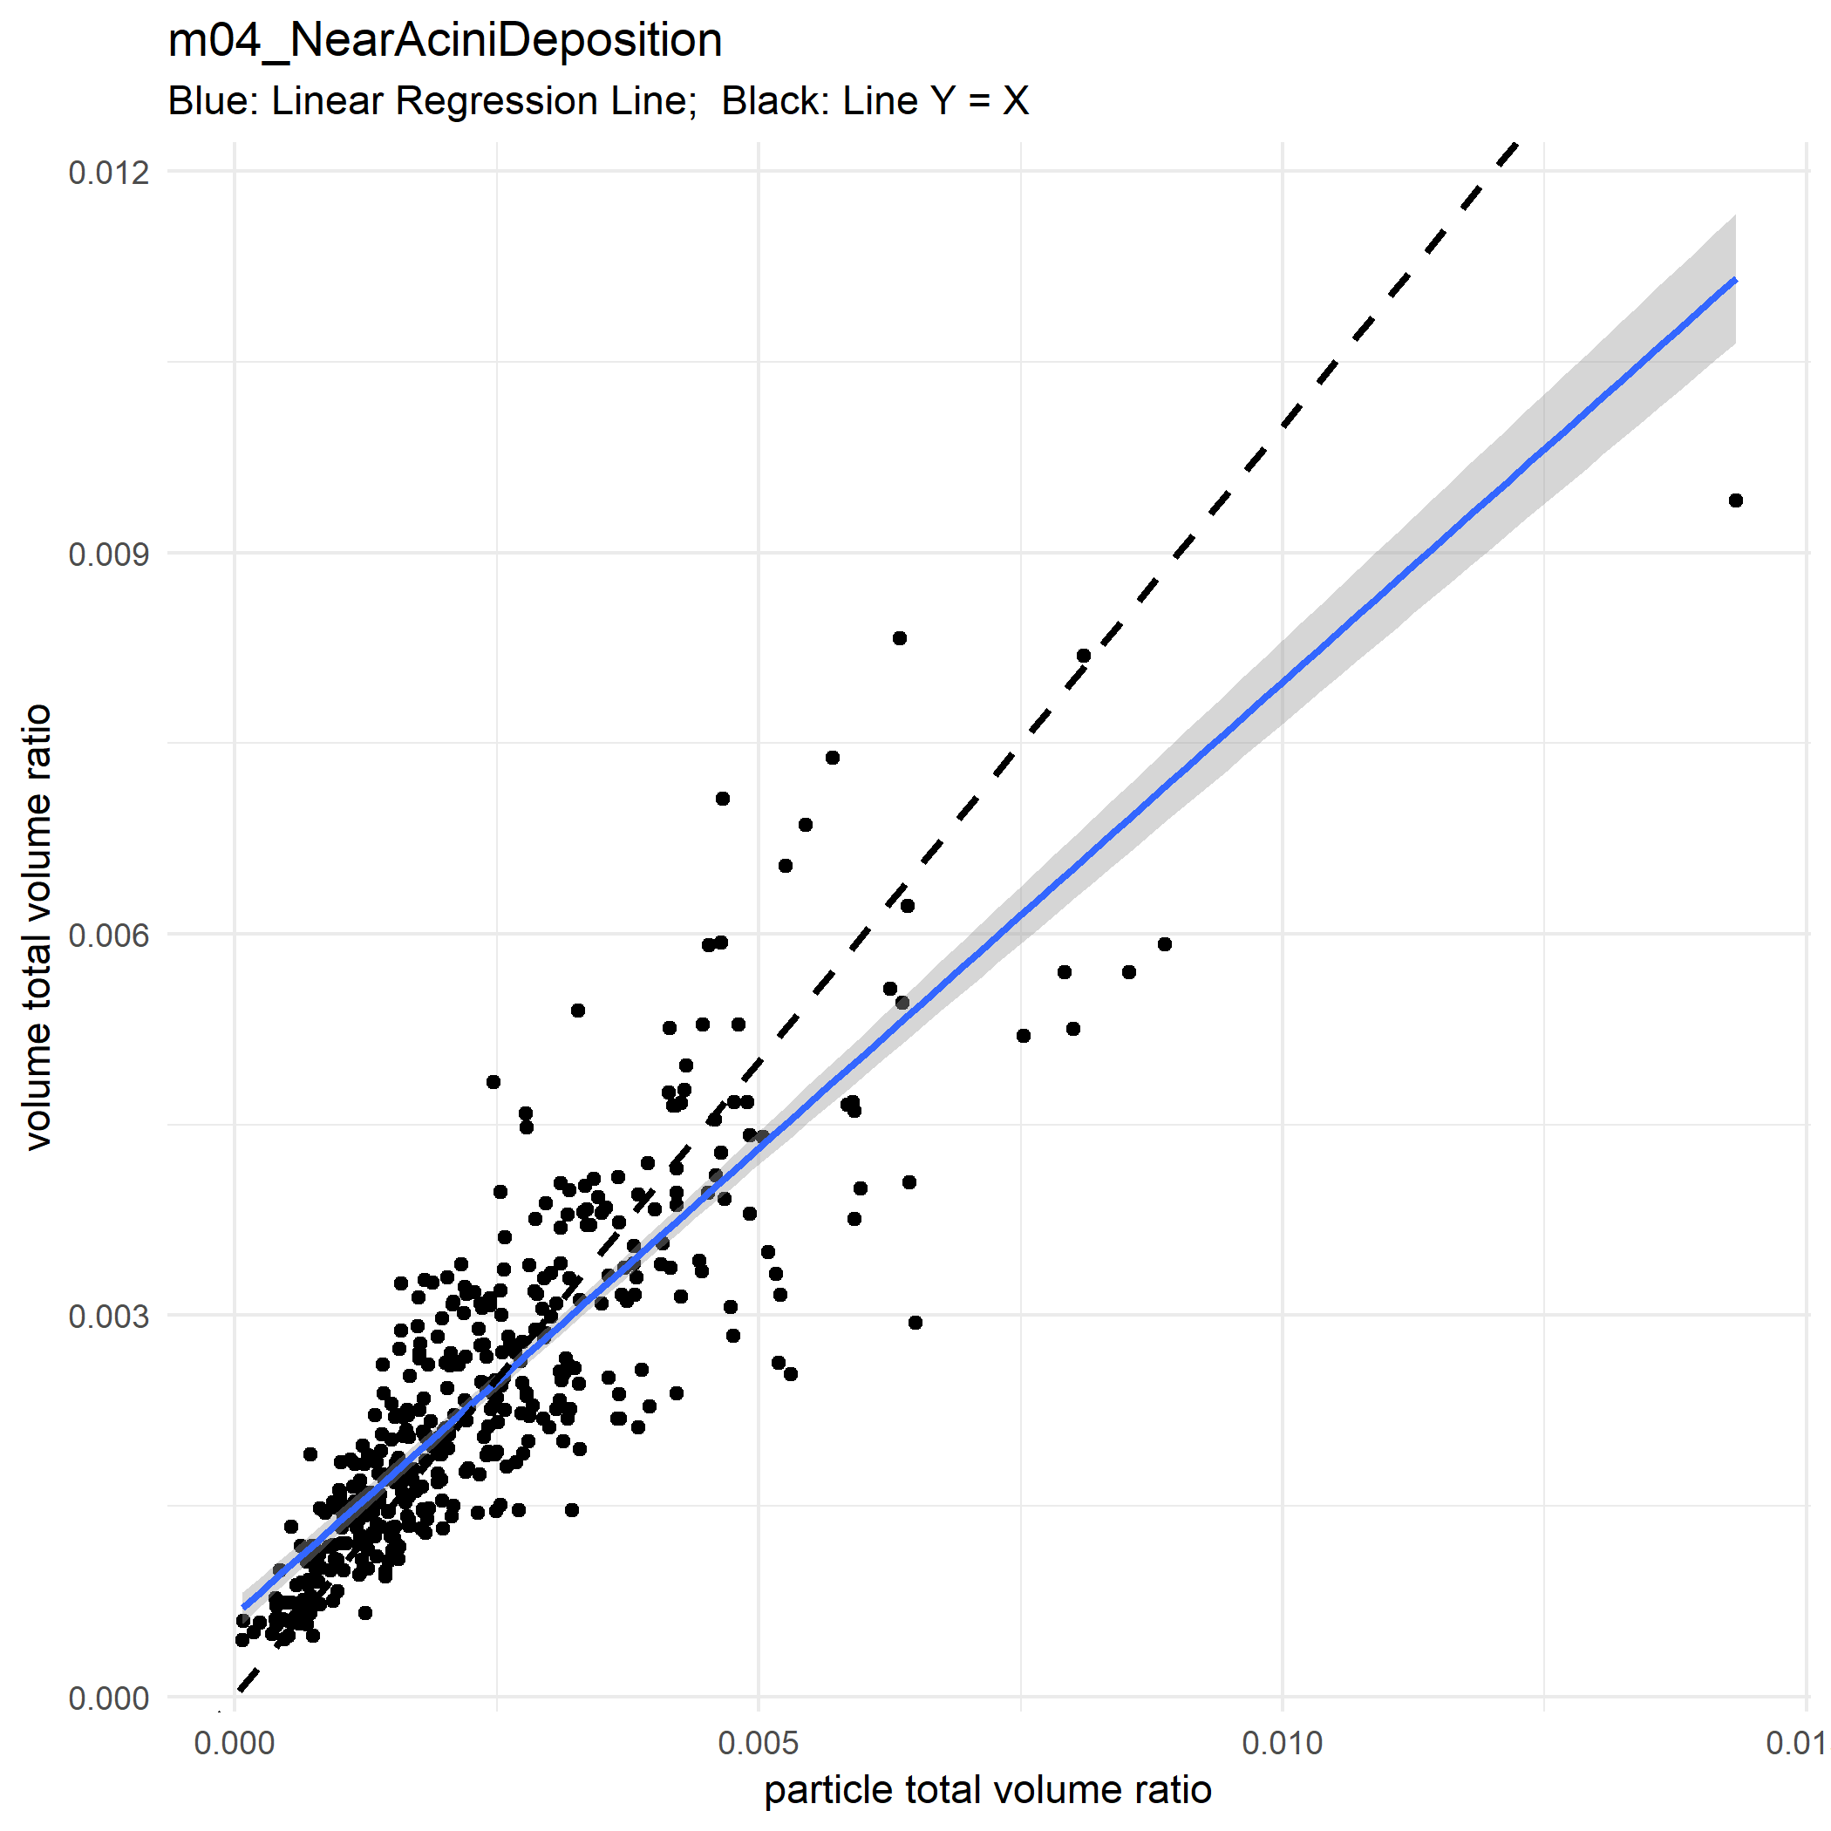
Ratio Plot

Slide 4
Lobe Level

Slide 5
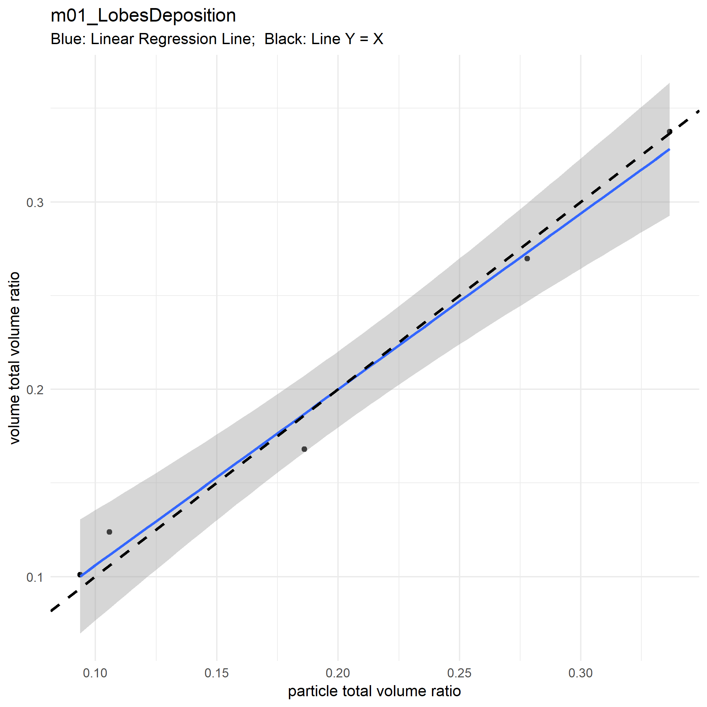

Slide 6
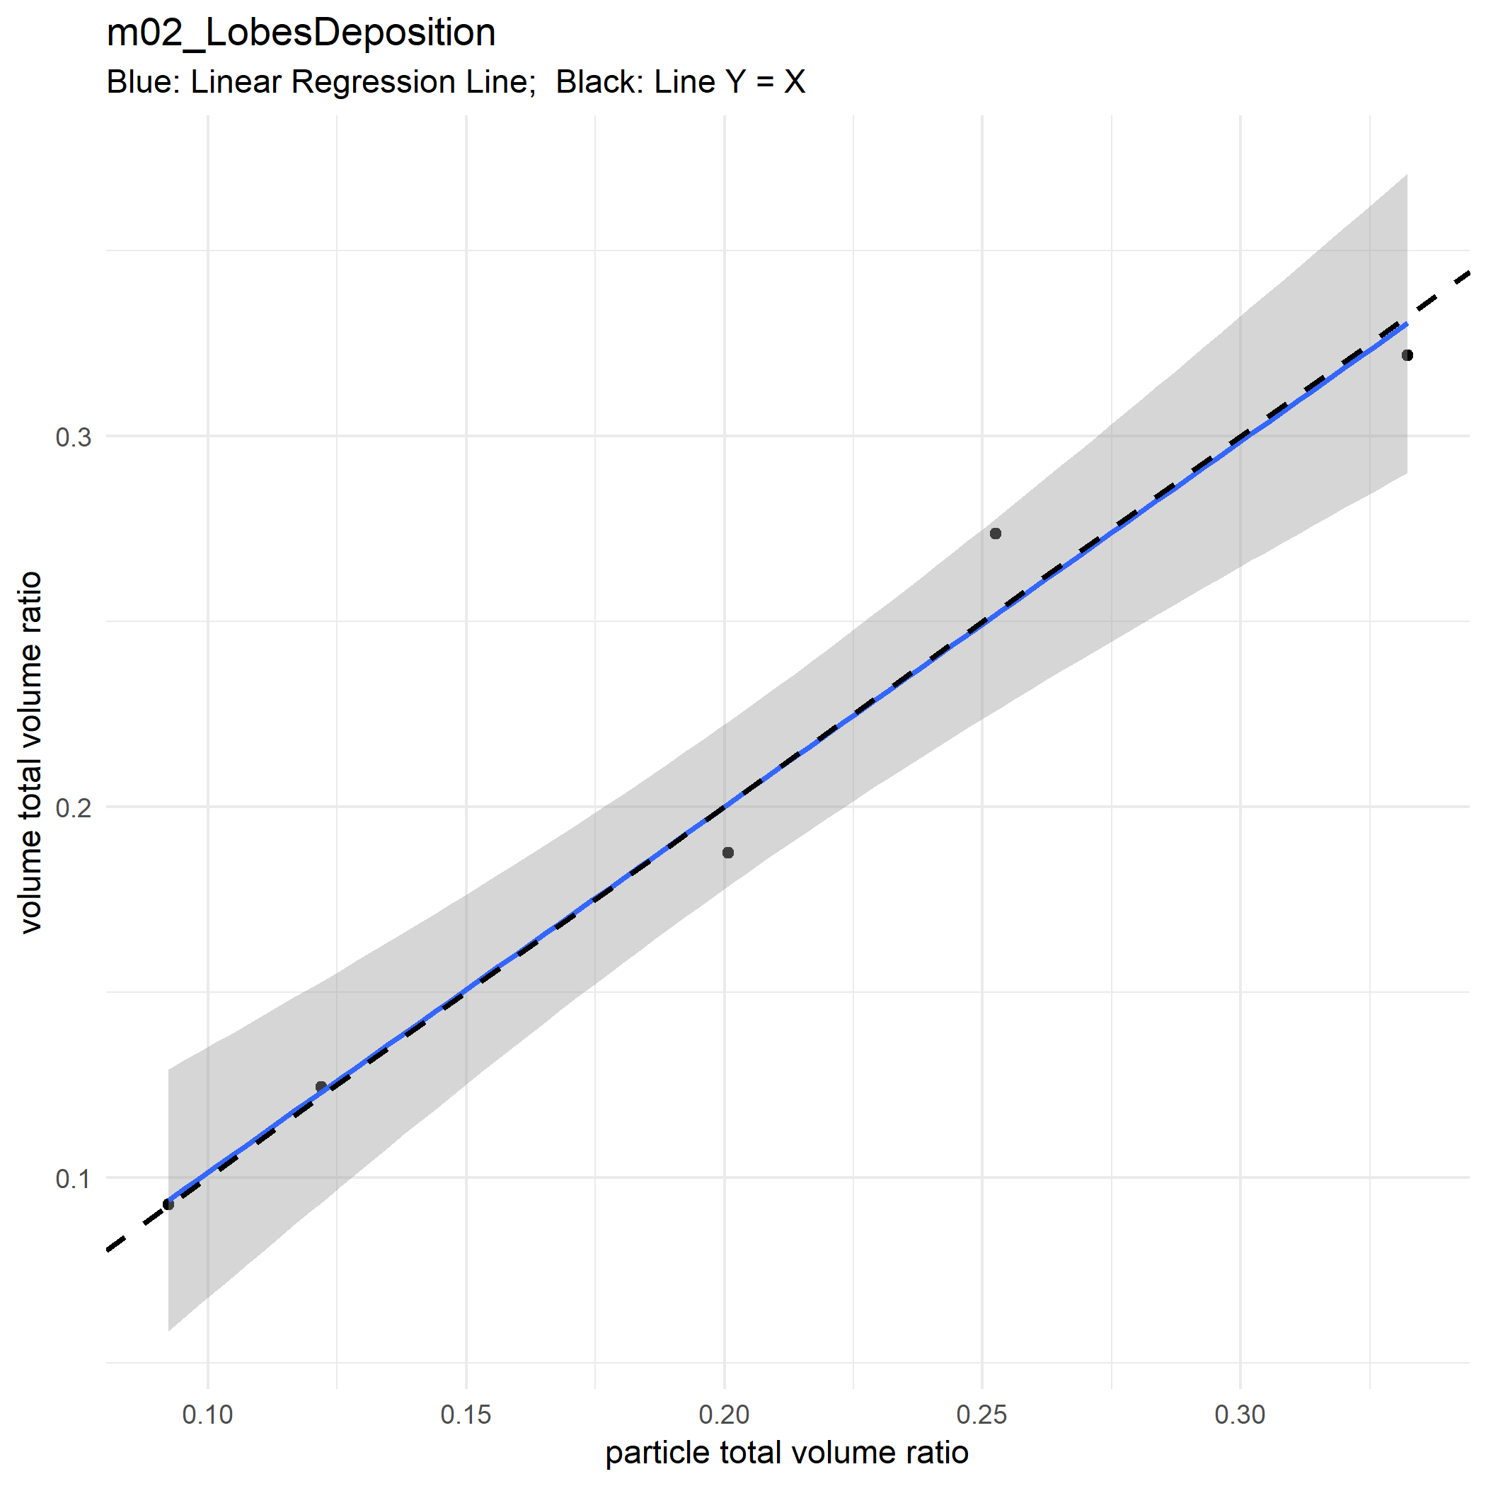

Slide 7
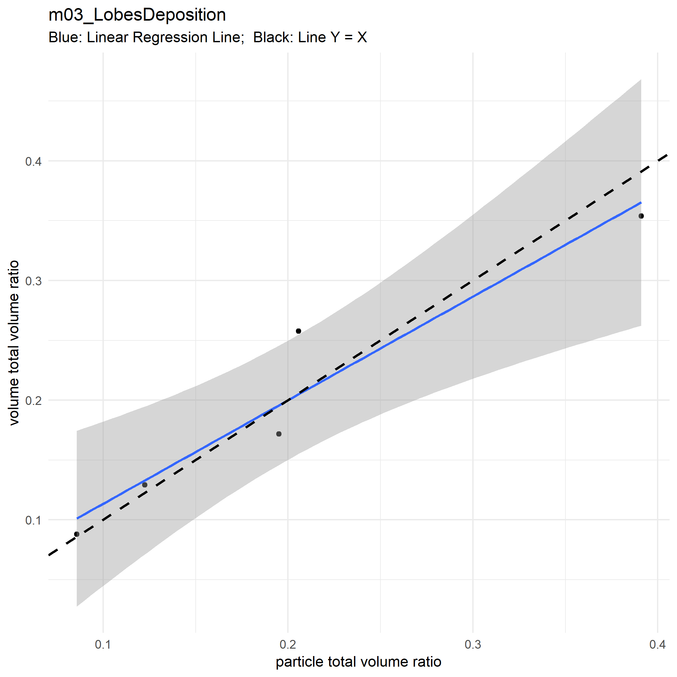

Slide 8
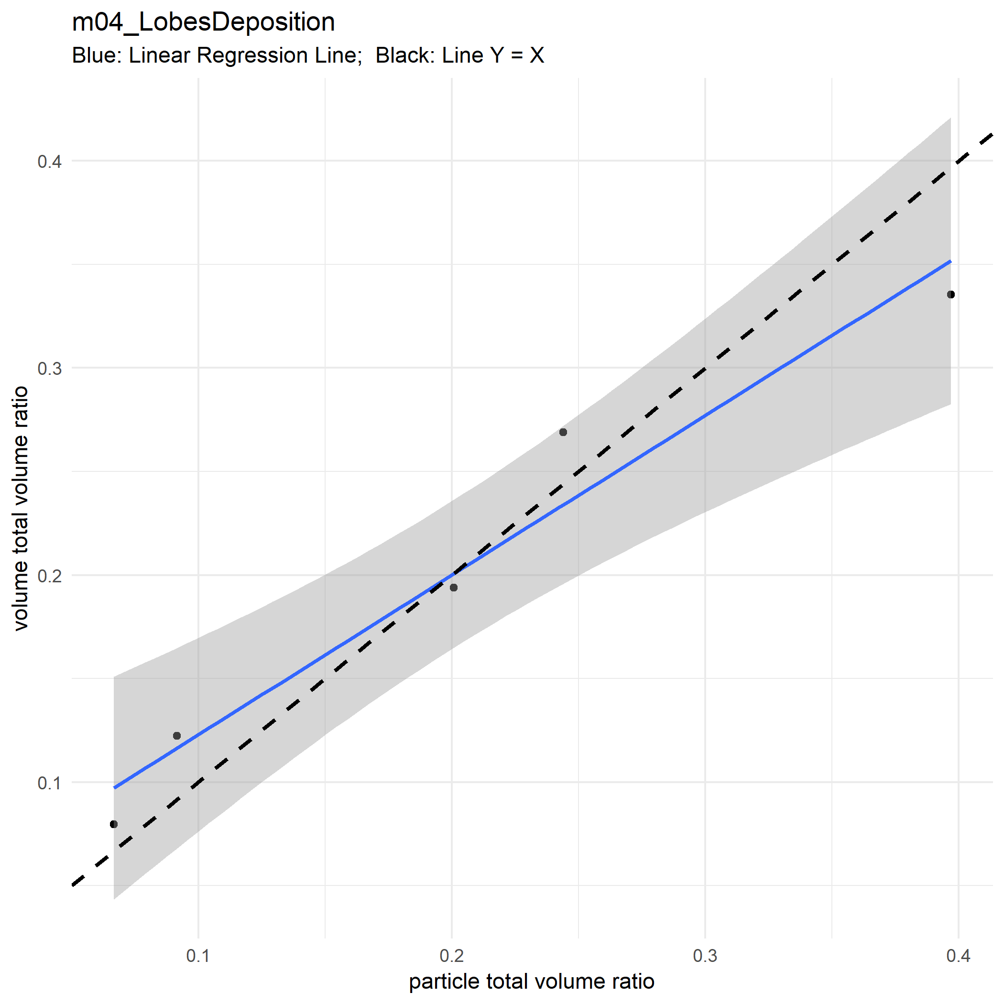

Slide 9
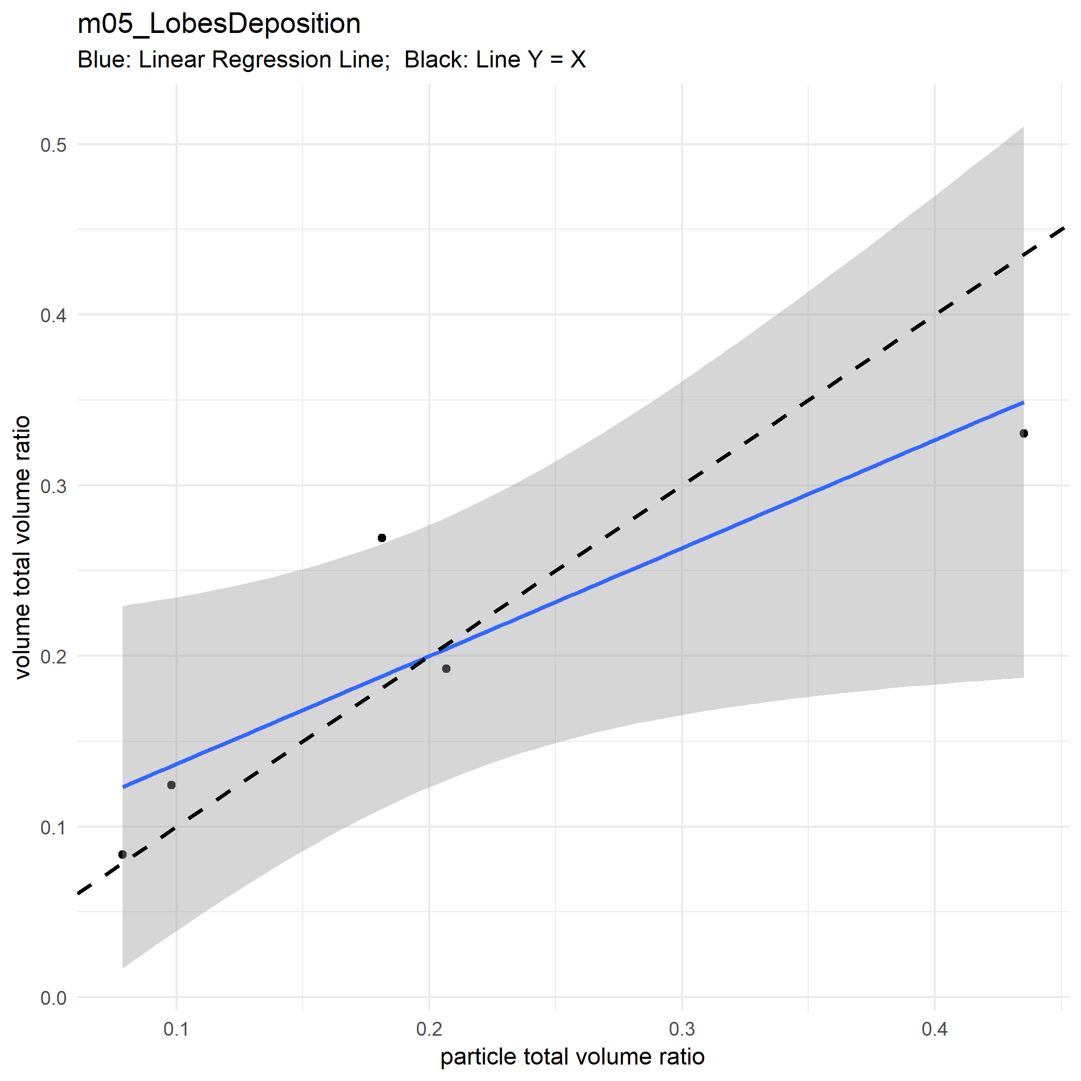

Slide 10
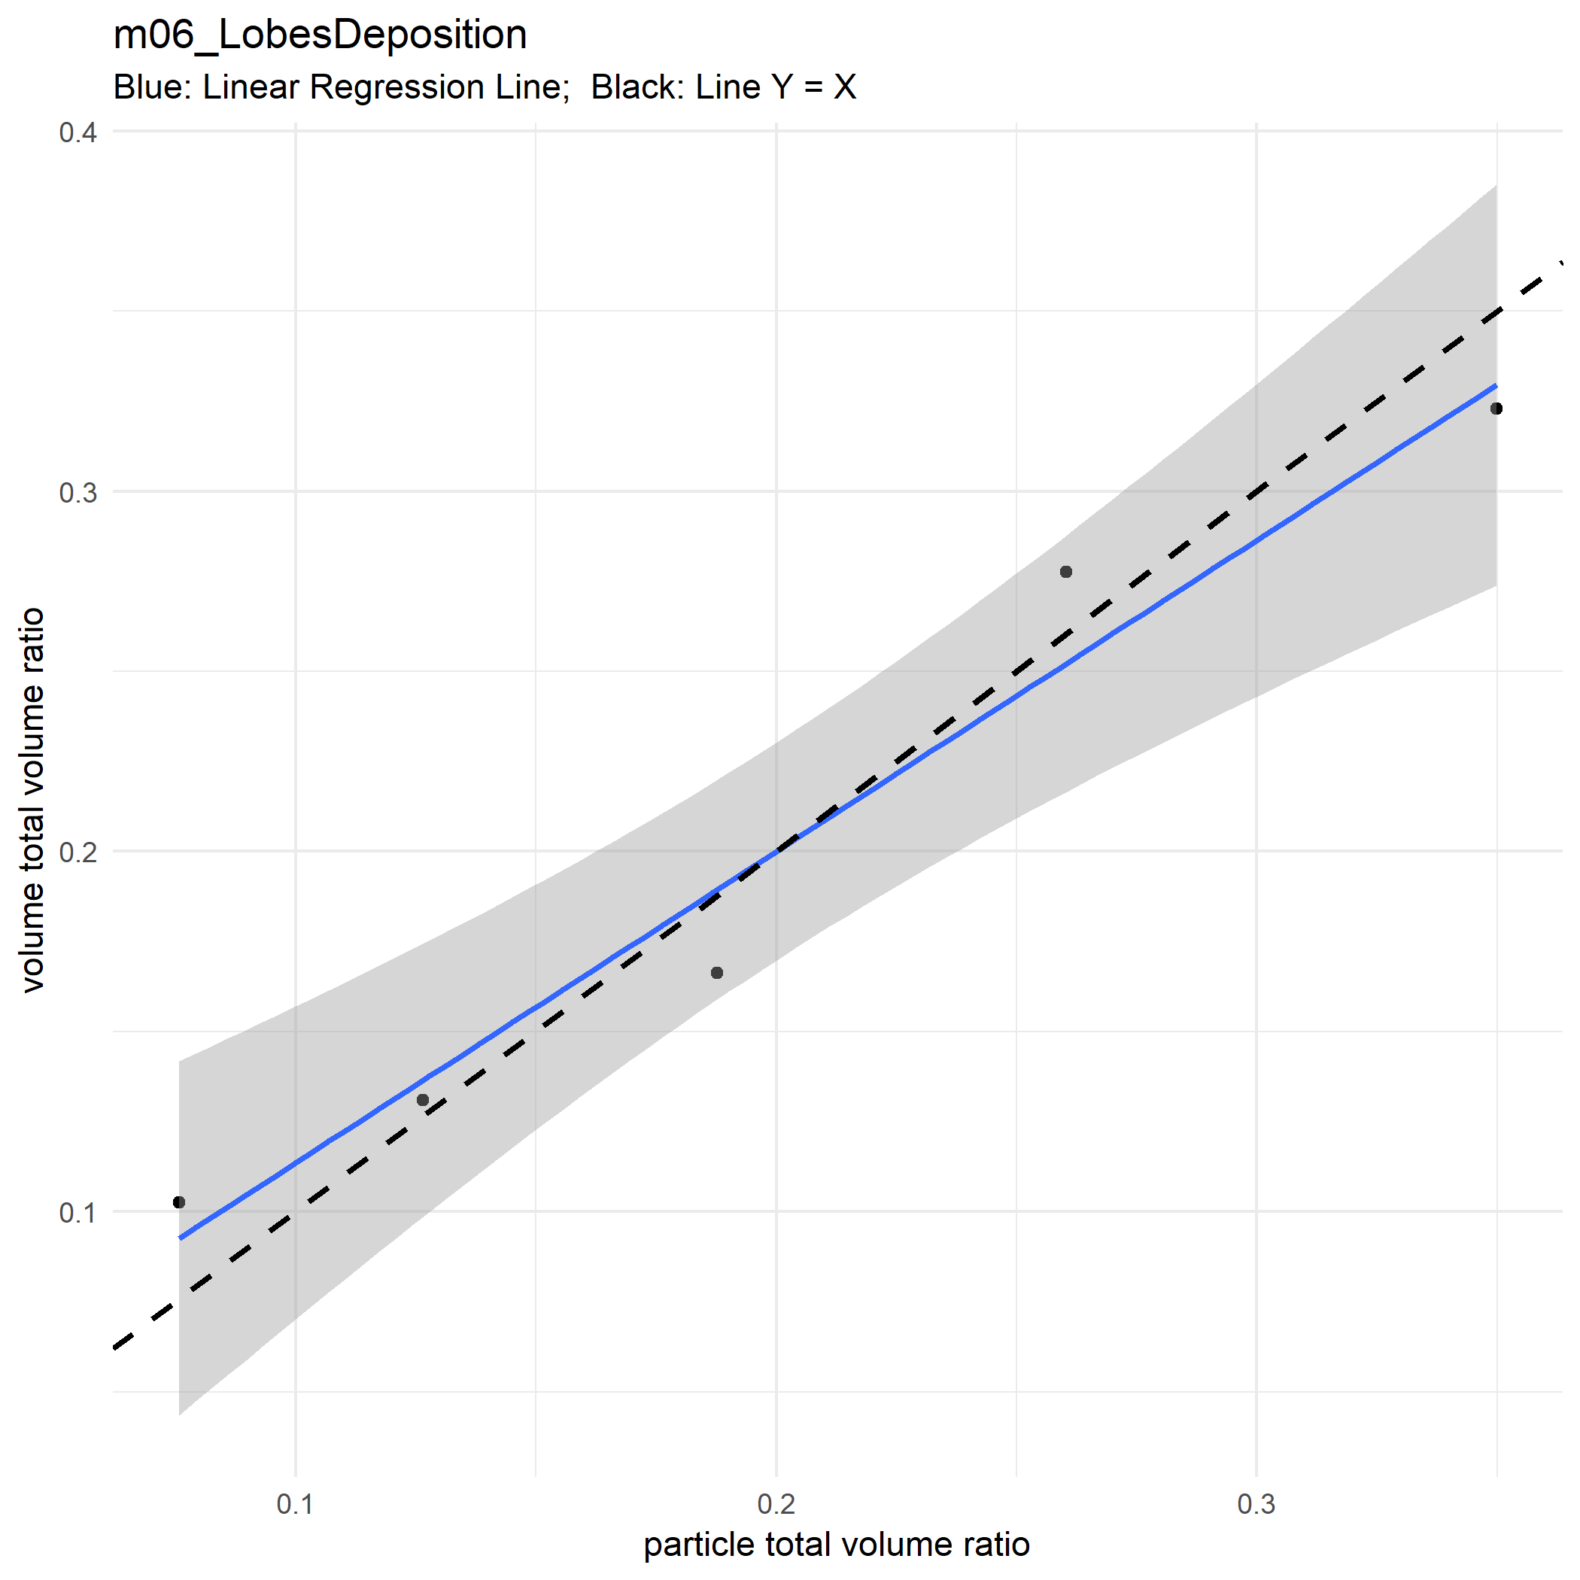

Slide 11
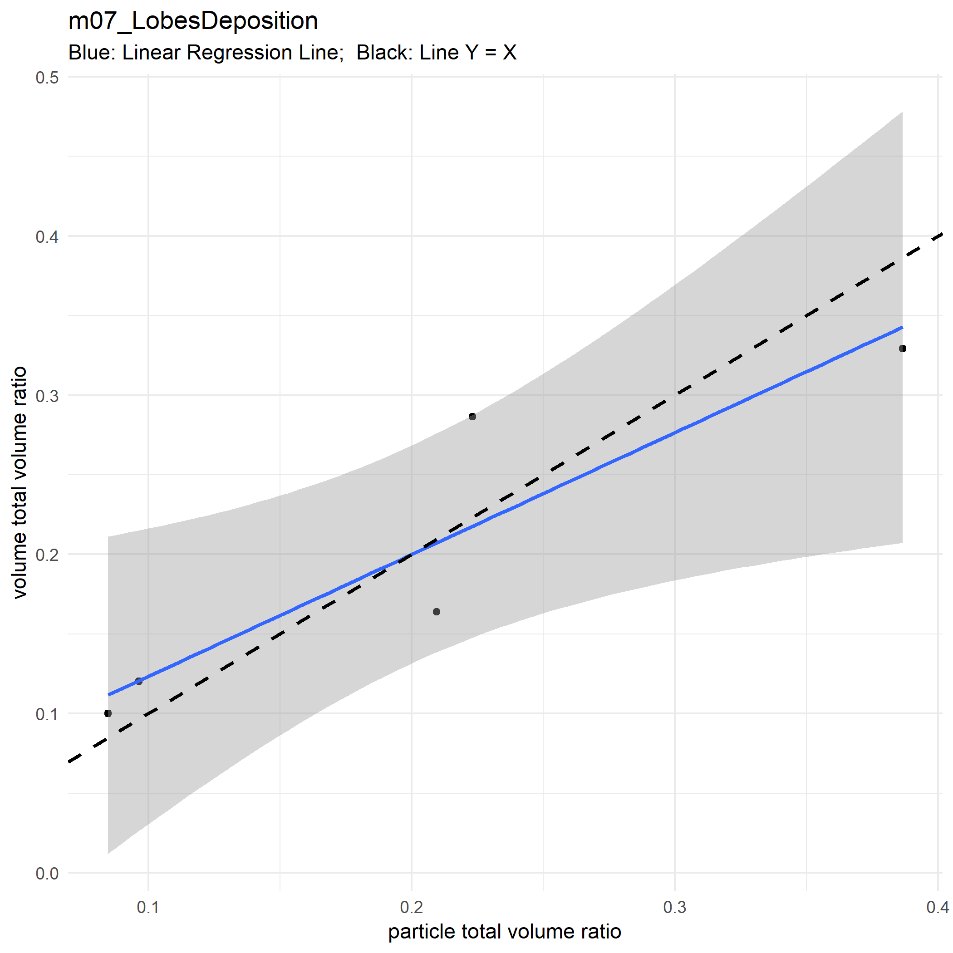

Slide 12
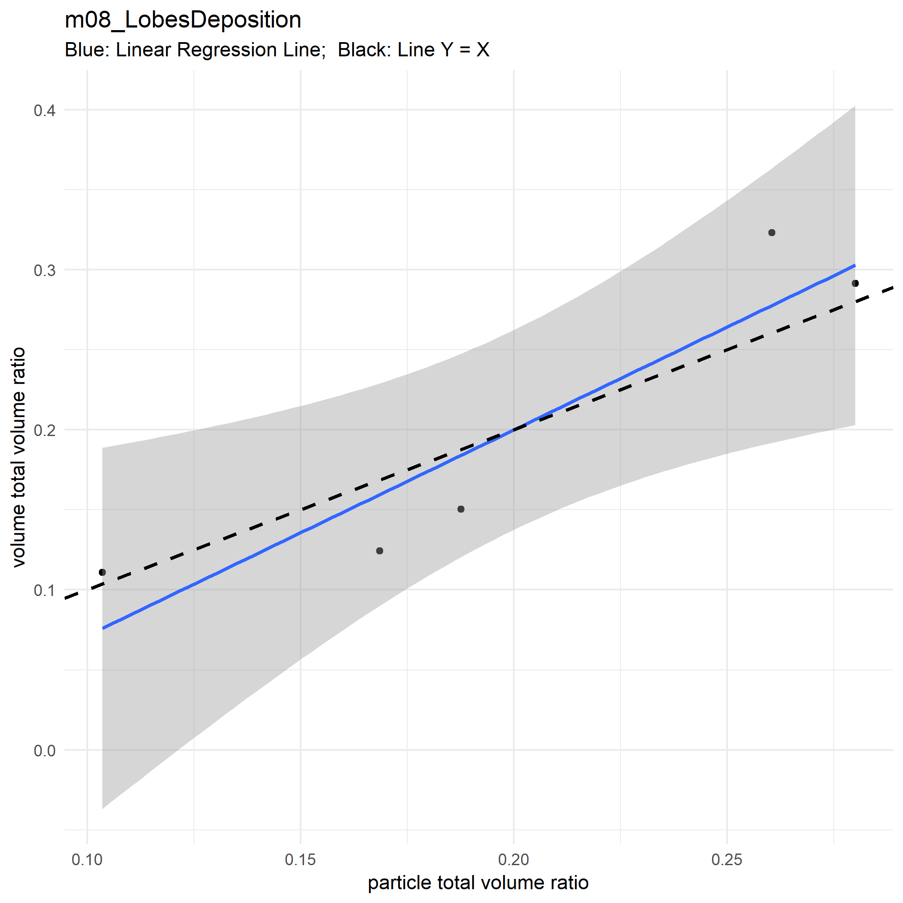

Slide 13
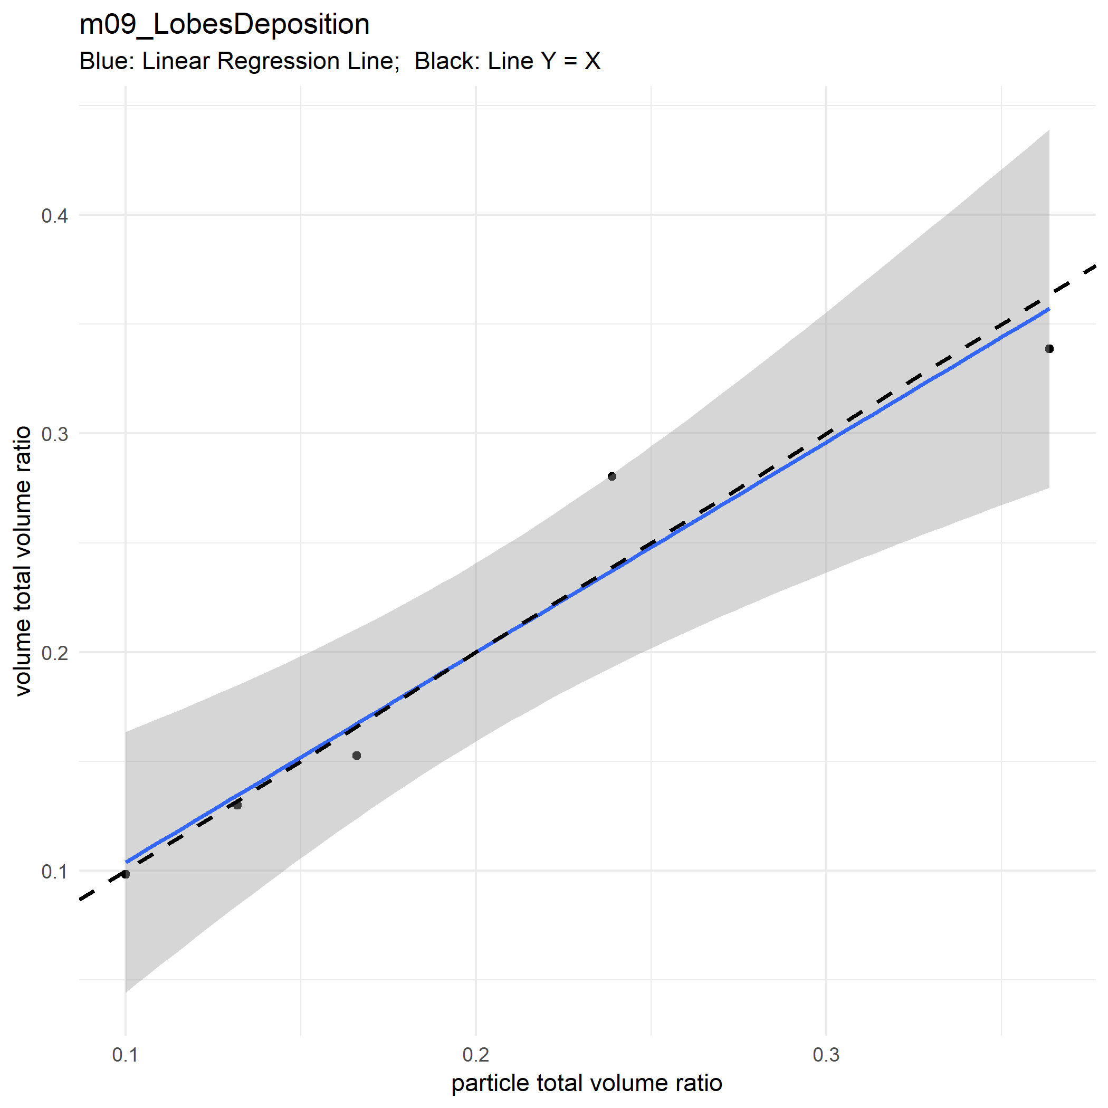

Slide 14
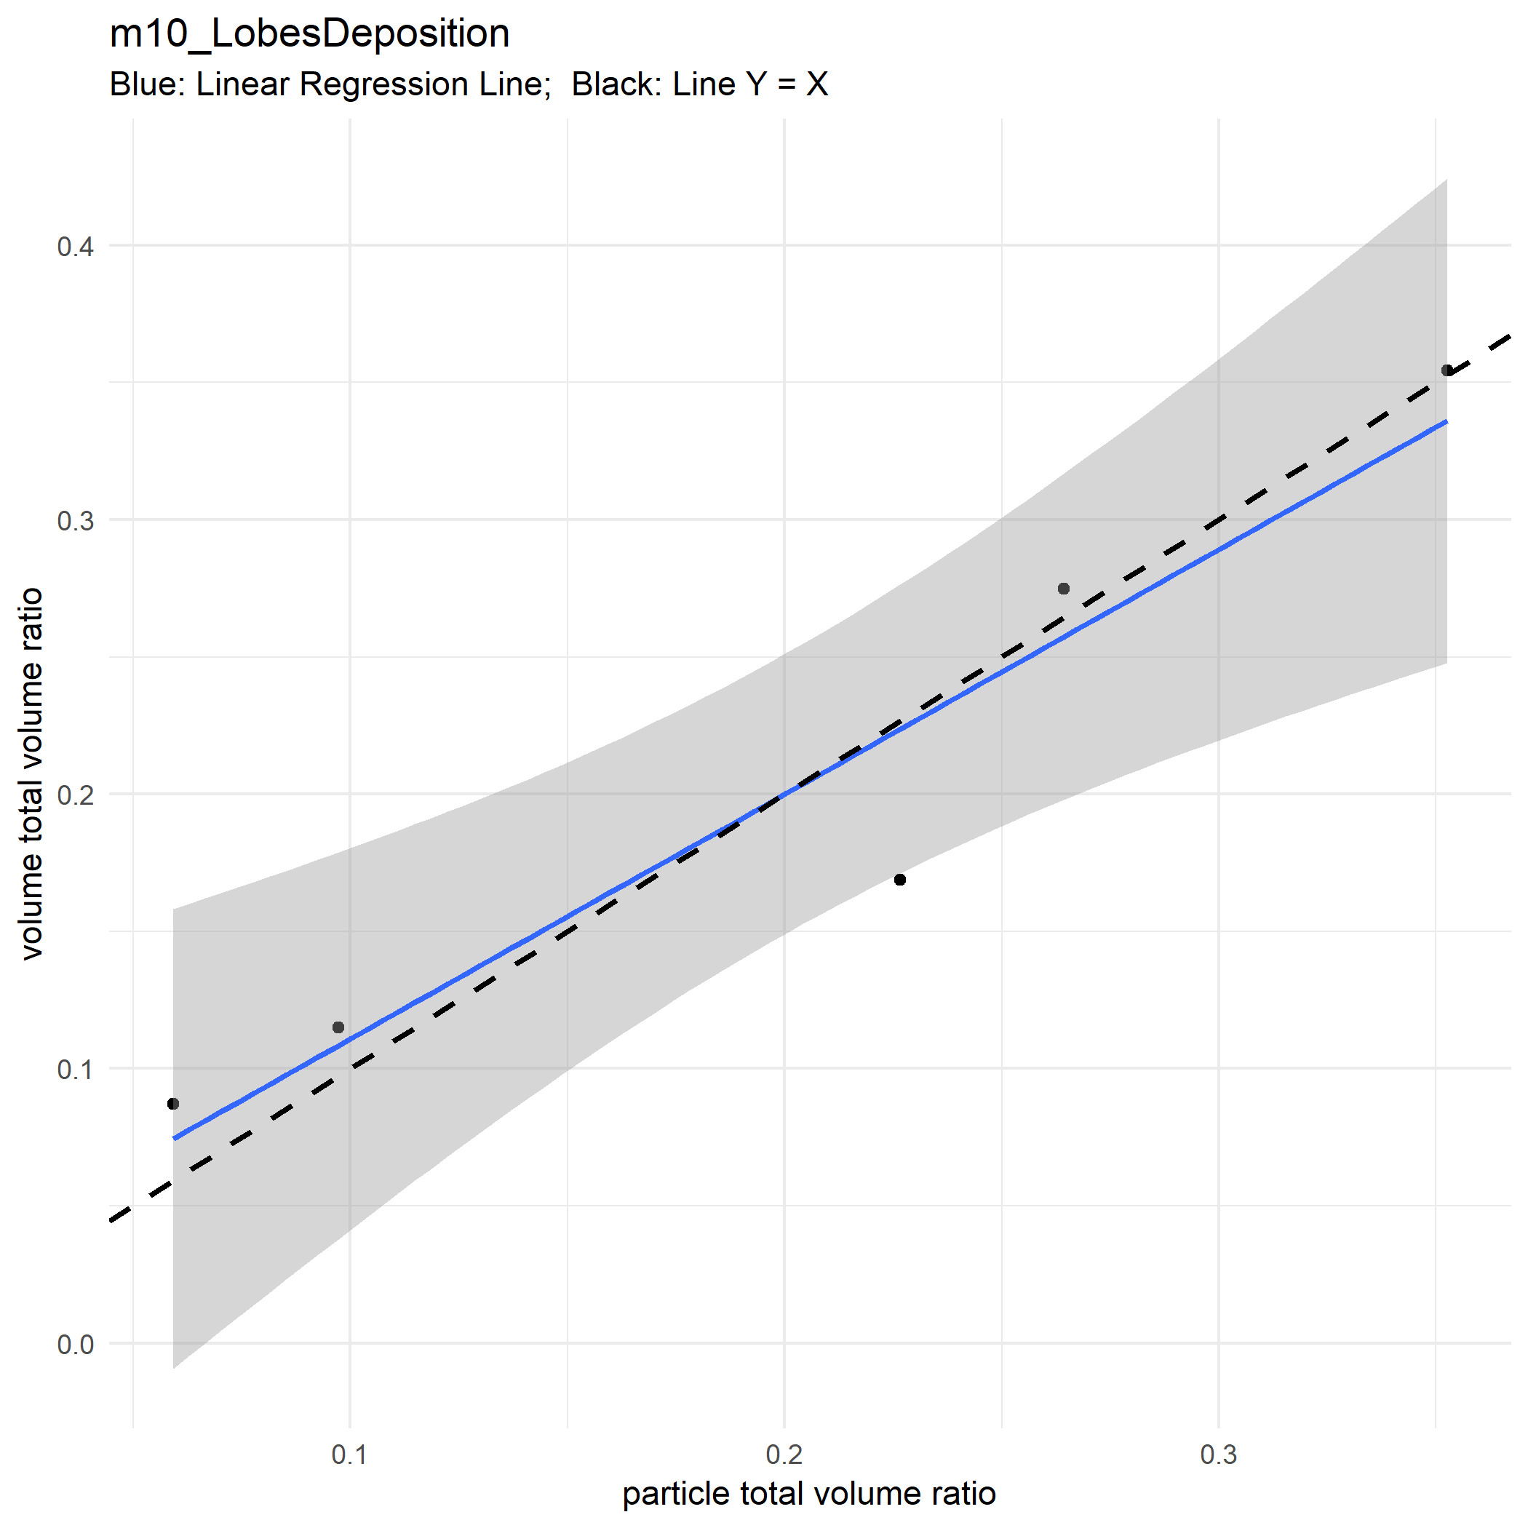

Slide 15
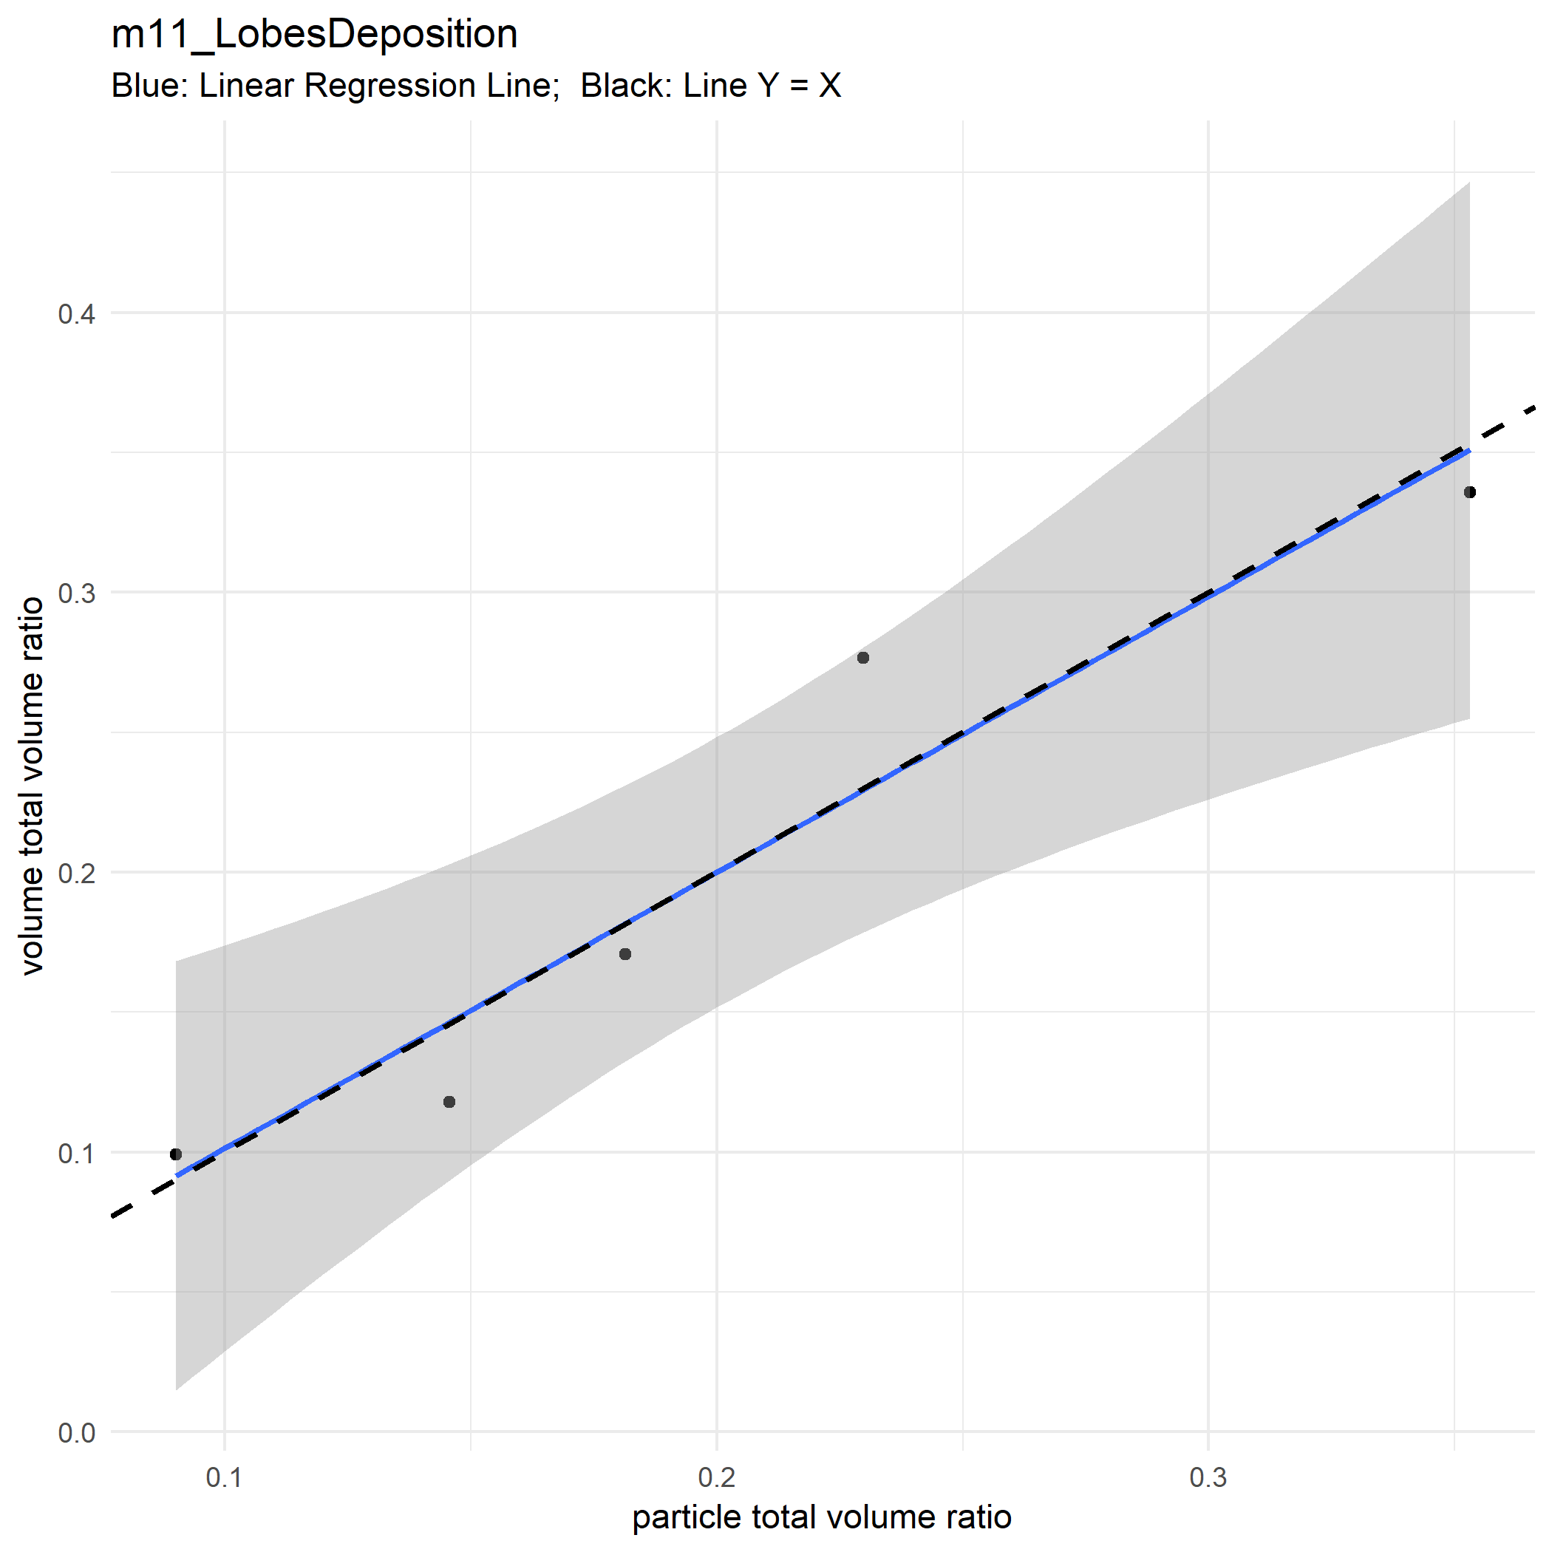

Slide 16
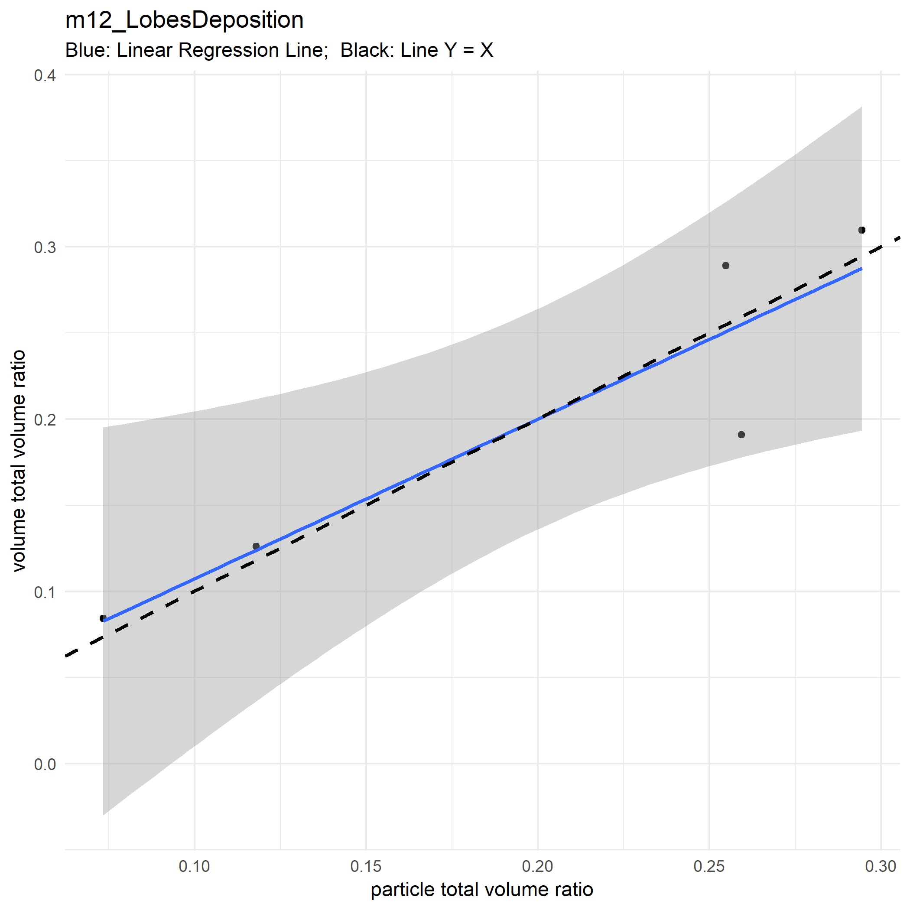

Slide 17
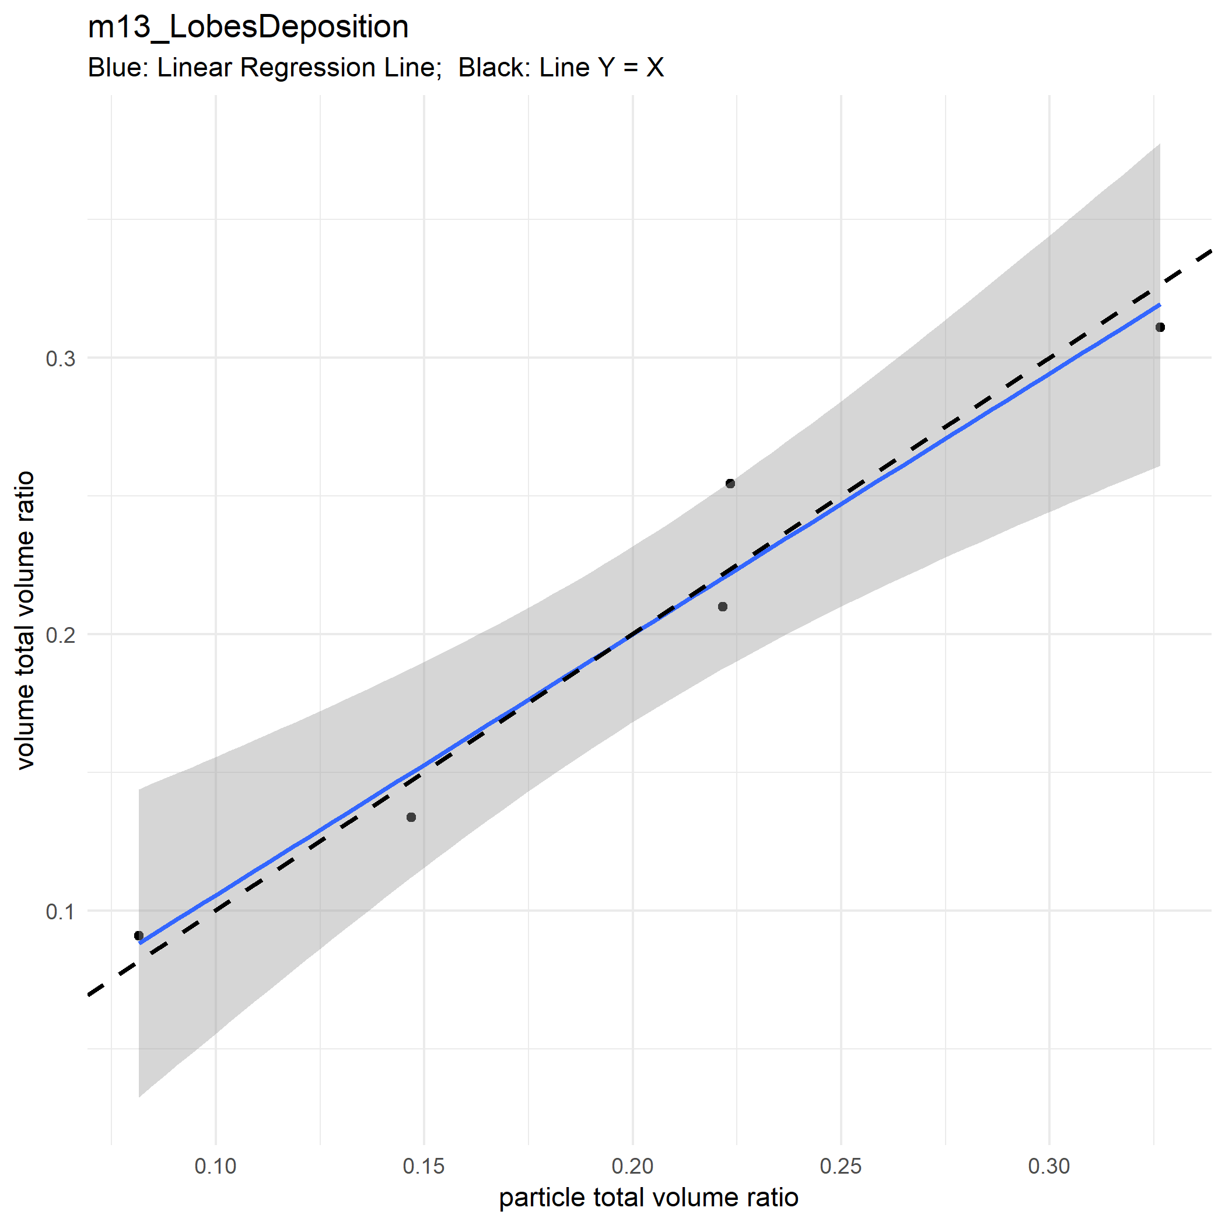

Slide 18
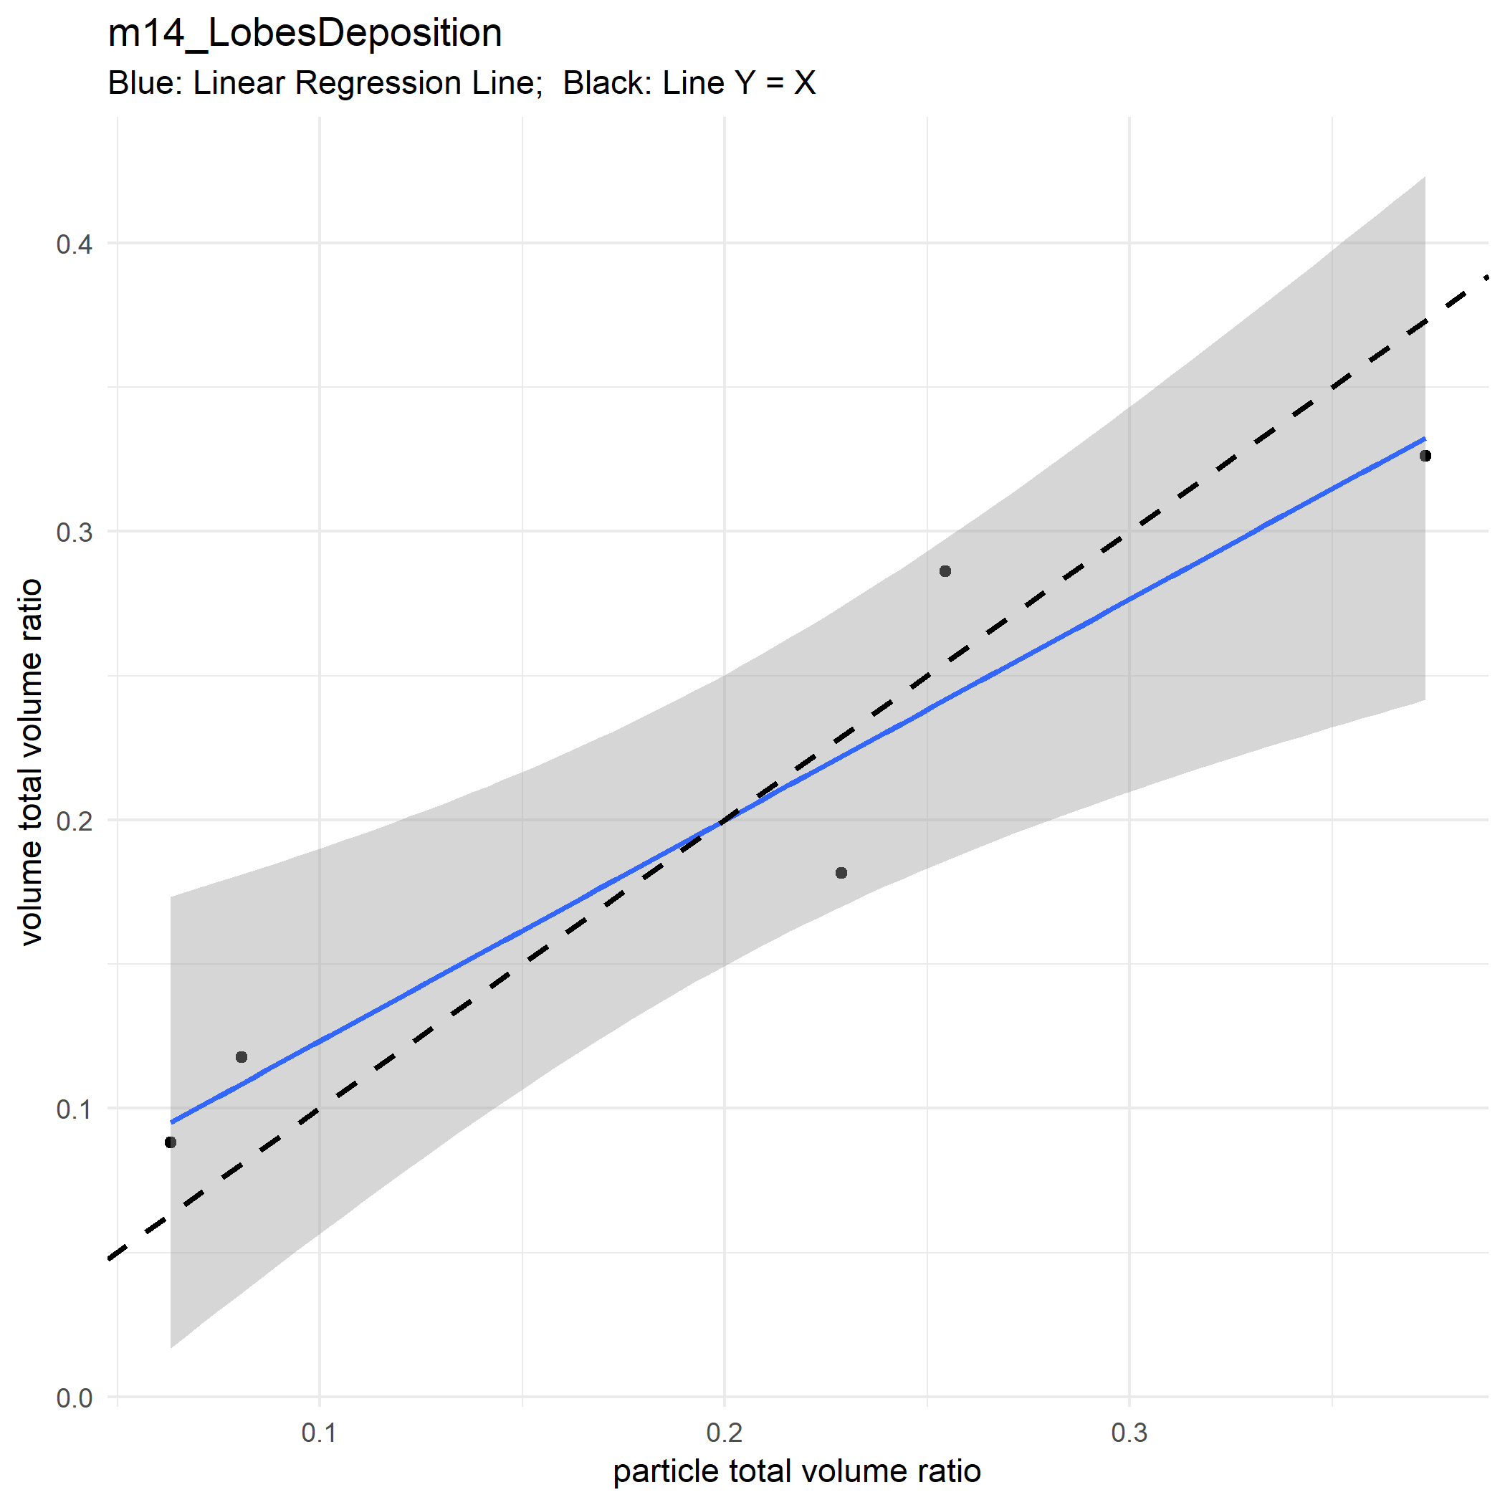

Slide 19
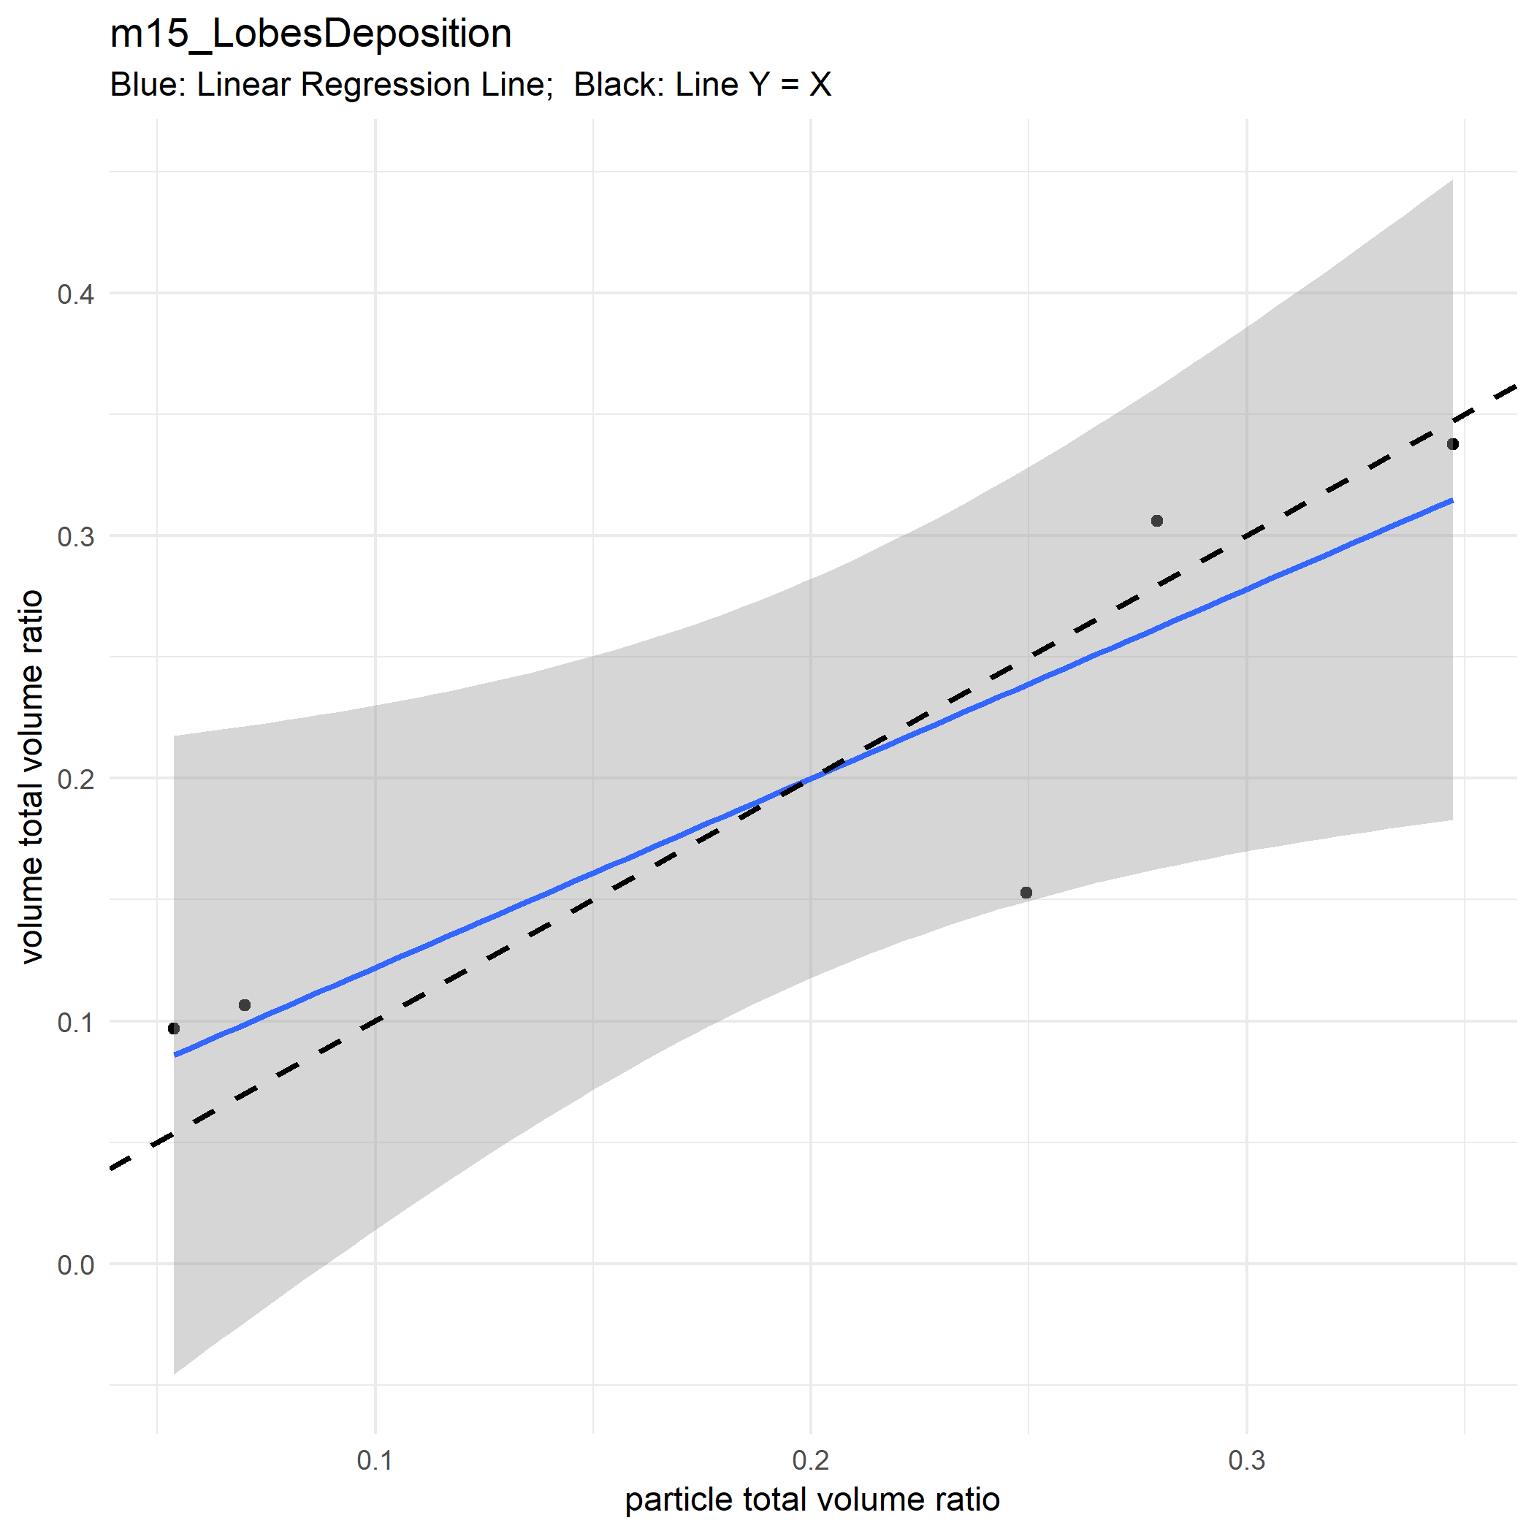

Slide 20
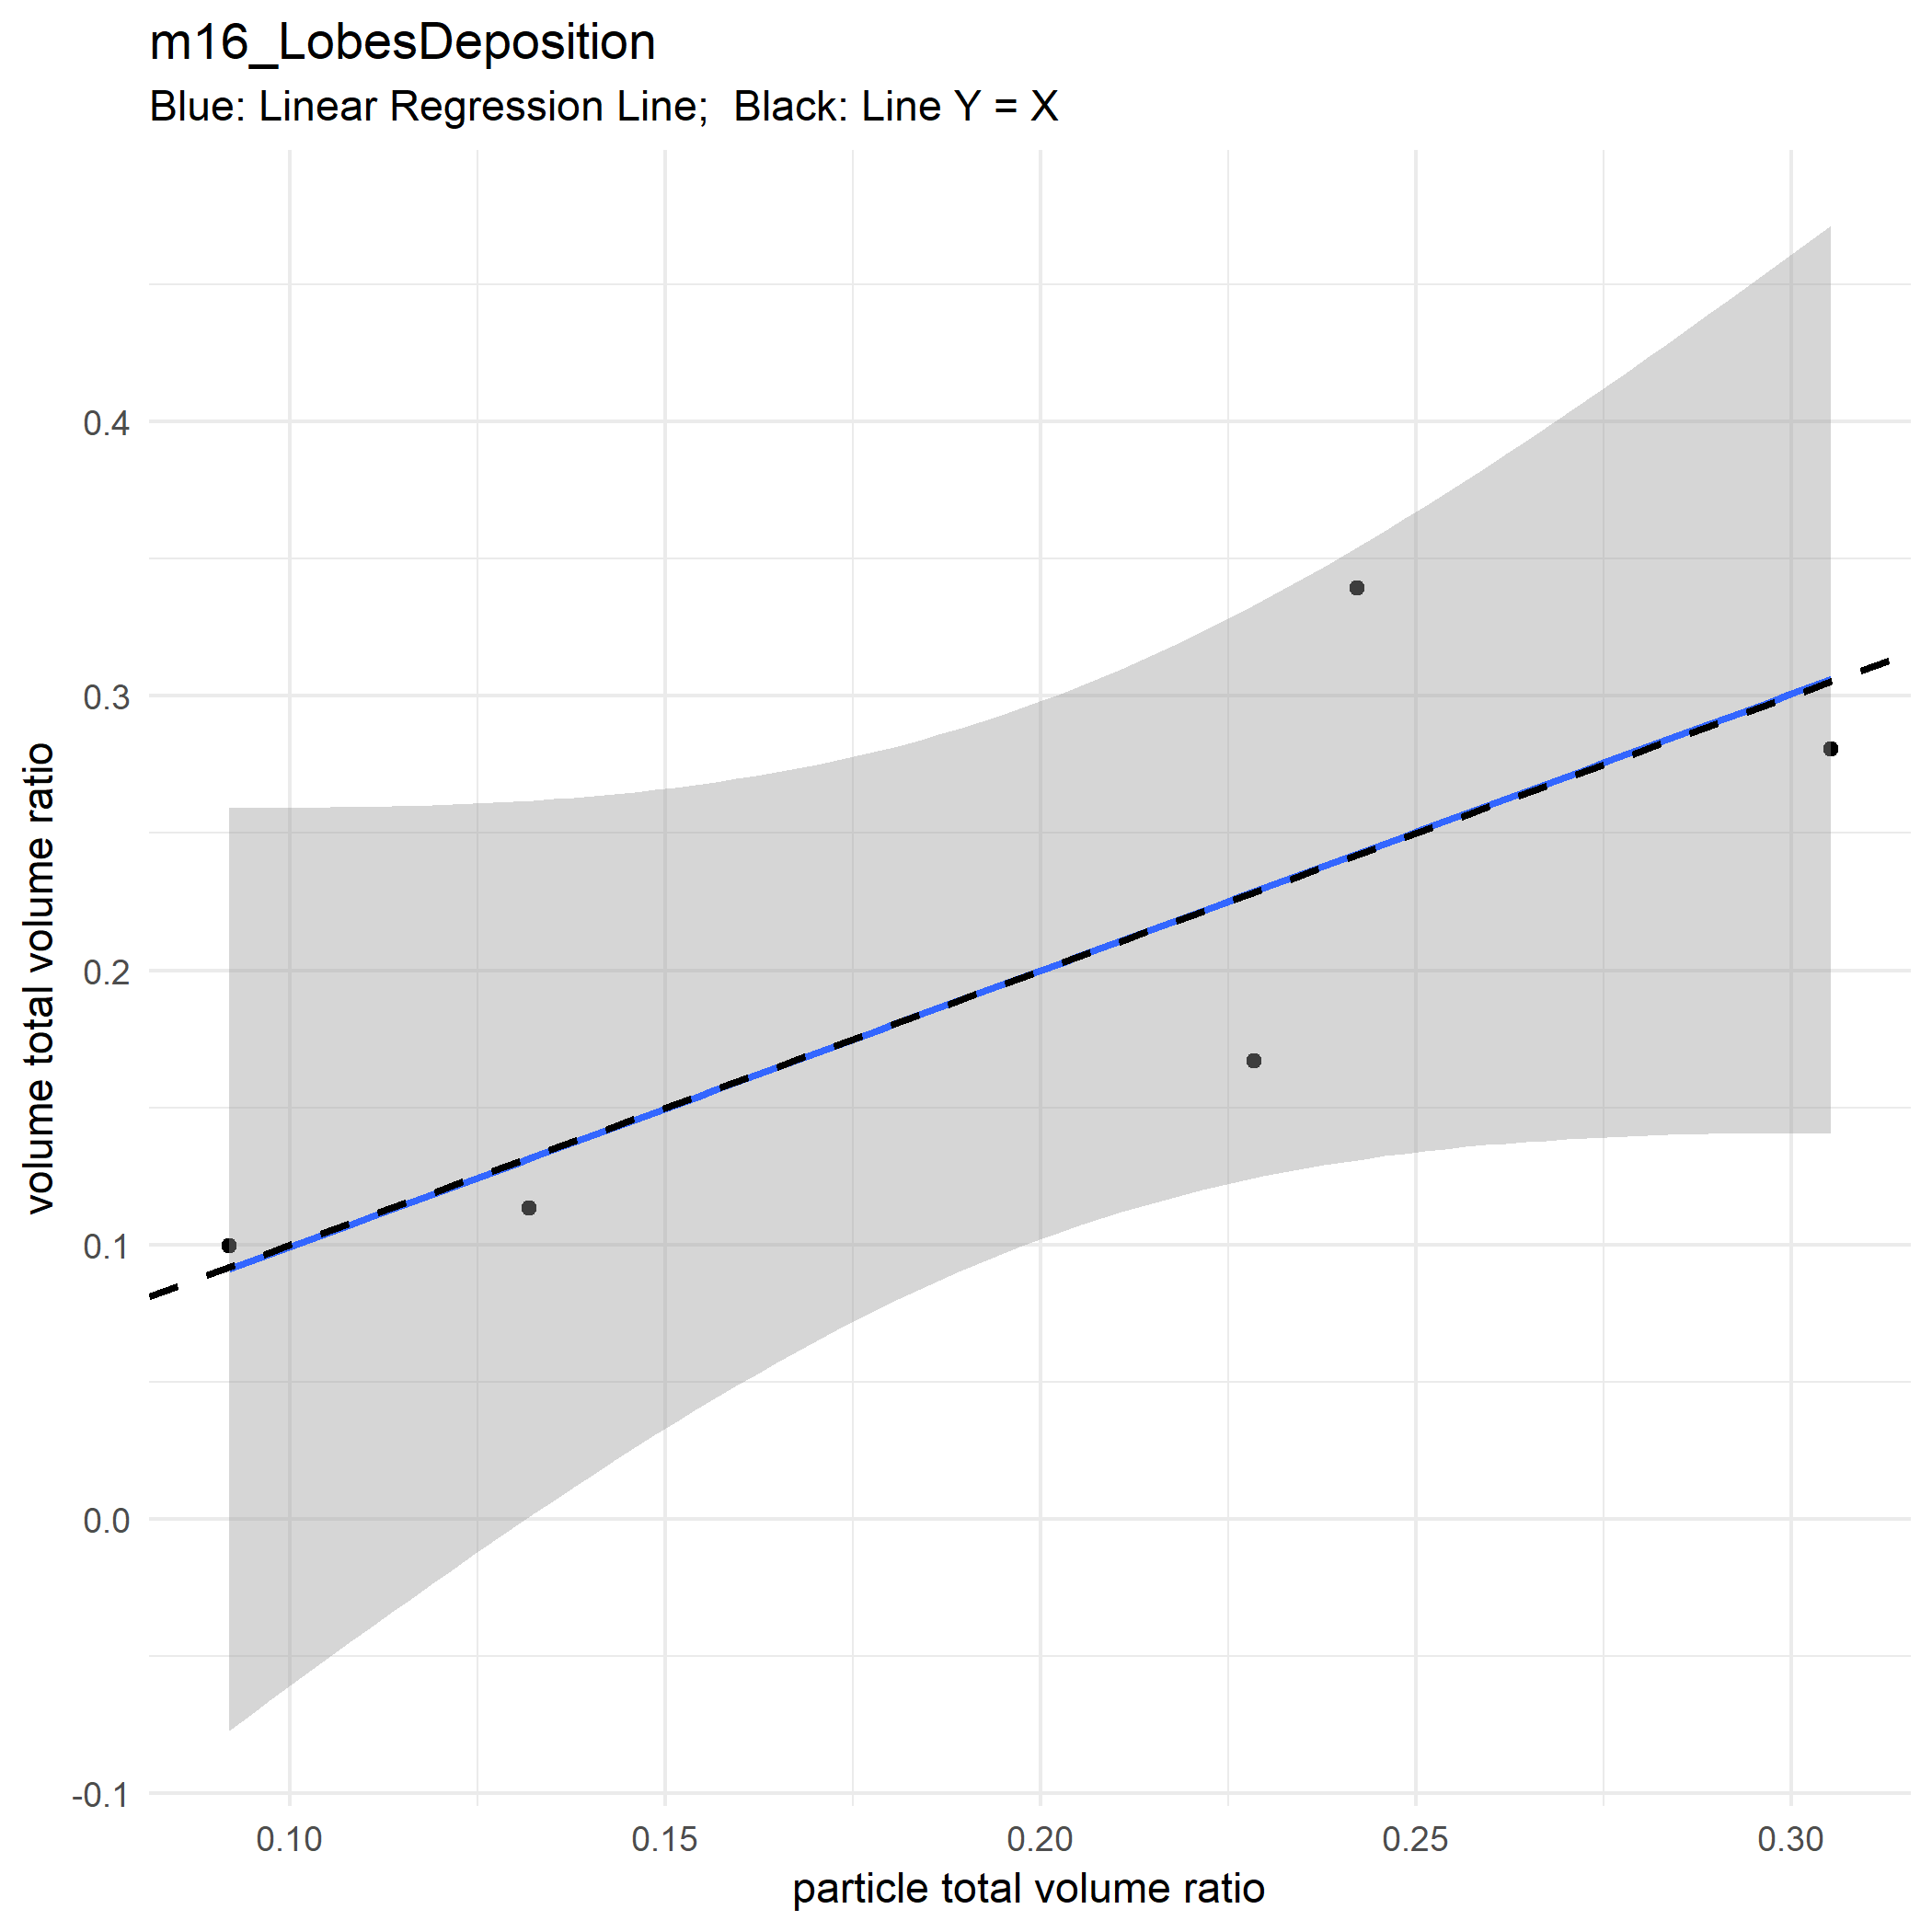

Slide 21
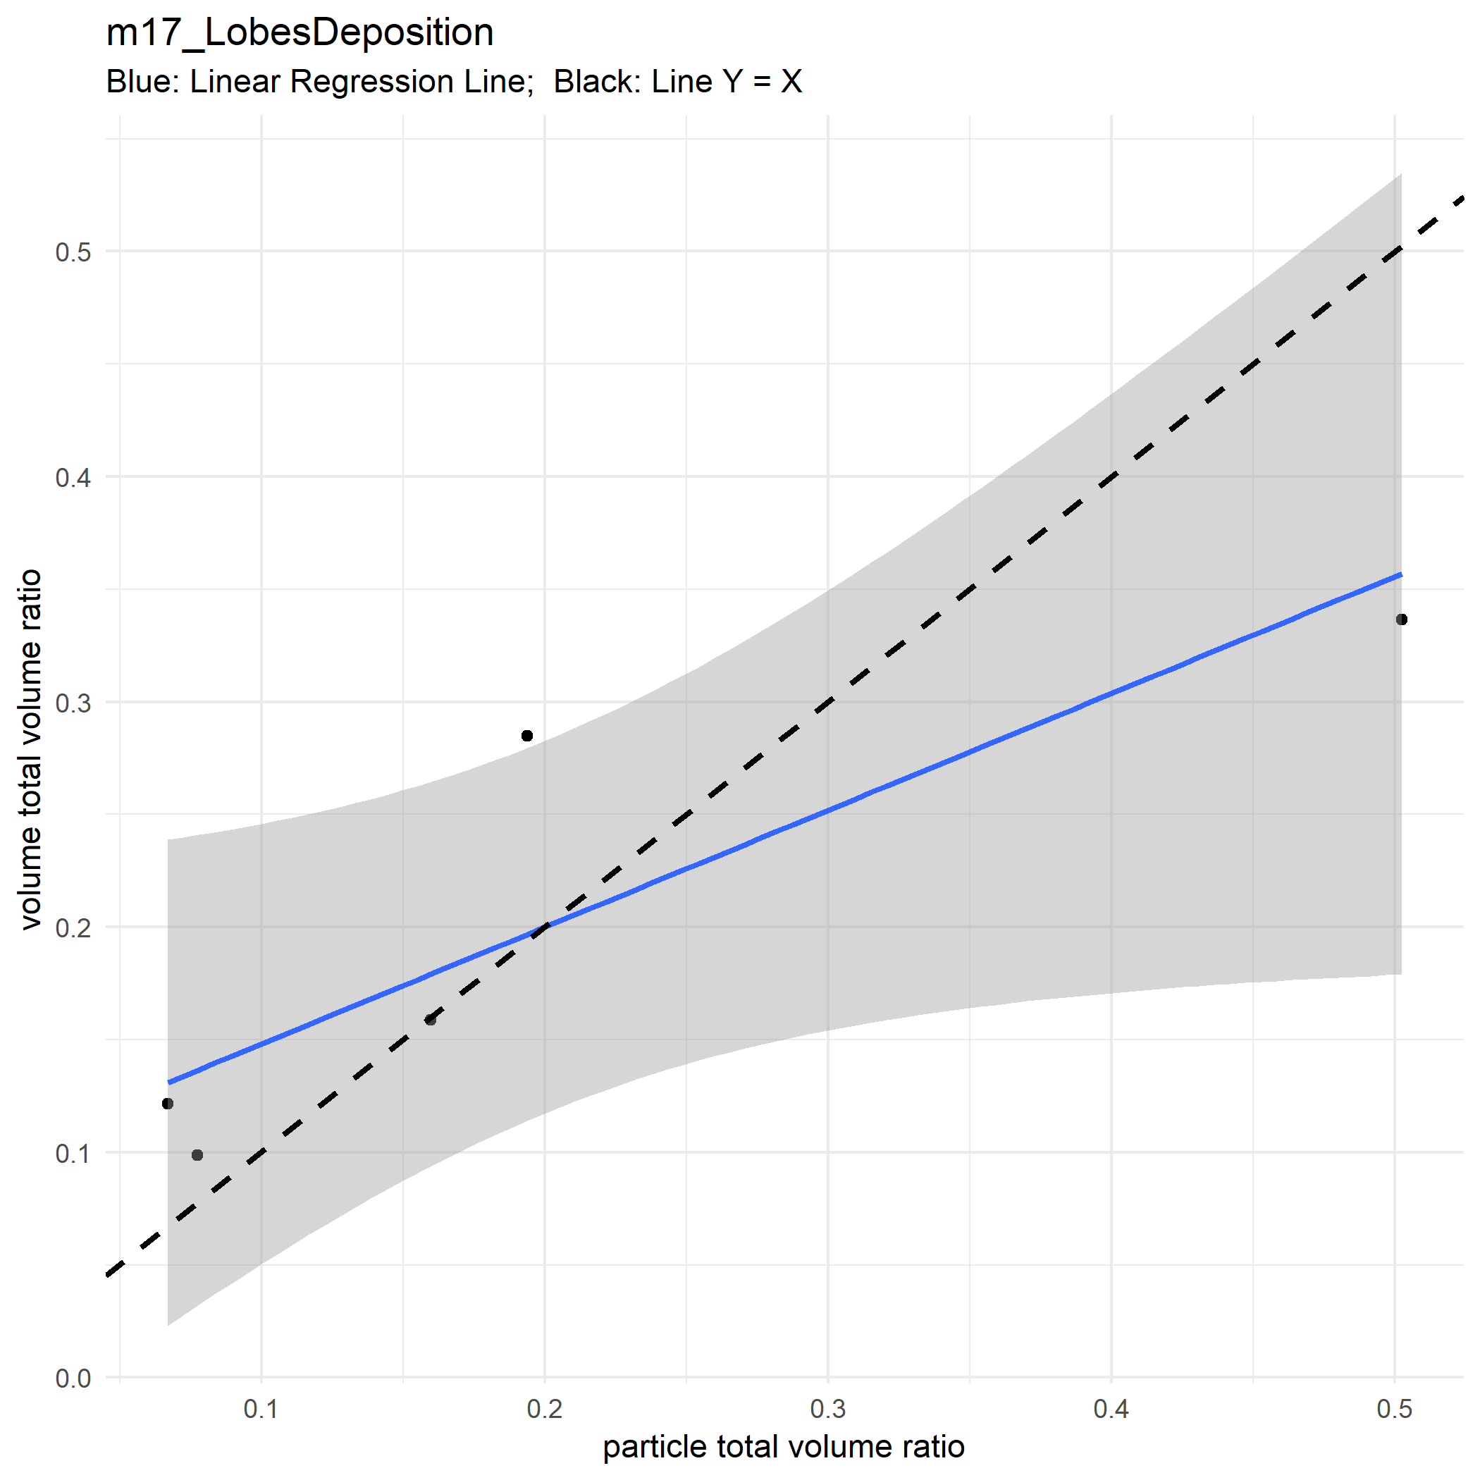

Slide 22
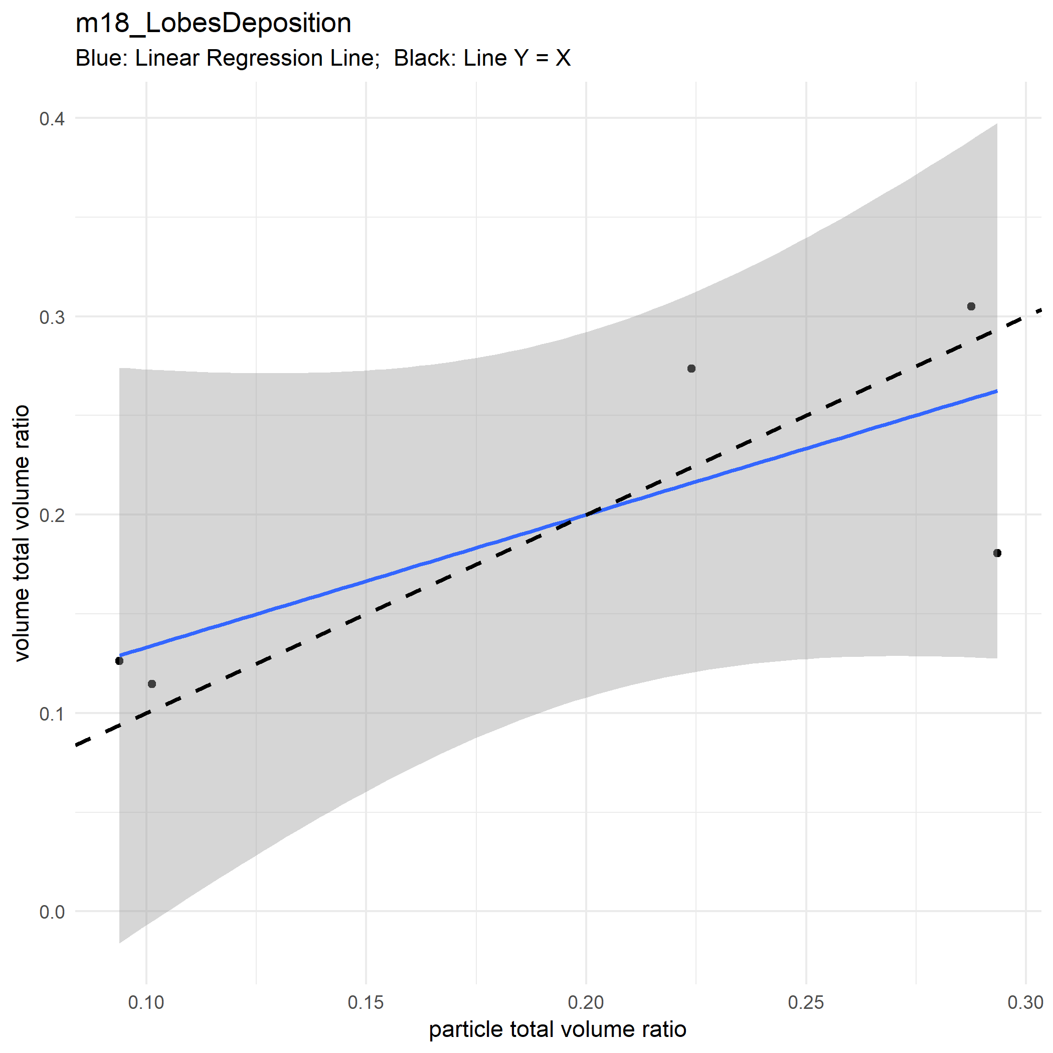

Slide 23
Sub lobe Level

Slide 24
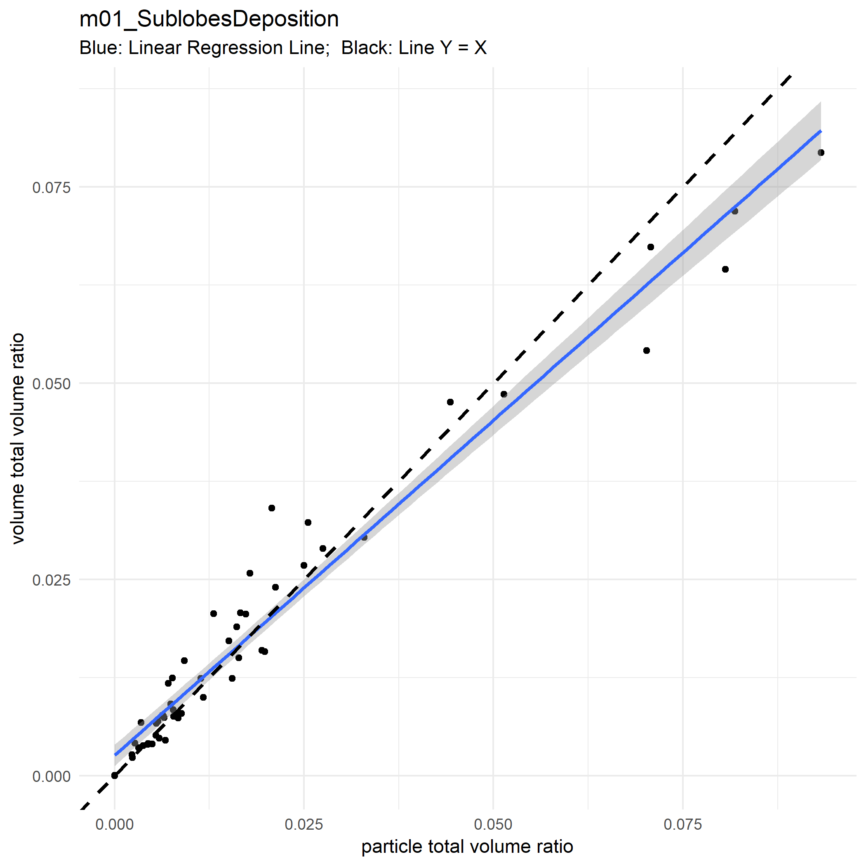

Slide 25
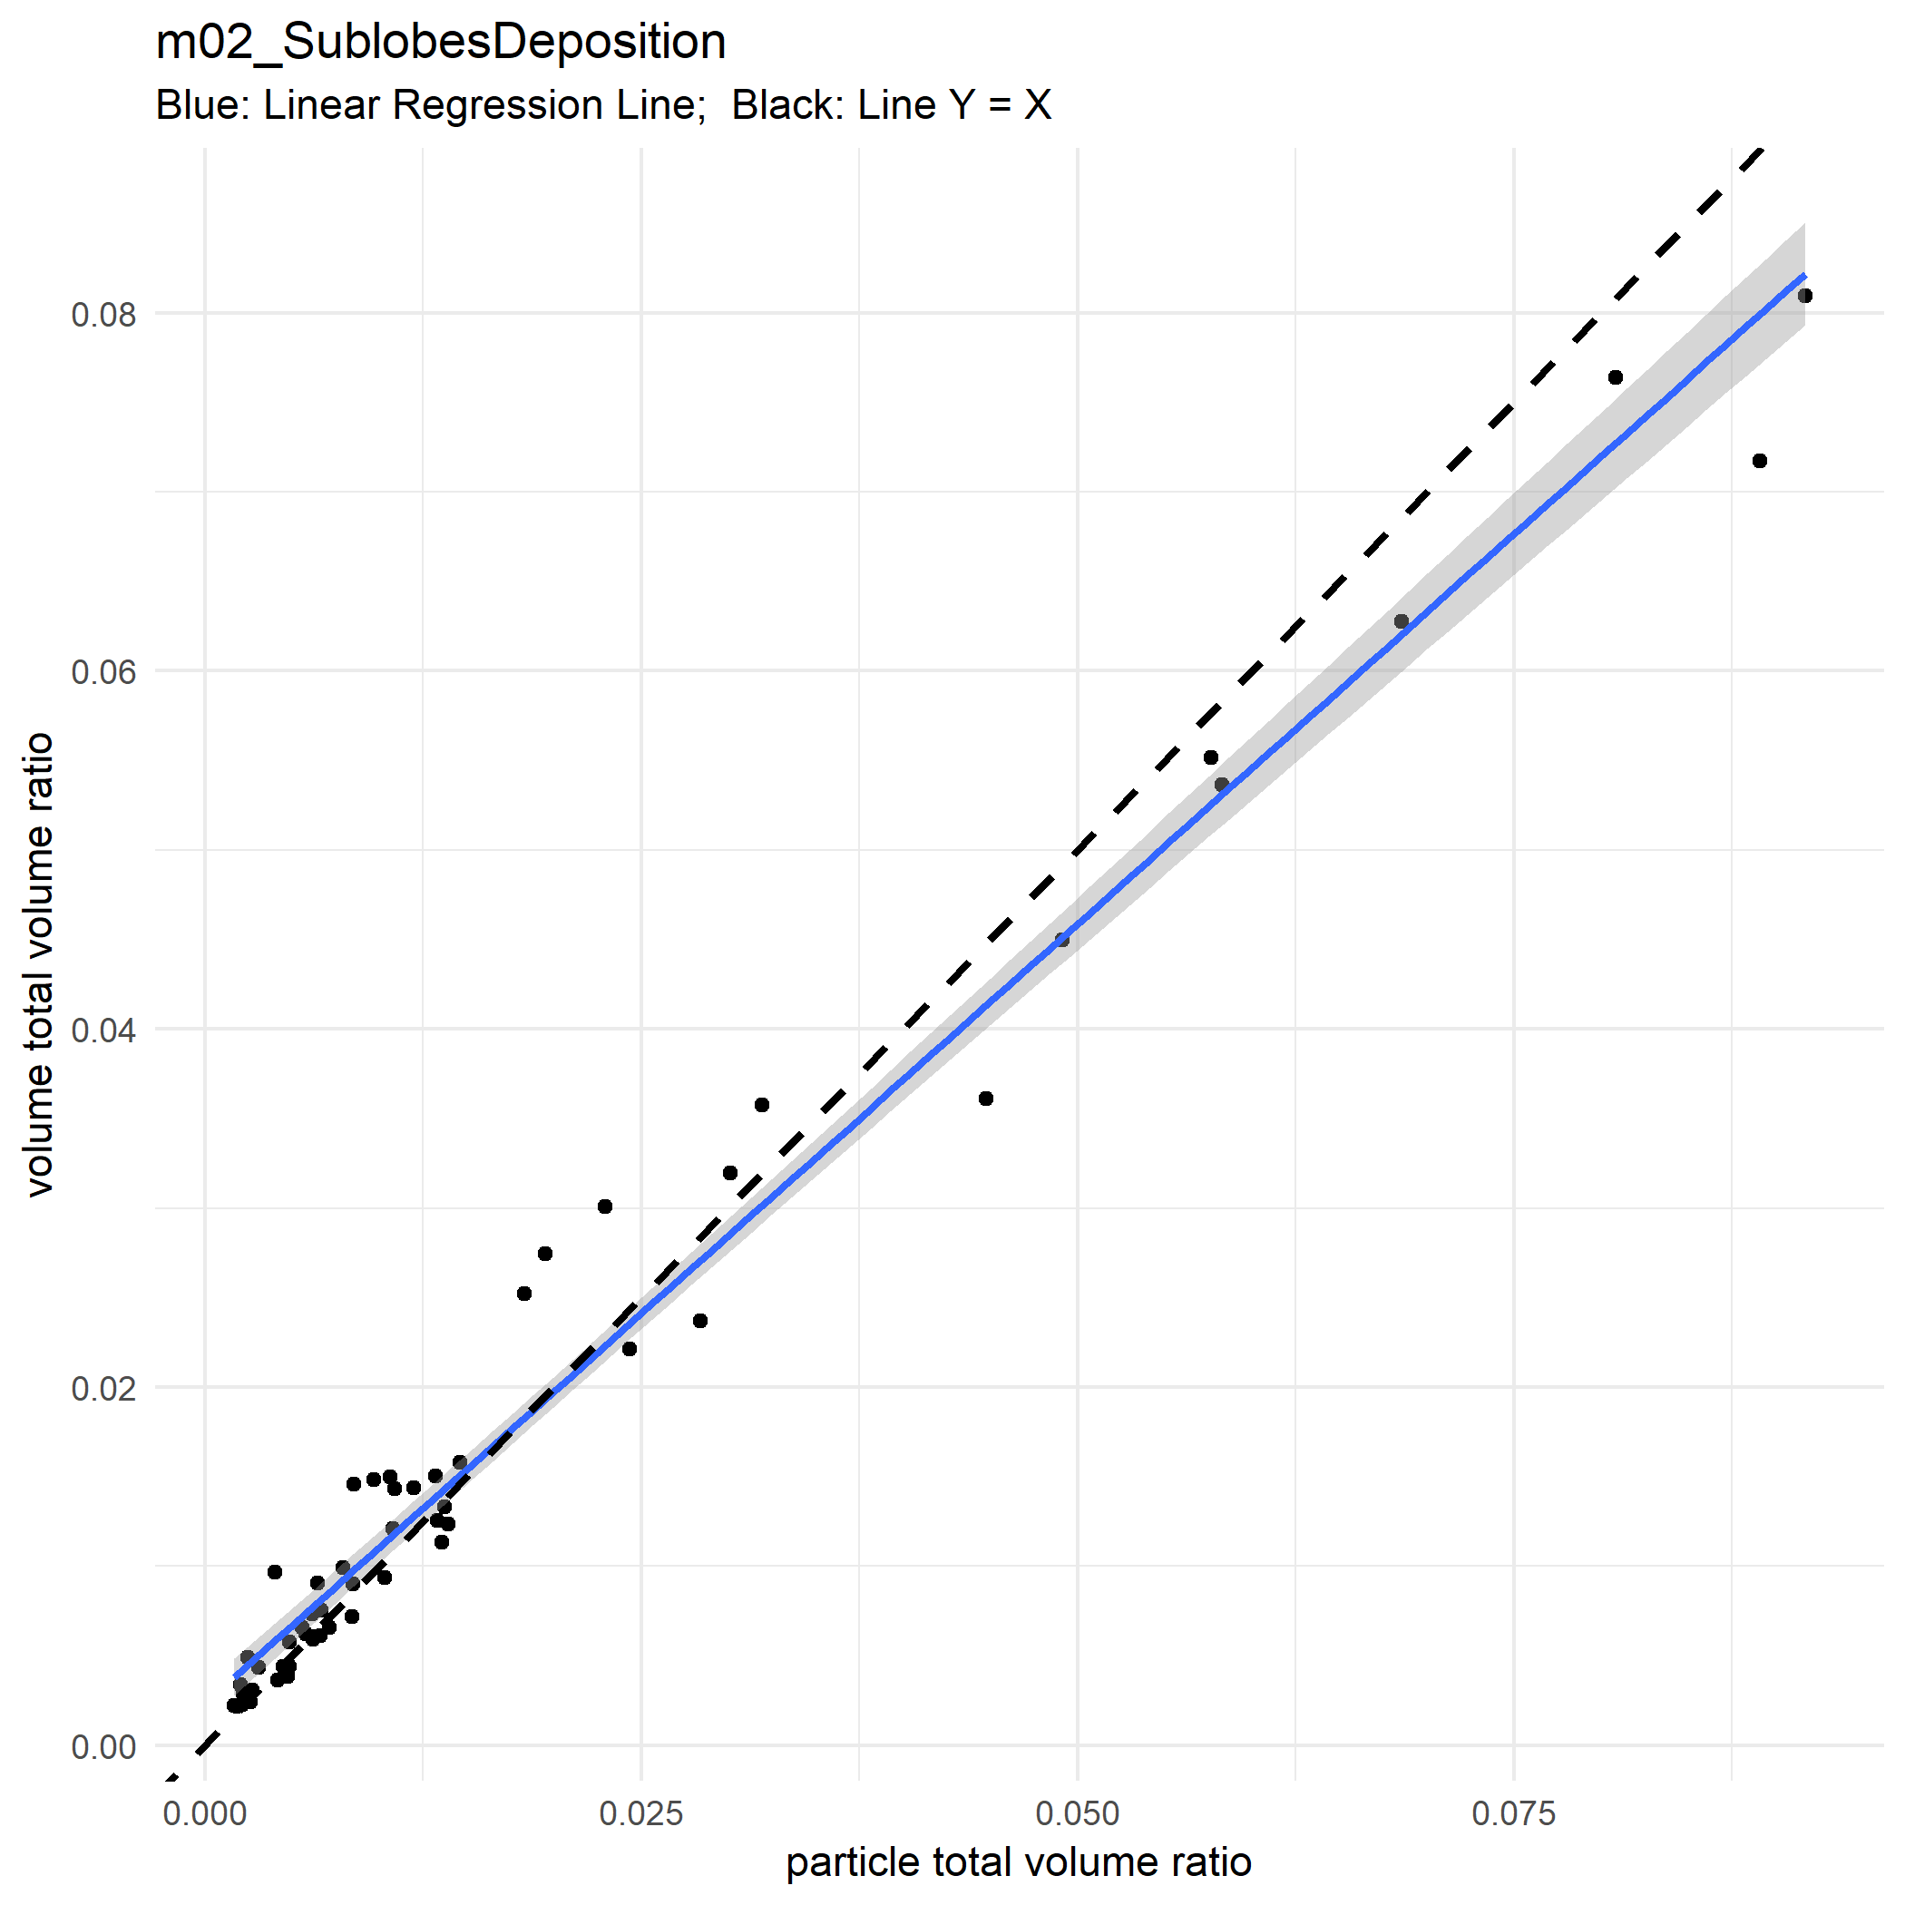

Slide 26


Slide 27
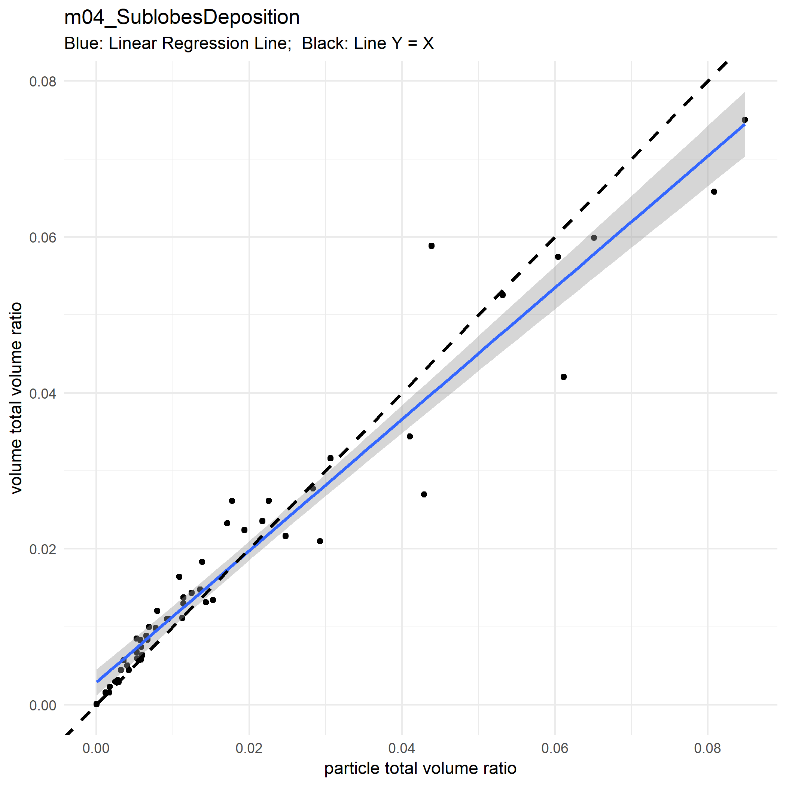

Slide 28
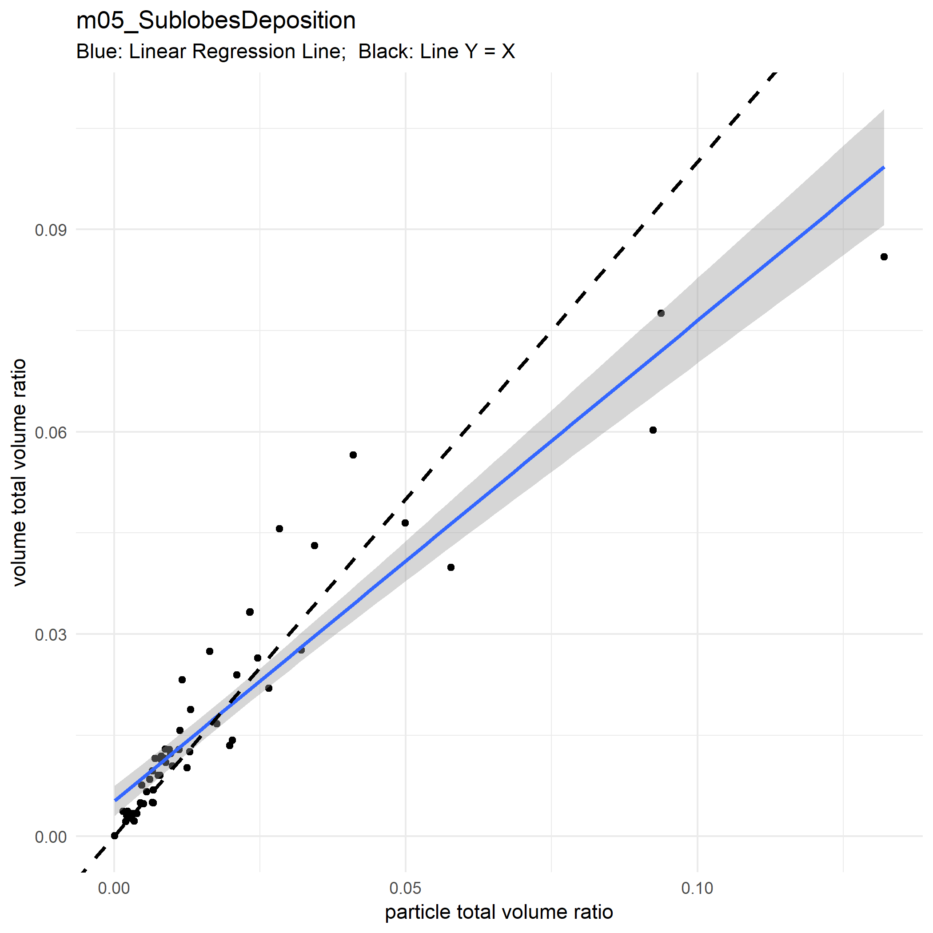

Slide 29


Slide 30


Slide 31


Slide 32


Slide 33


Slide 34
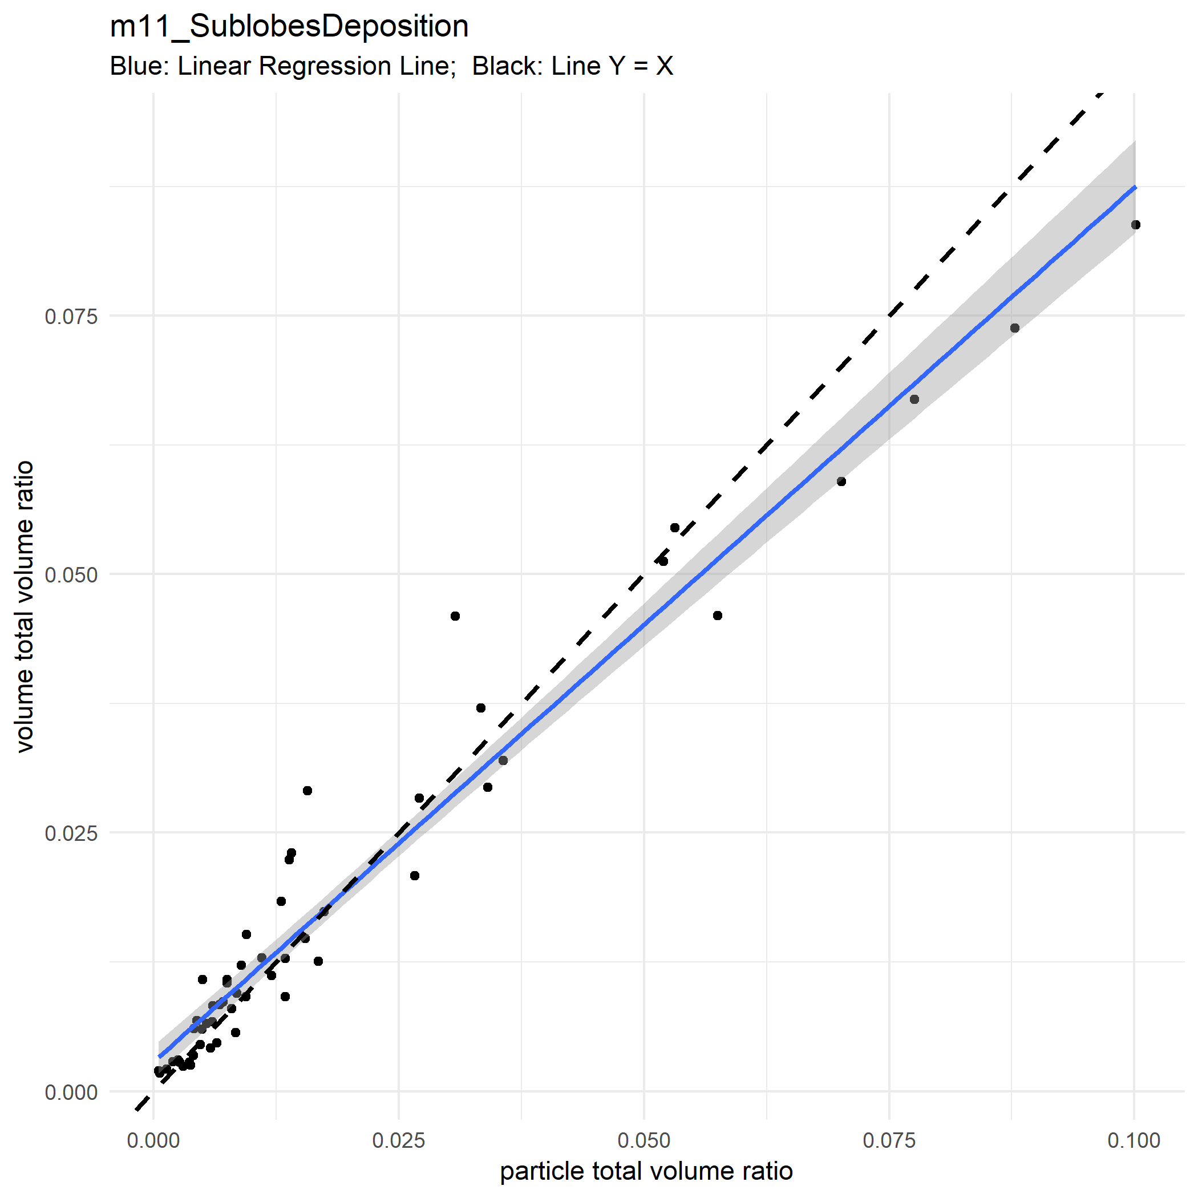

Slide 35


Slide 36
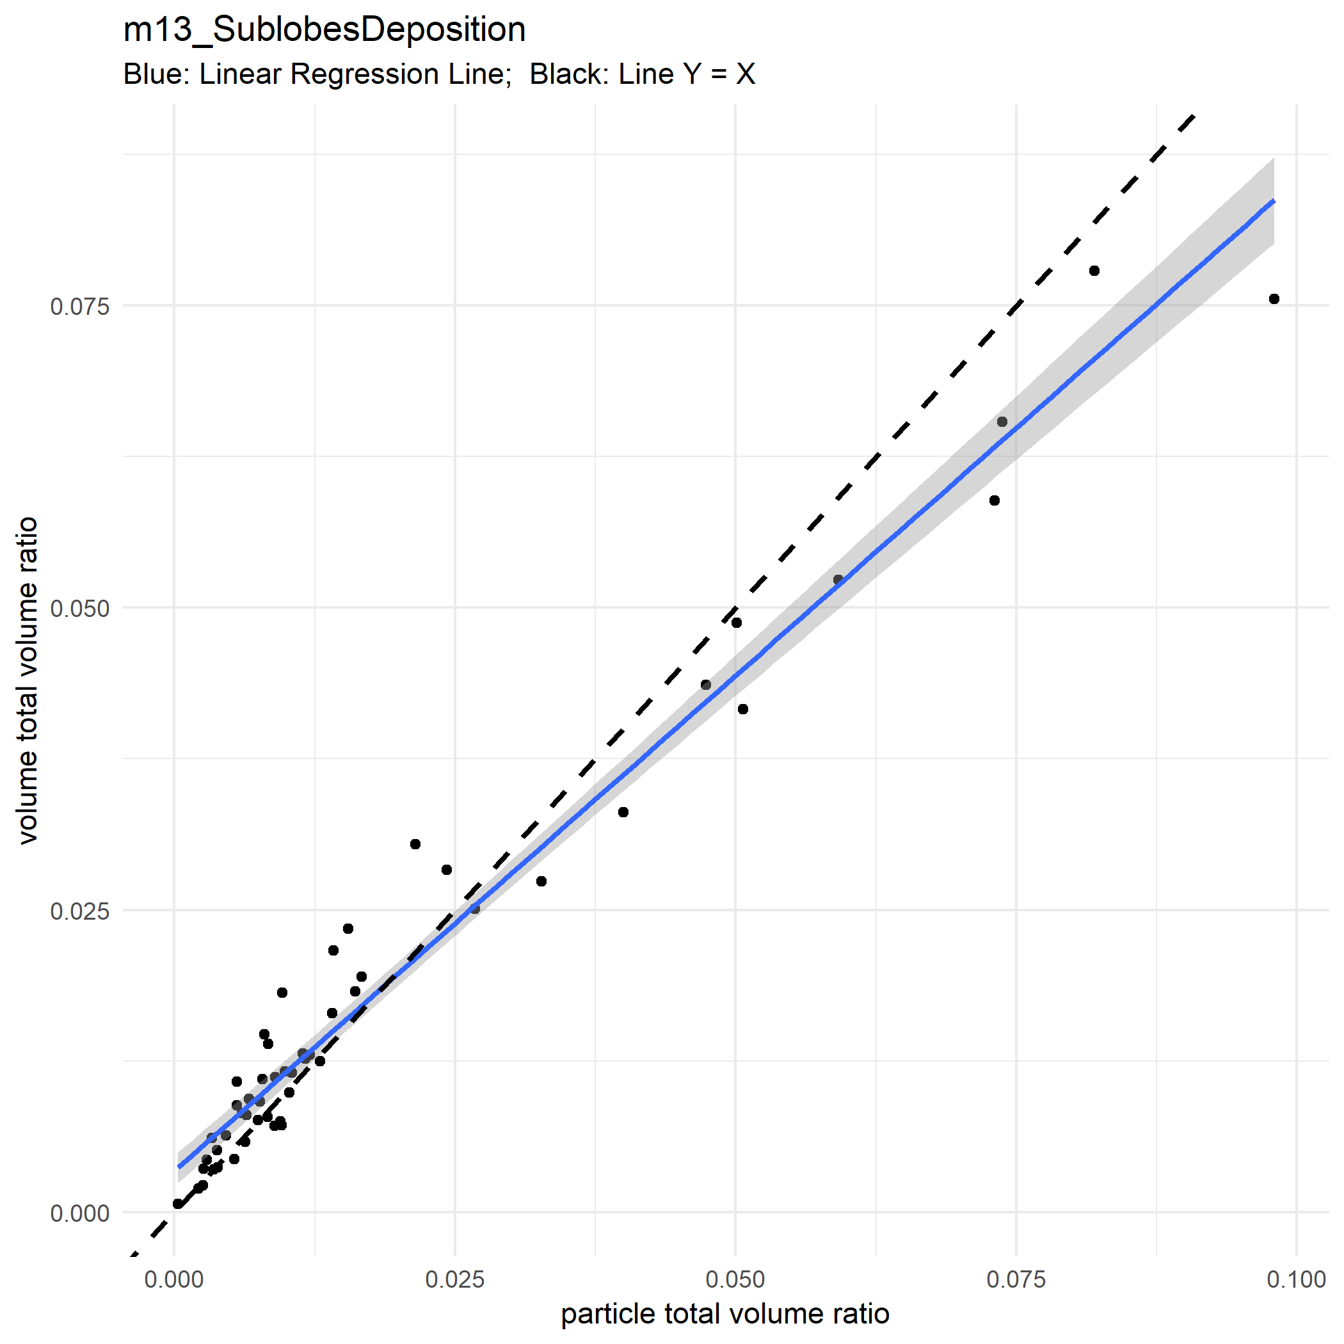

Slide 37


Slide 38
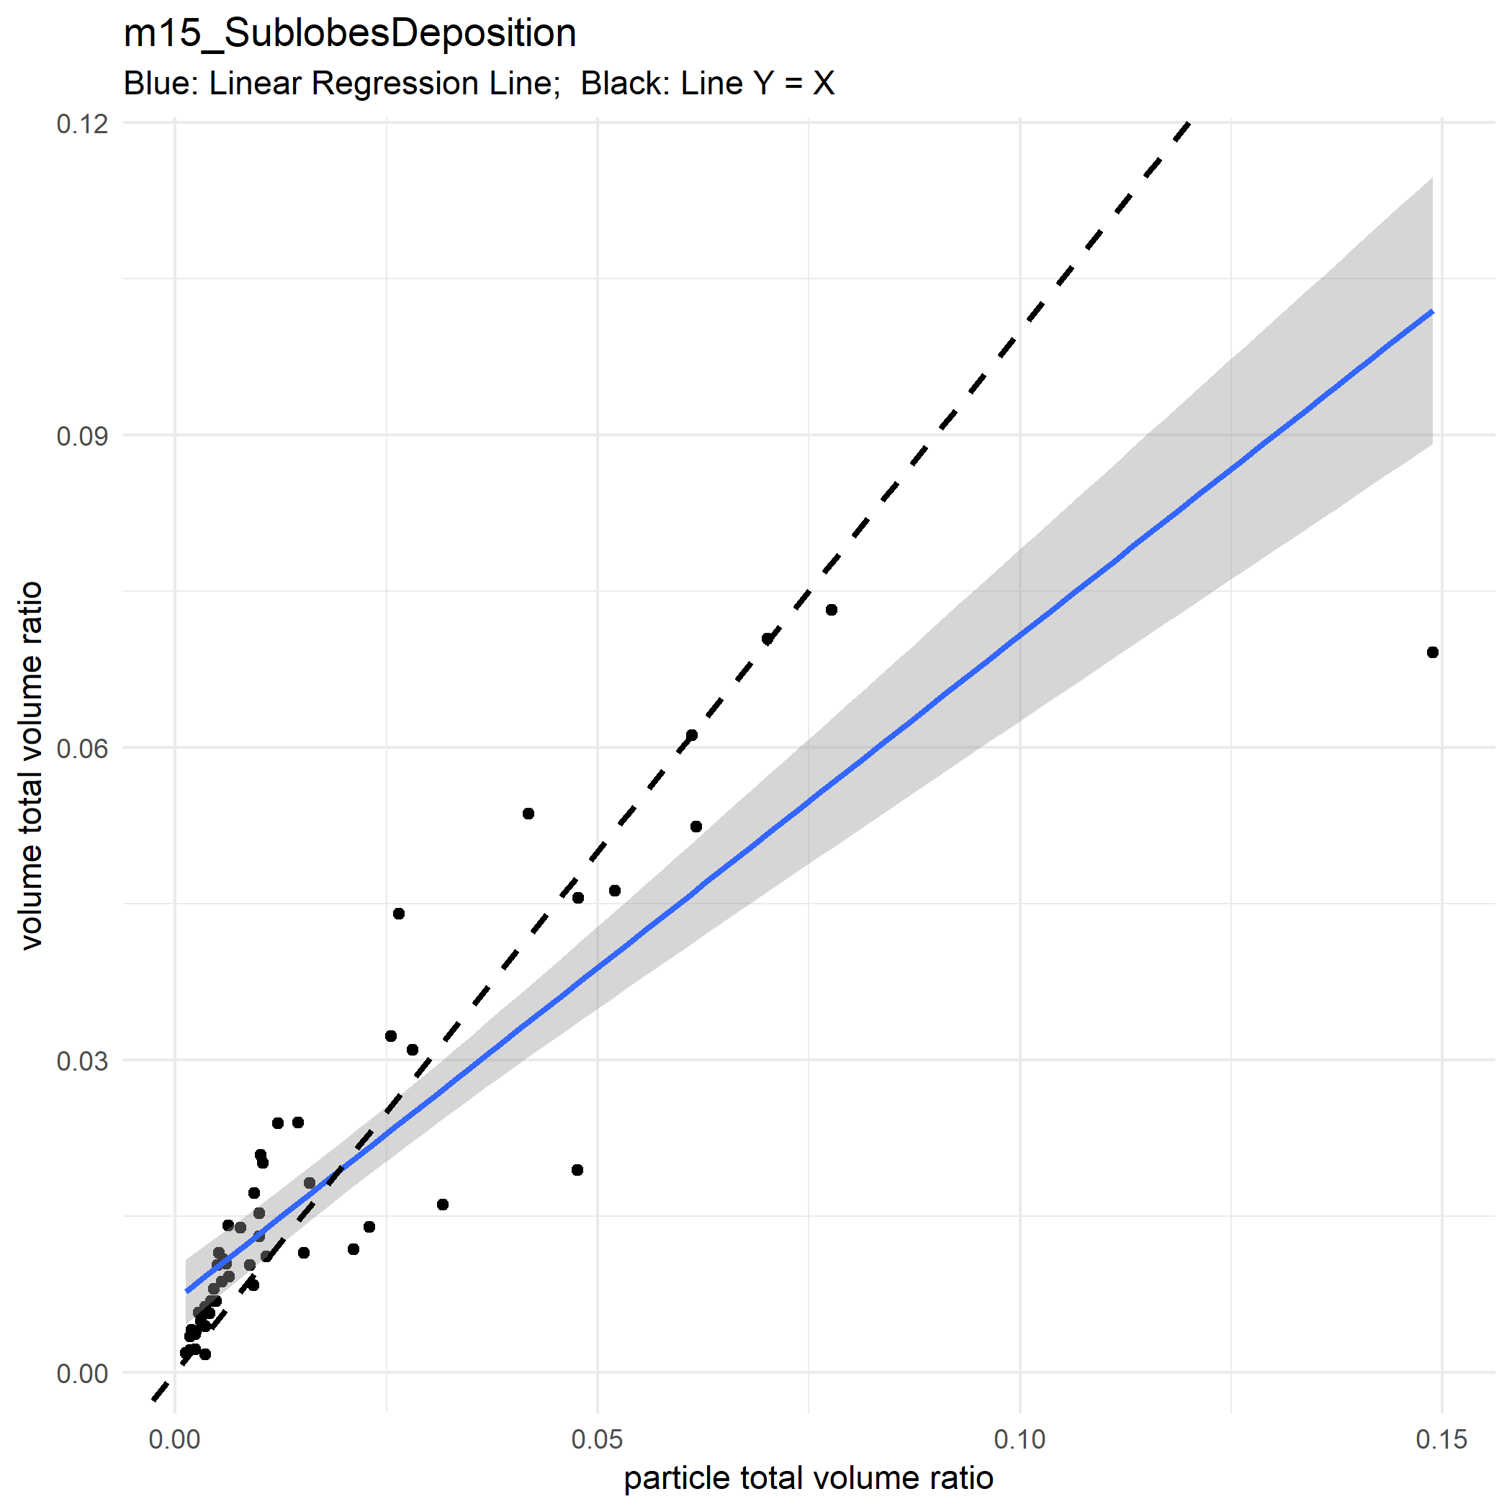

Slide 39
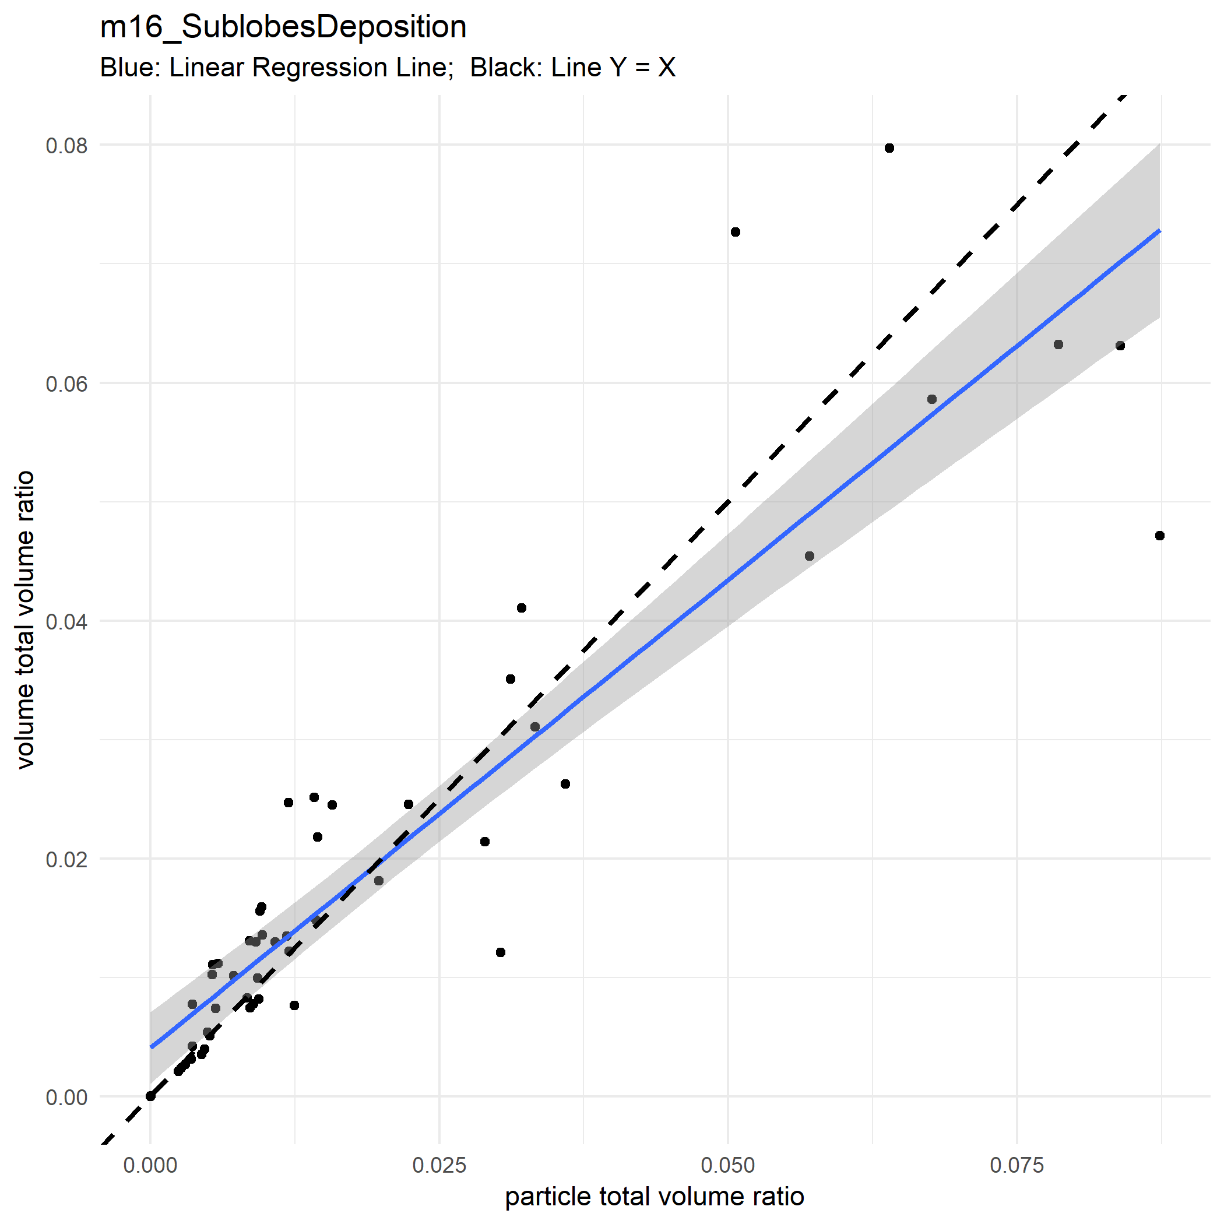

Slide 40
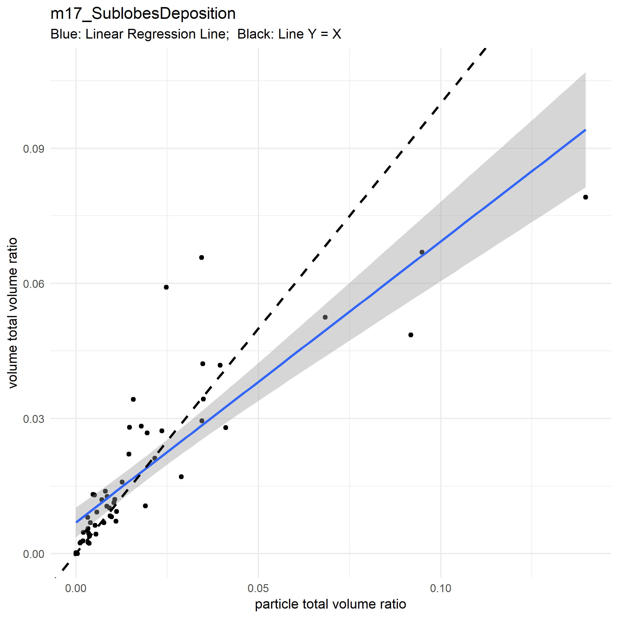

Slide 41
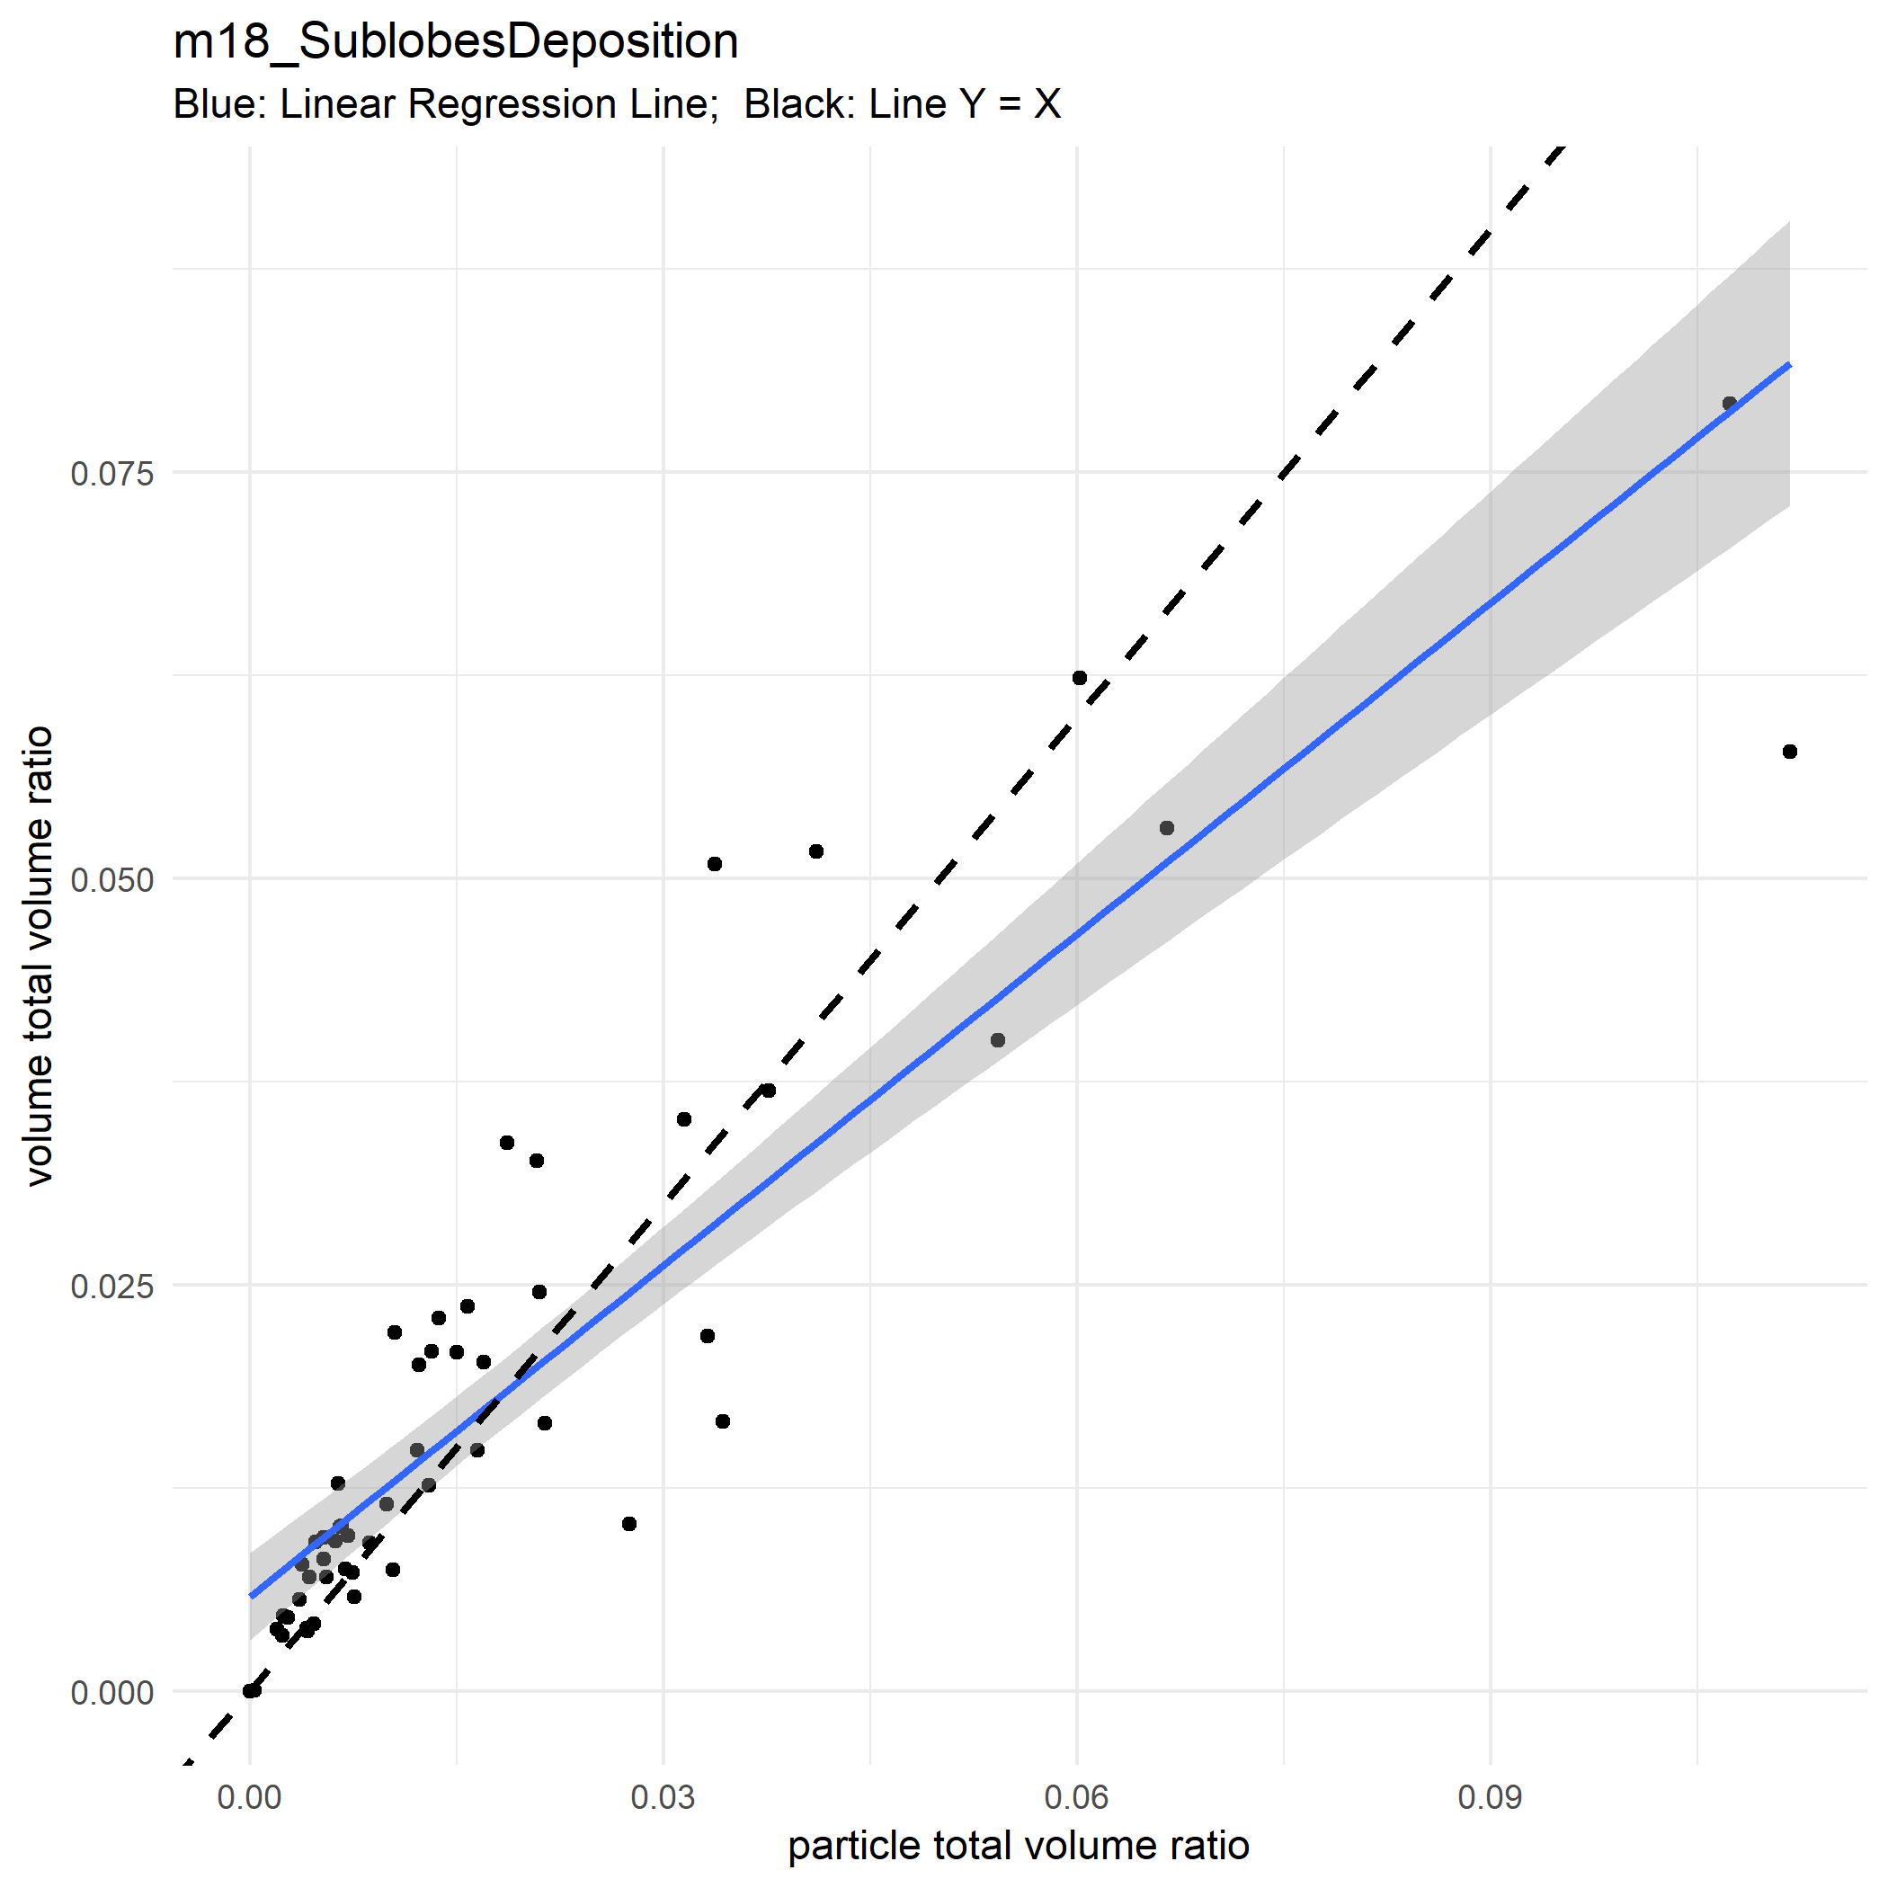

Slide 42
Near Acini Level

Slide 47
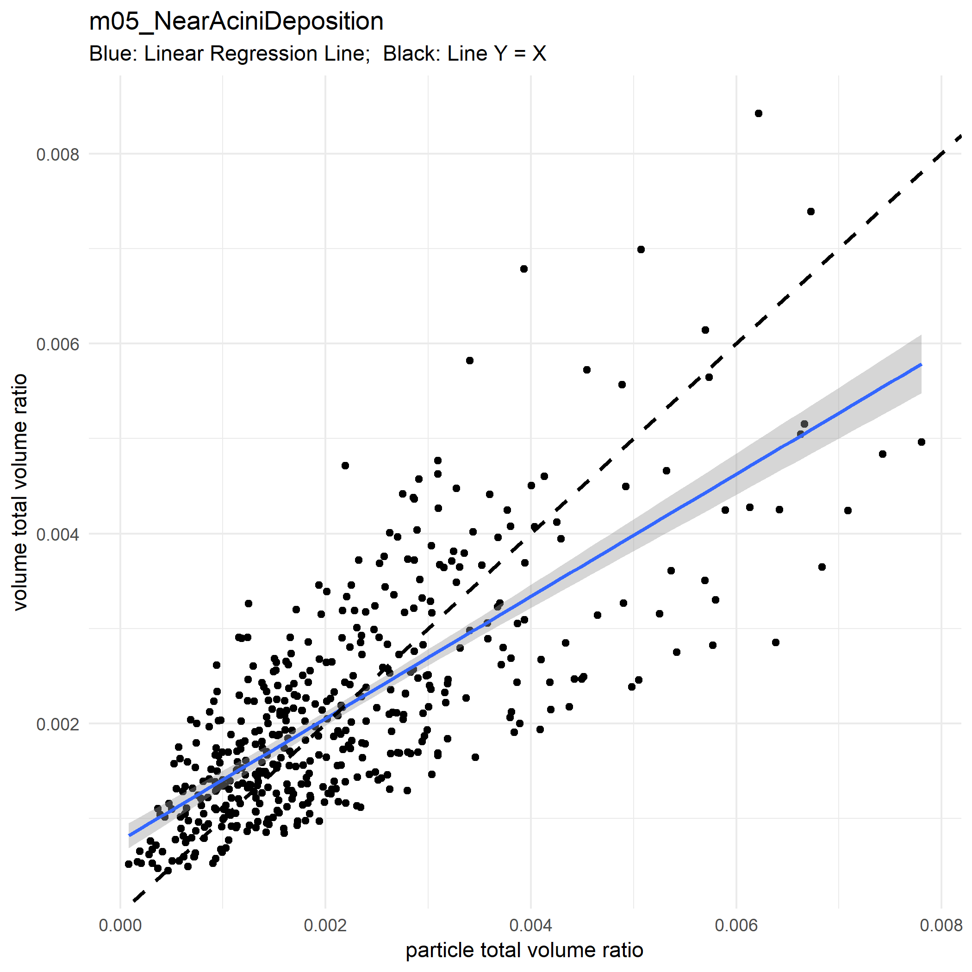

Slide 48
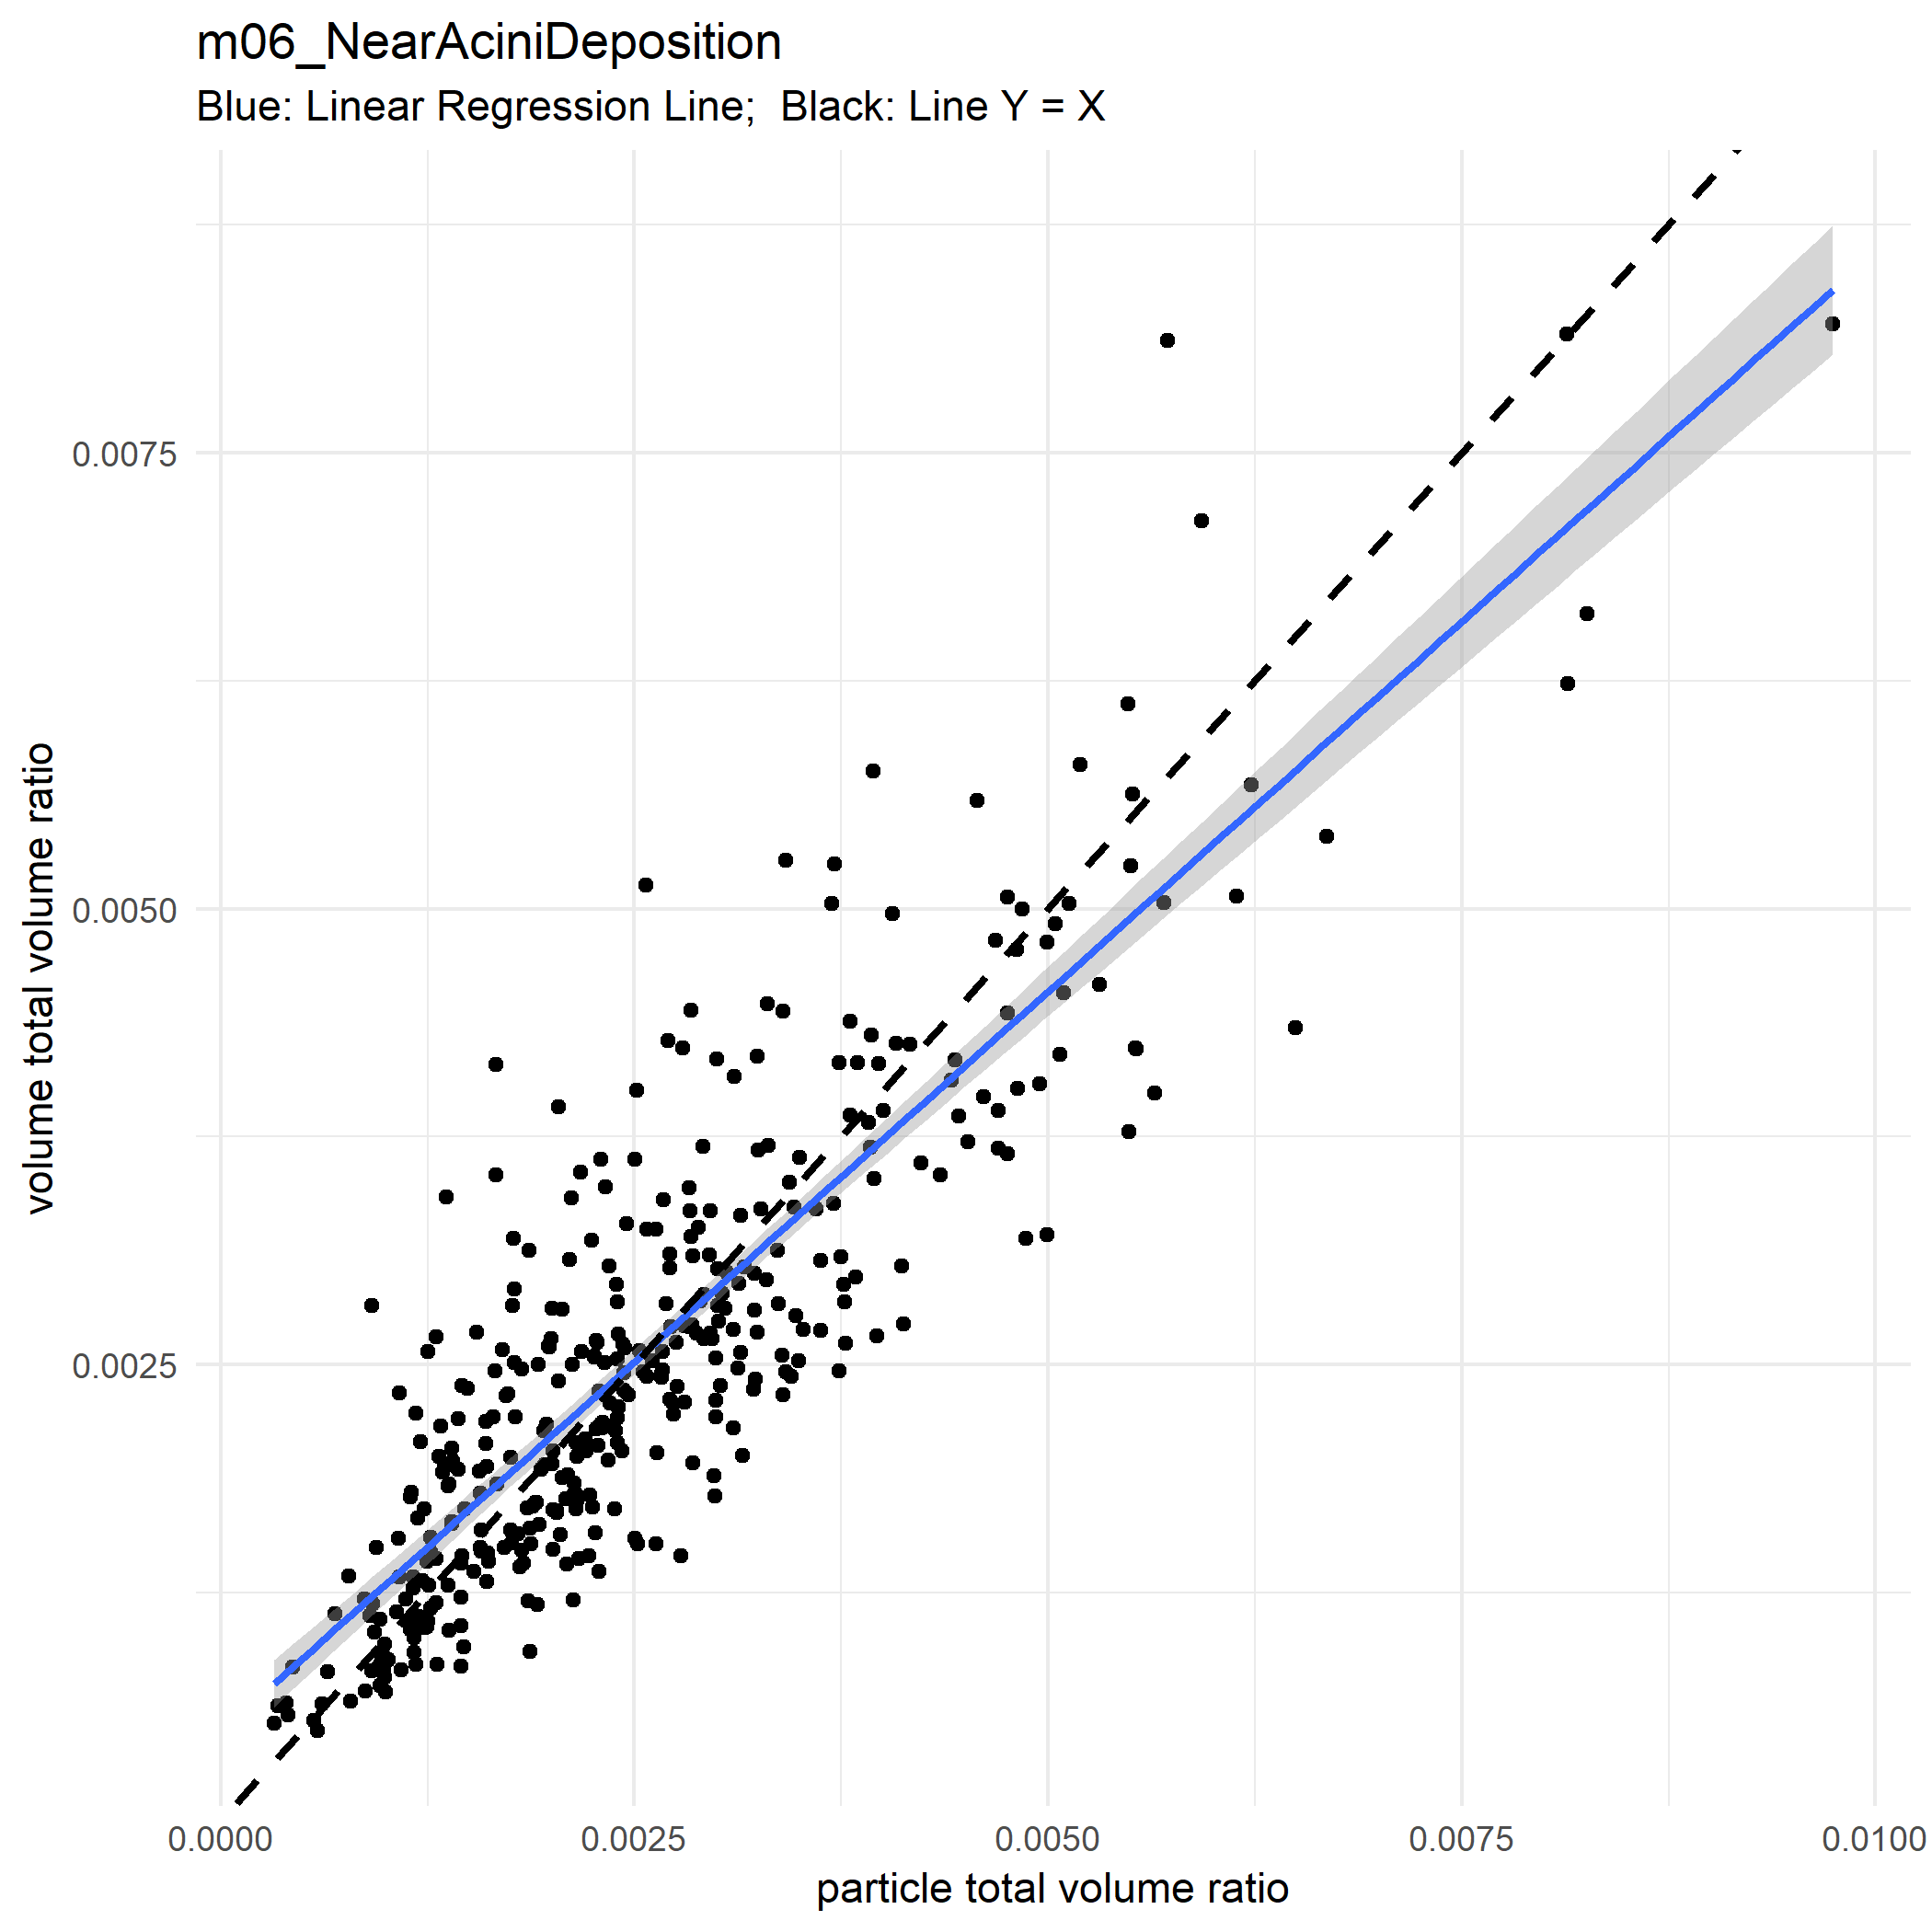

Slide 49
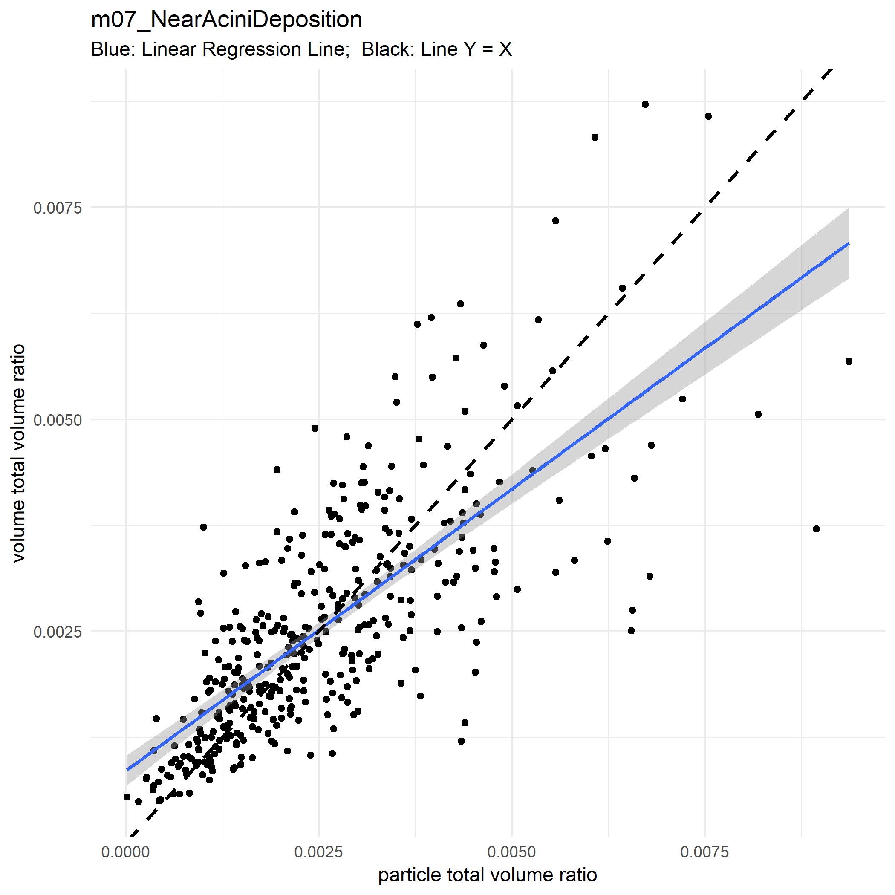

Slide 50
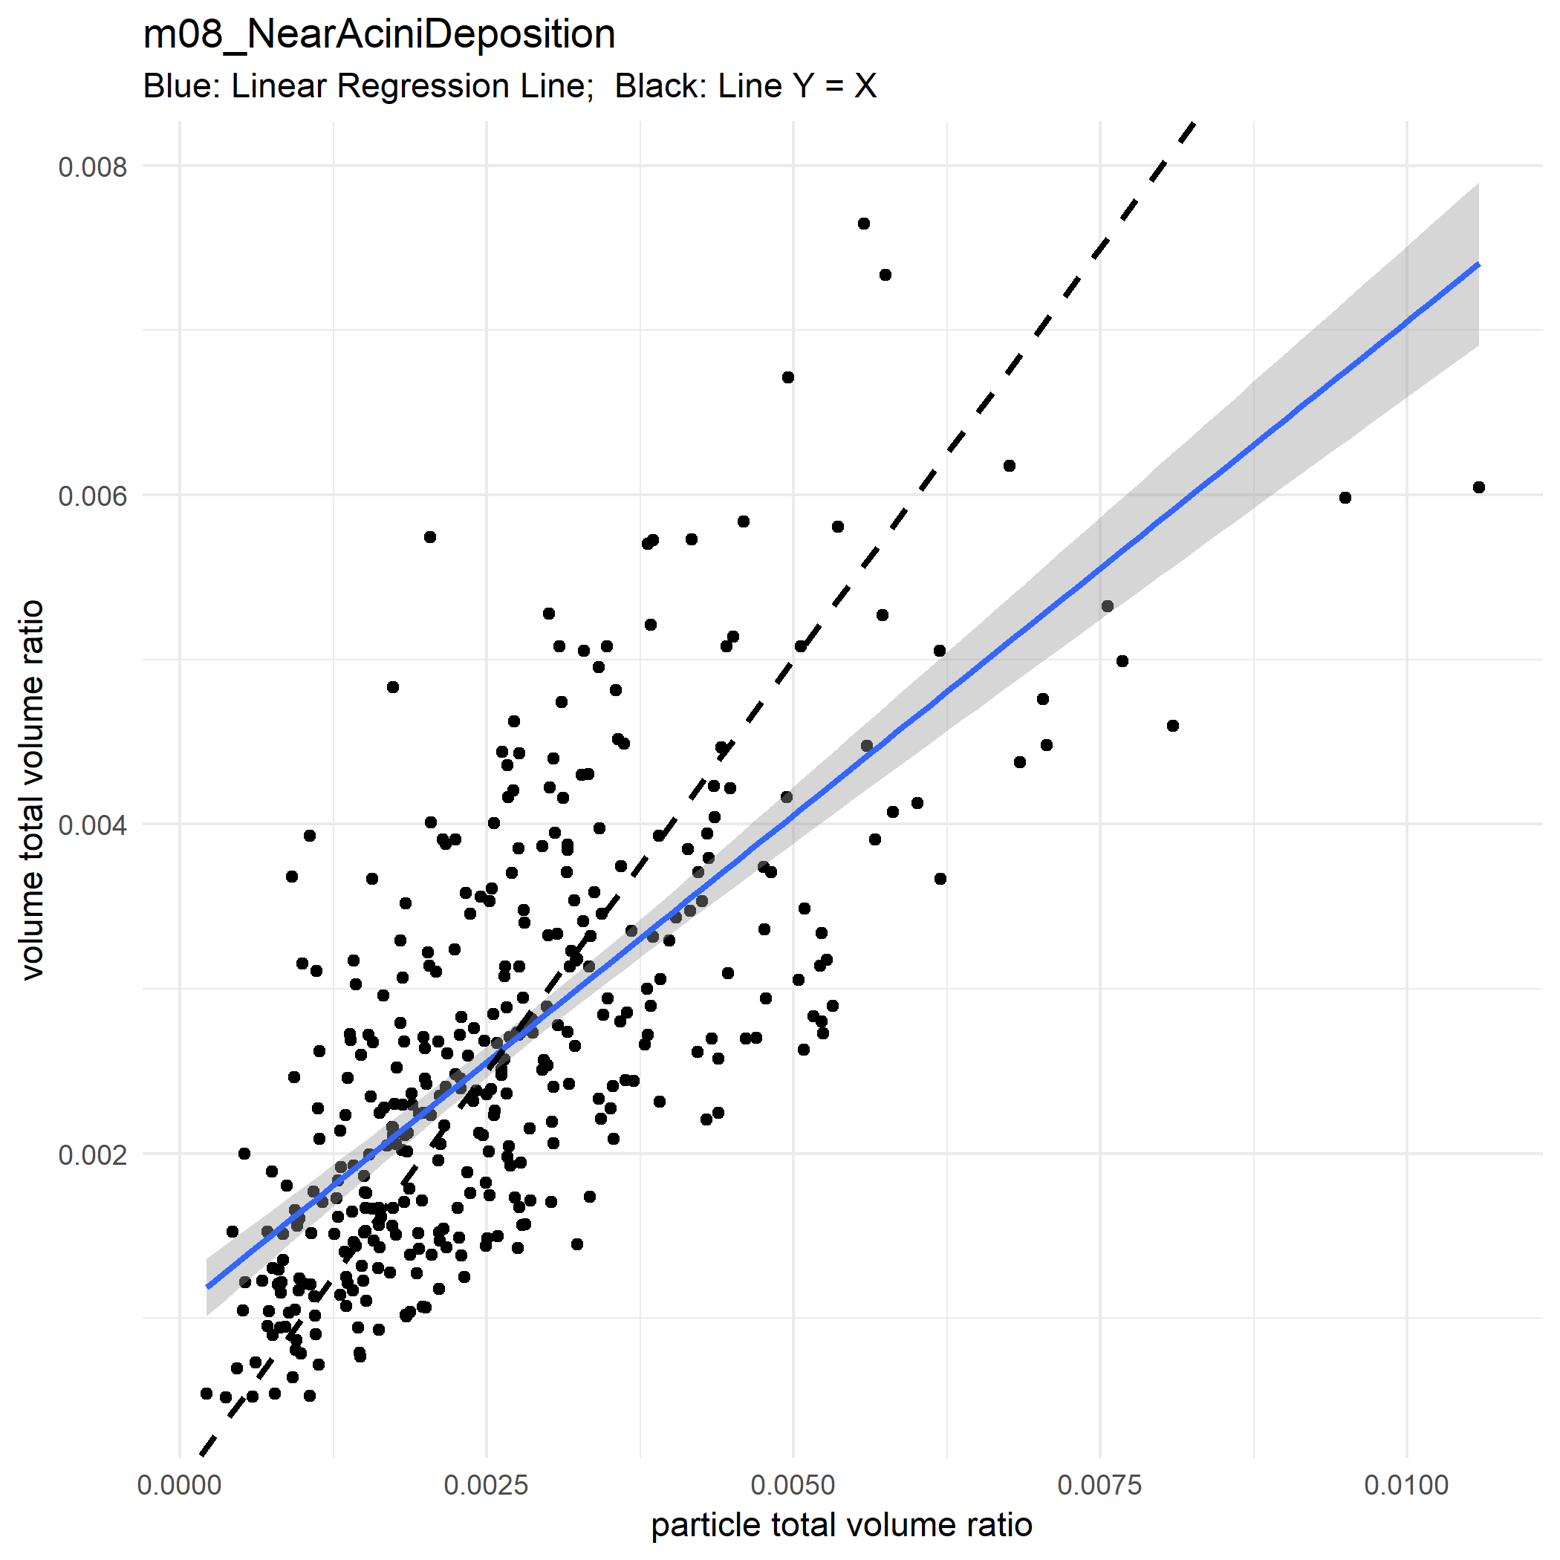

Slide 51
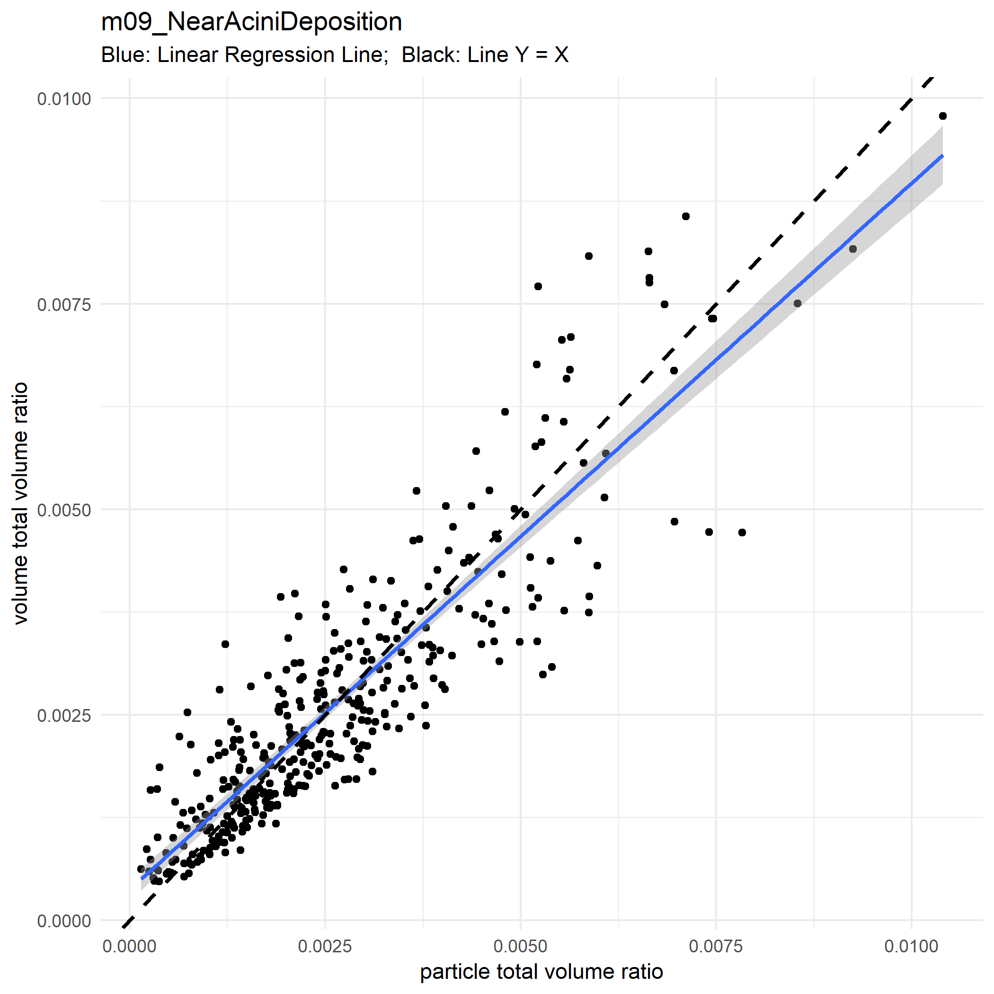

Slide 52
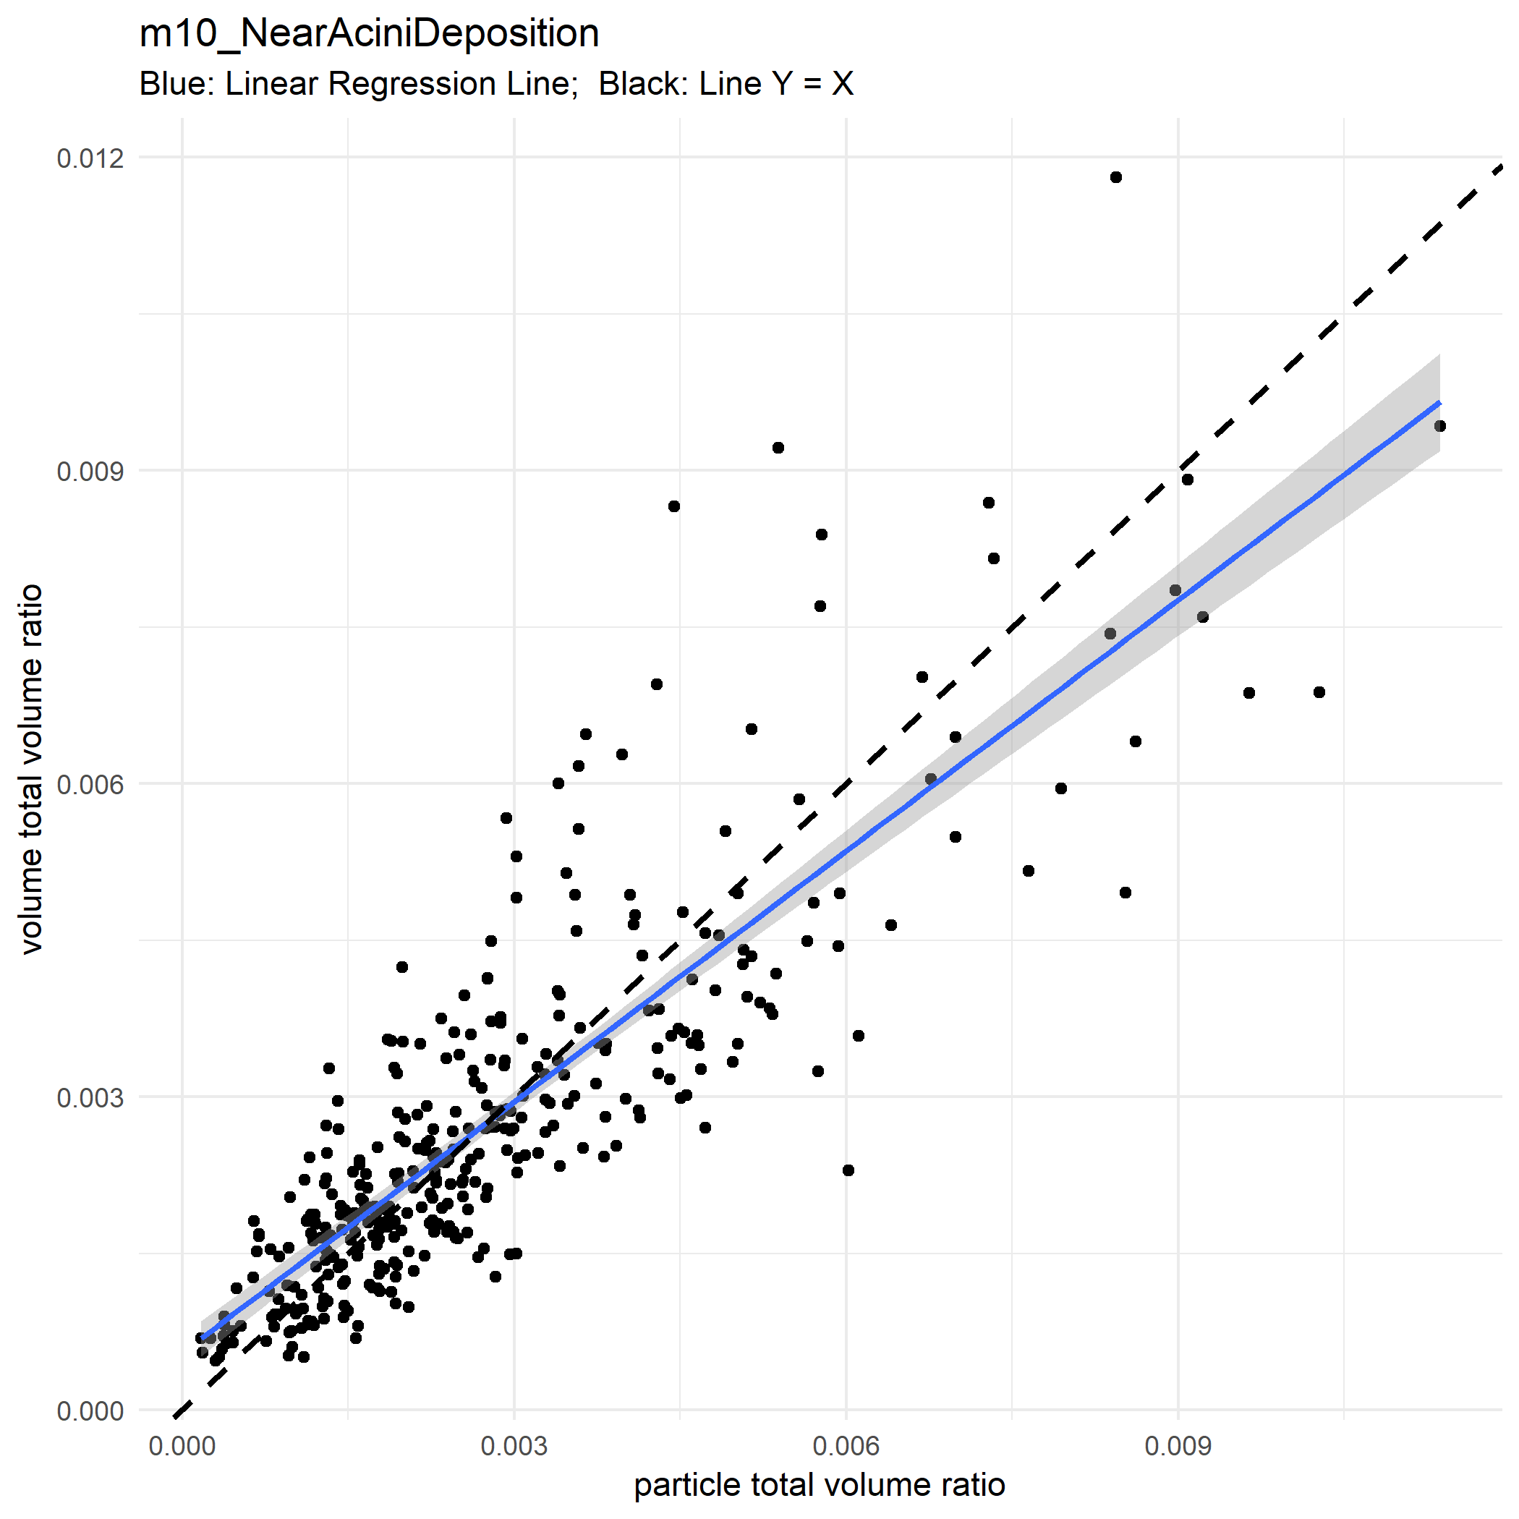

Slide 53
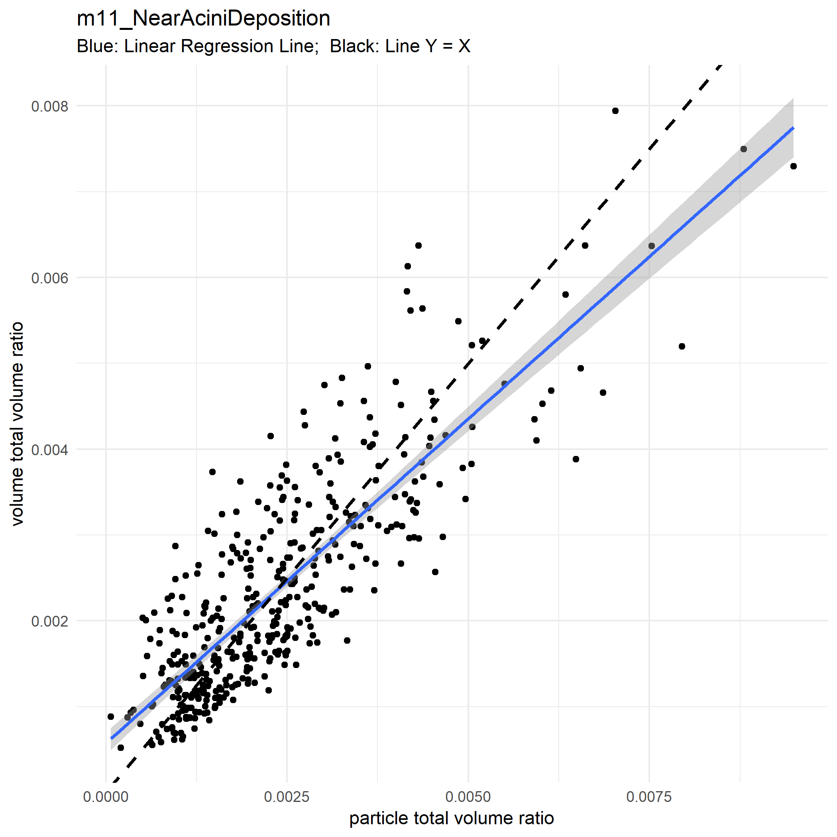

Slide 54
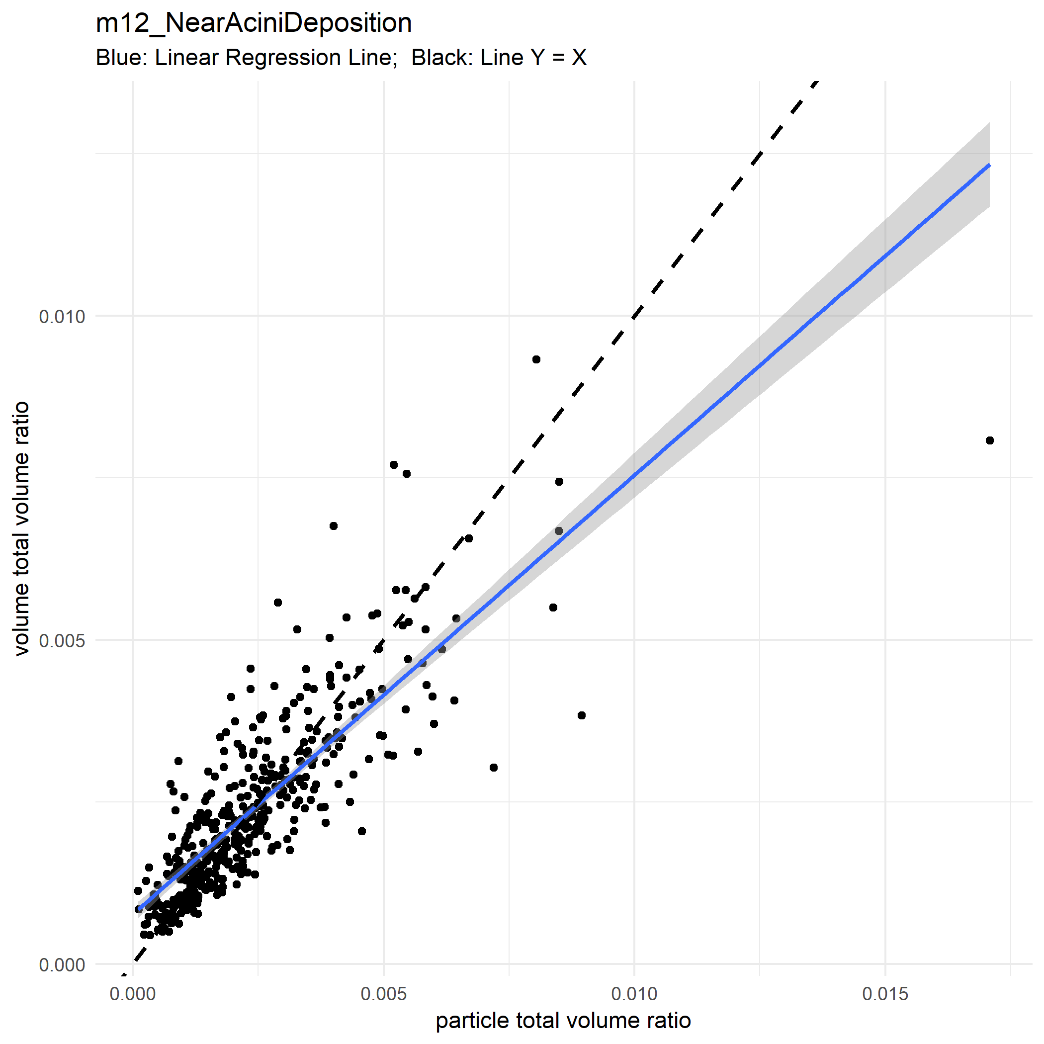

Slide 55
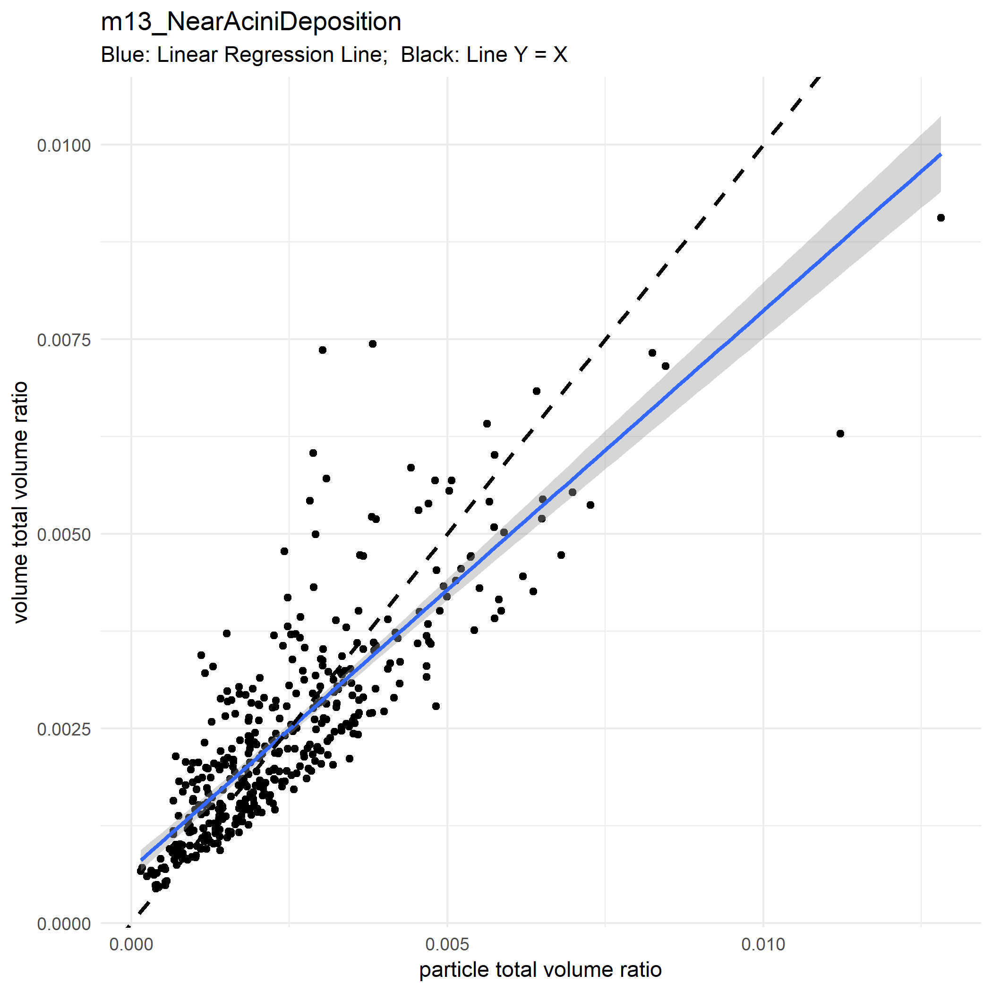

Slide 56
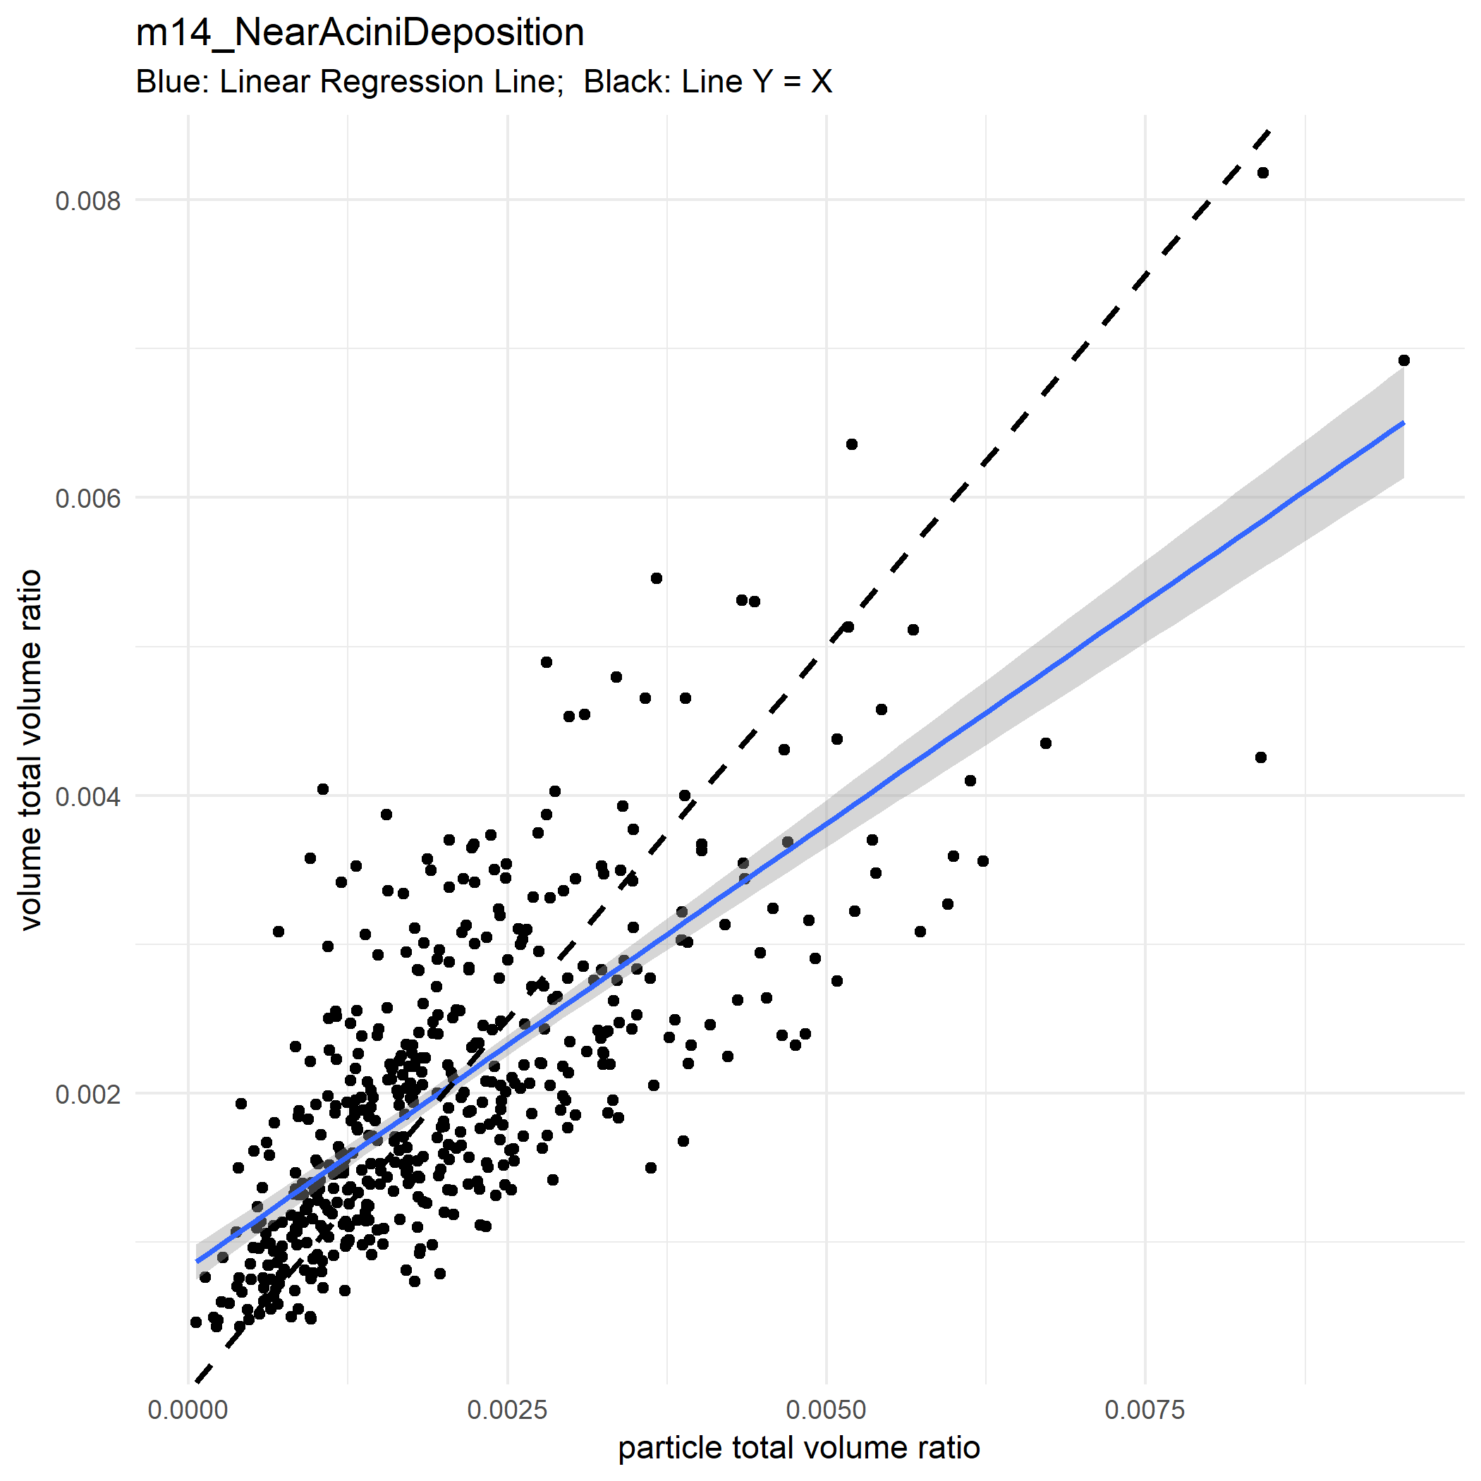

Slide 57
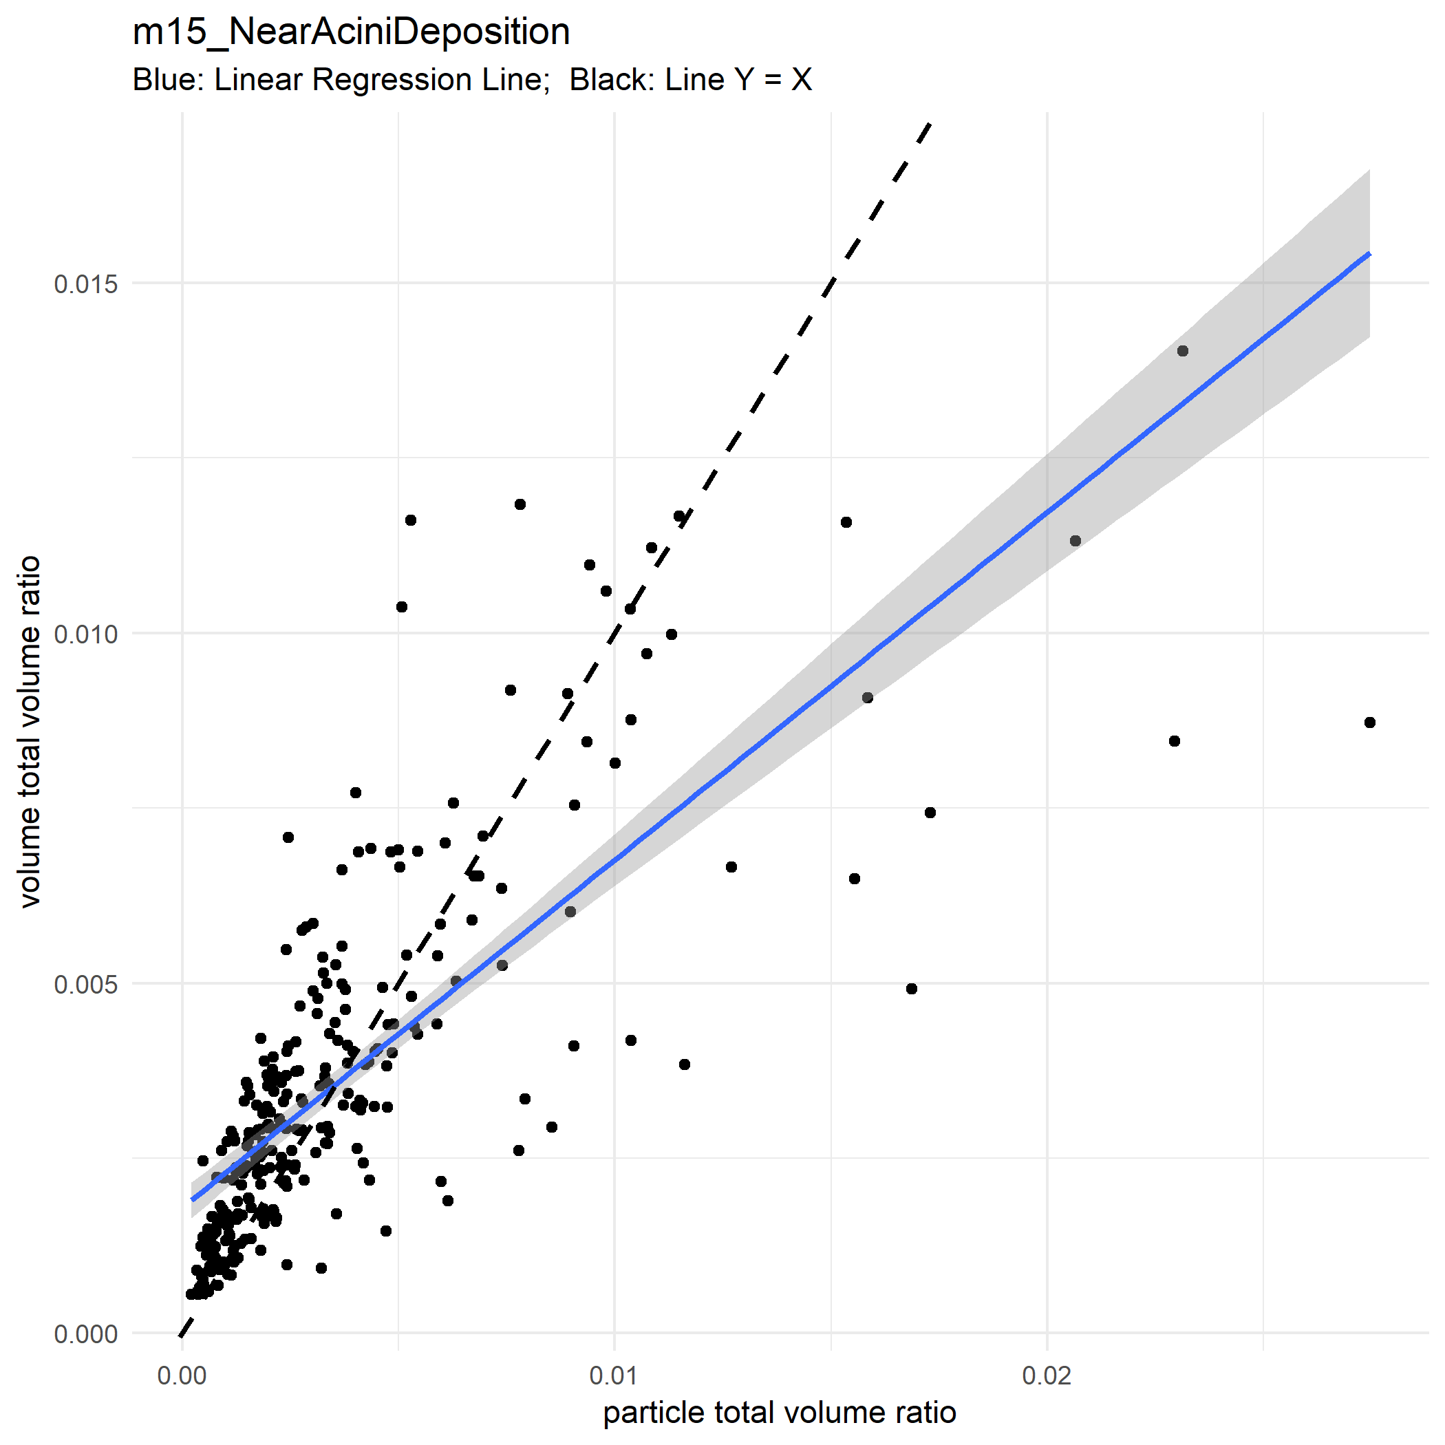

Slide 58
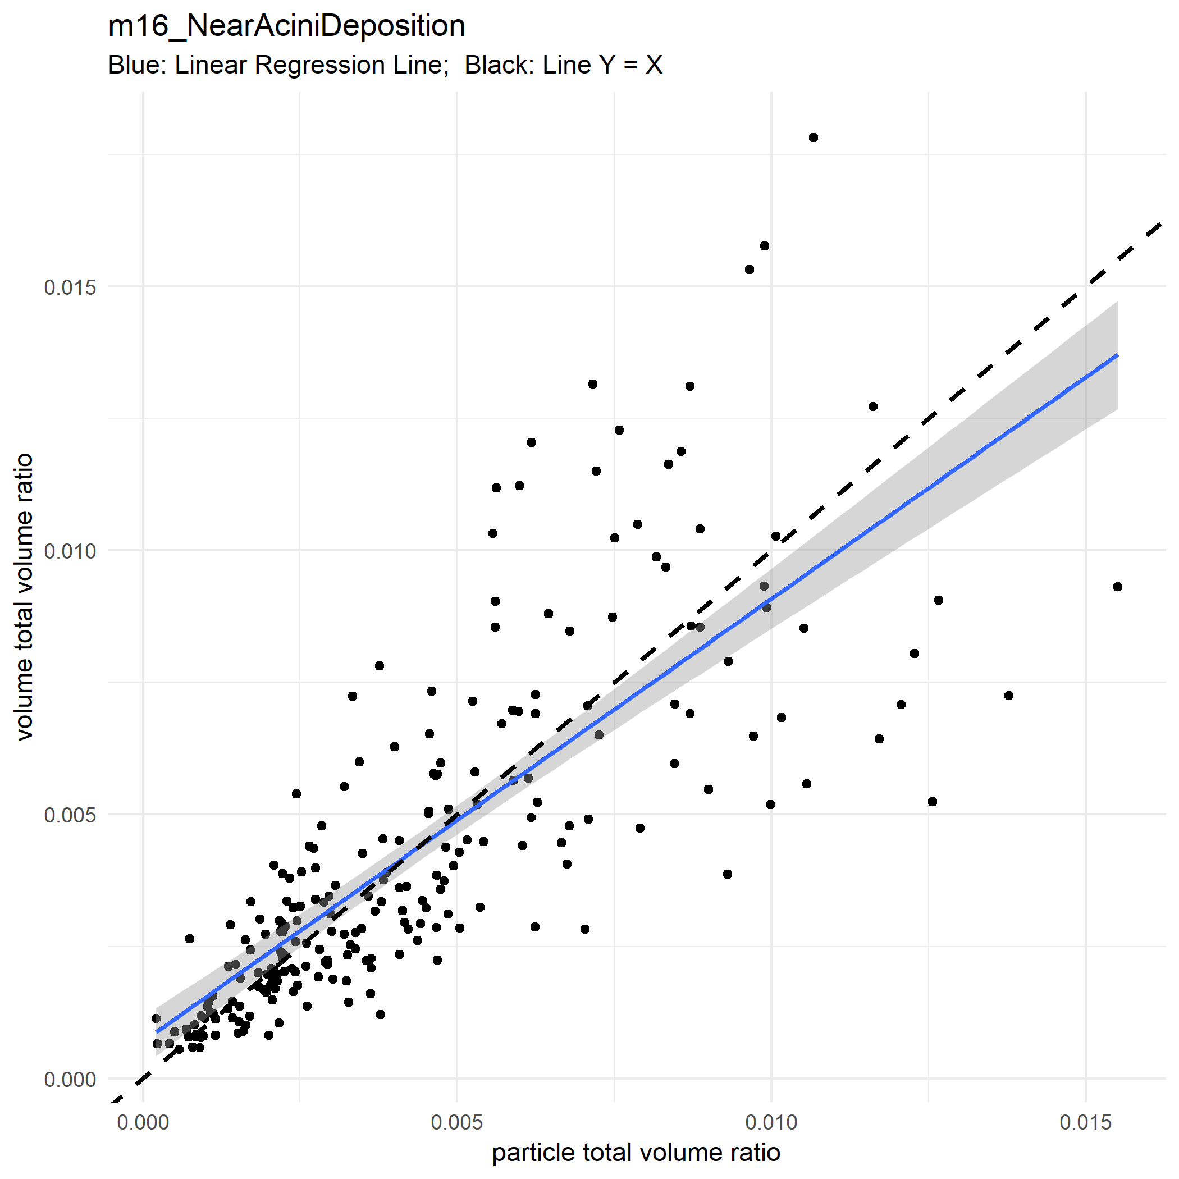

Slide 59
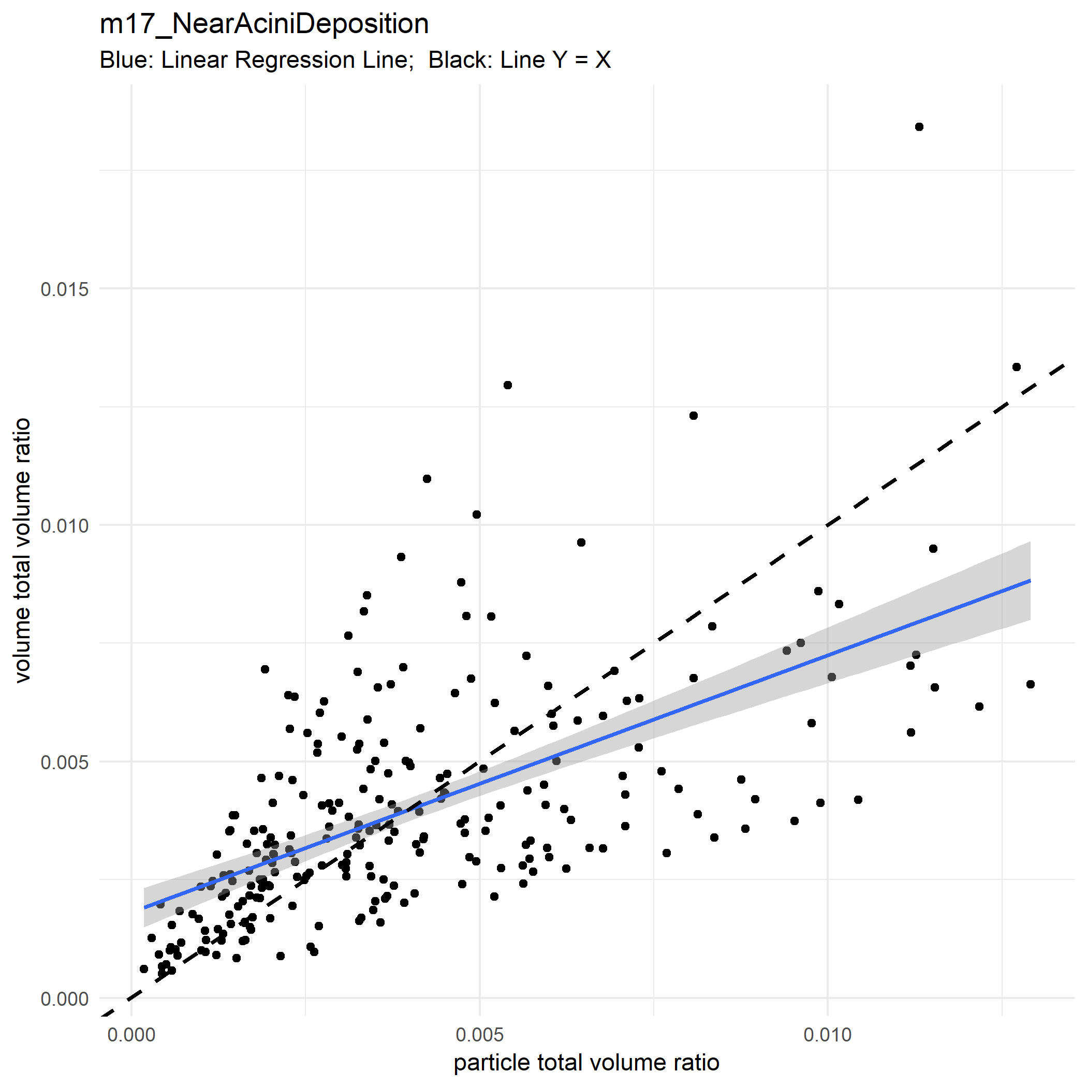

Slide 60
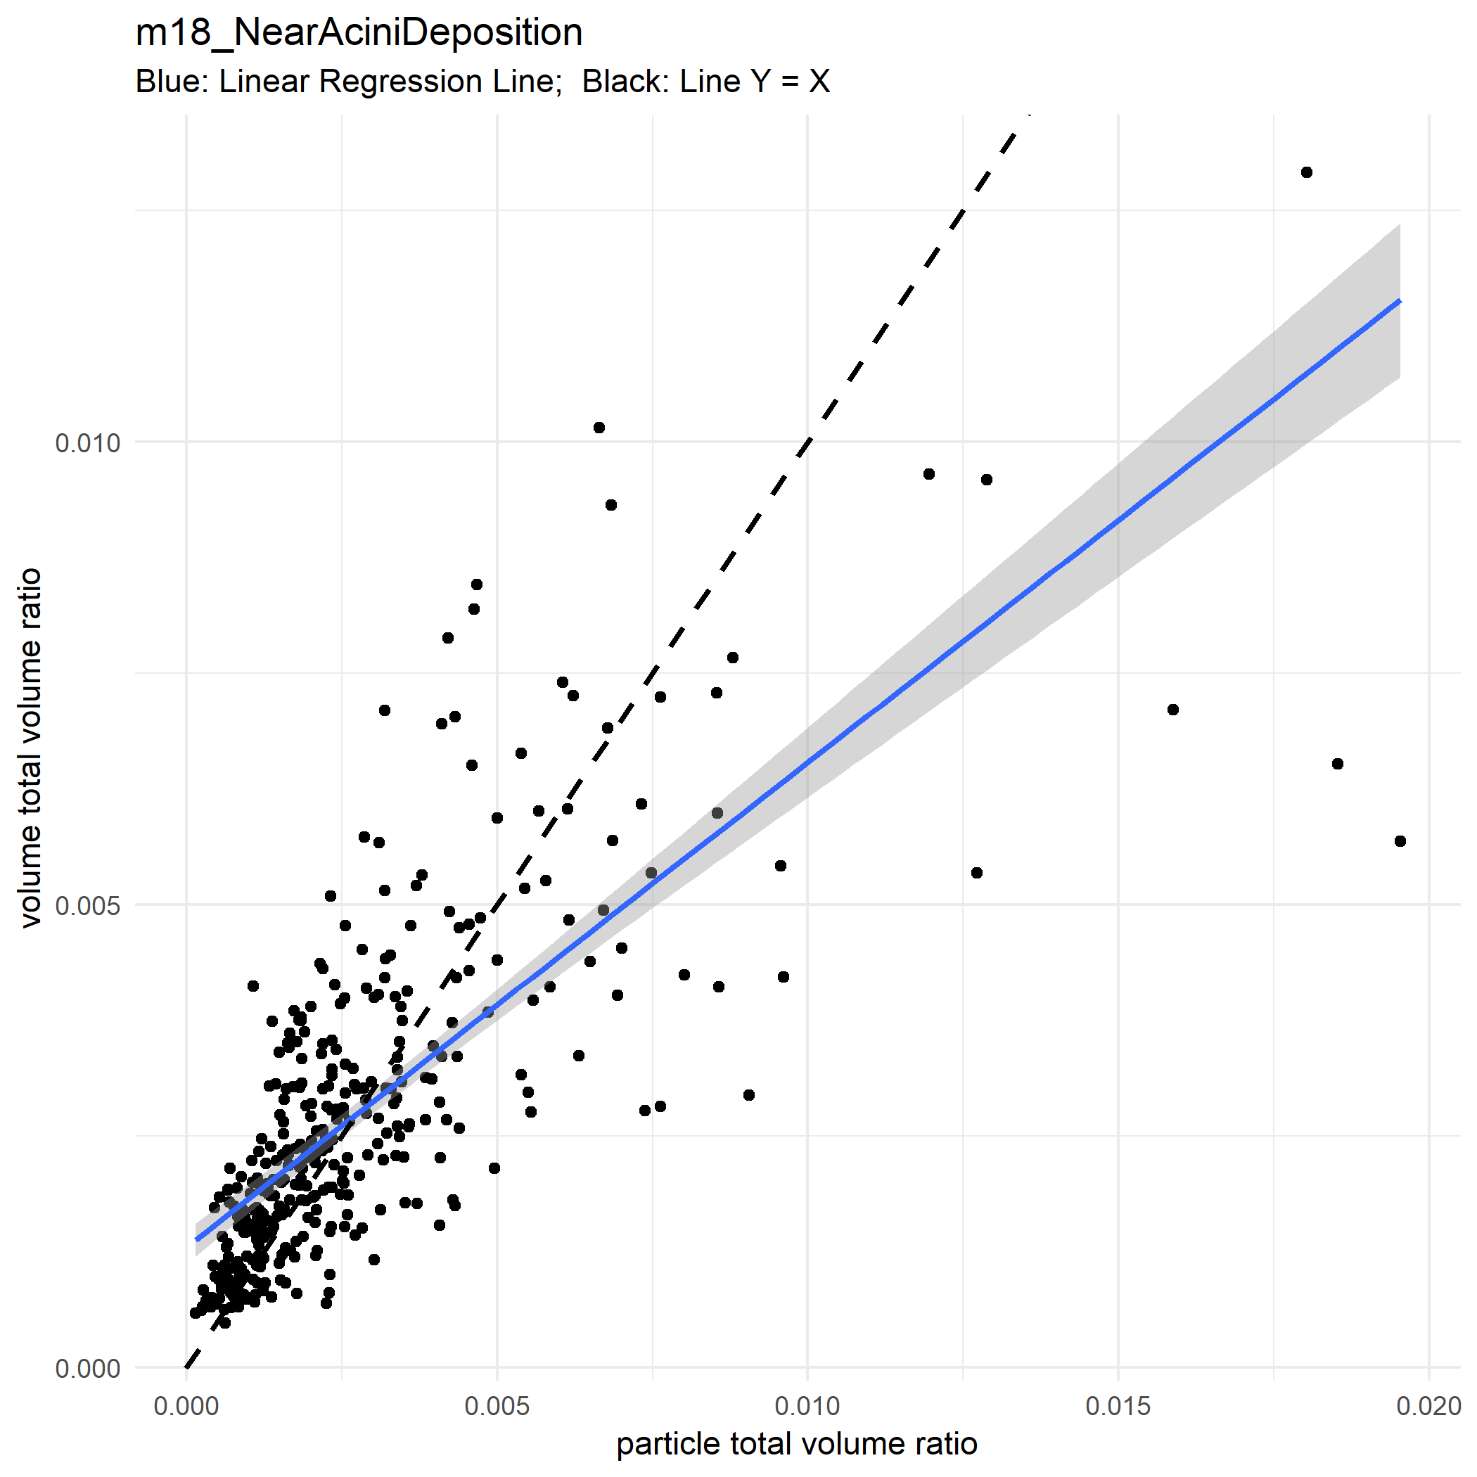

Slide 61
Lobe |  |  | Sublobe |  |  | NearAcini
MEAN | SD | REL_SD | MEAN | SD | REL_SD | MEAN | SD | REL_SD
0.2 | 2.73E-08 | 1.36E-07 | 0.014864 | 0.010853 | 0.730166 | 0.000936 | 0.006316 | 6.746918

Slide 62
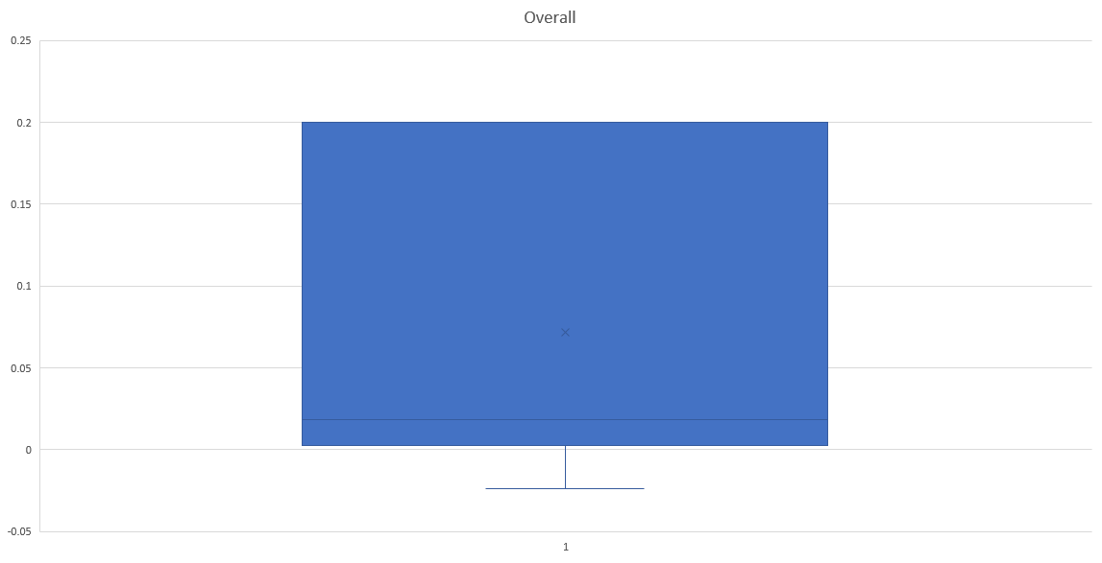

Slide 63
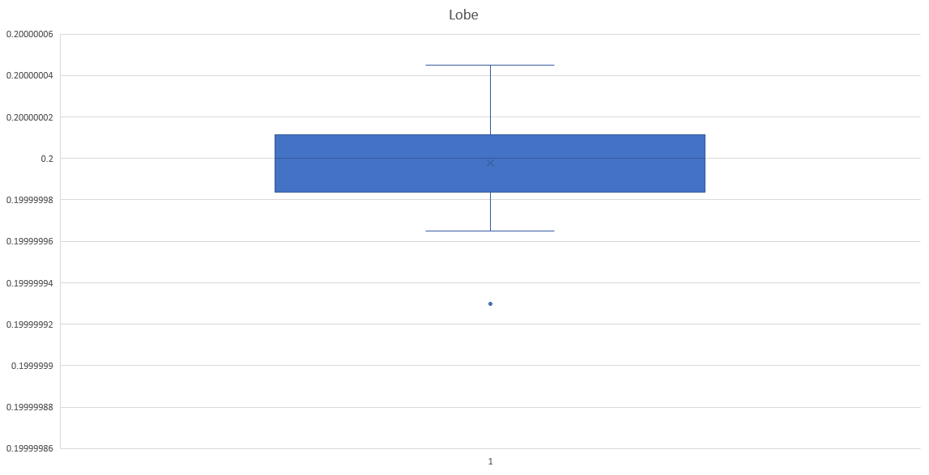

Slide 64
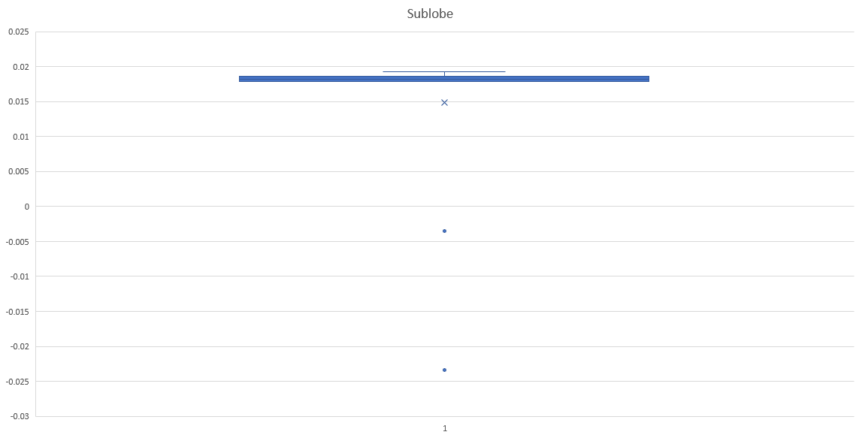

Slide 65


Slide 66

Assumptions
Note: $\frac{\text{Particle} \text{Count}}{\text{Total} \text{Volume}}$ [=] mm^(-3), thus it is not dimensionless
There may exist a critical volume ratio for mice.
Partitions of lung that are above the ratio tend to aggregate more particles
Partitions of lung that are below the ratio tend to even hinder particles from depositing

Slide 67




Bar Plot

Slide 68
Lobe Level

Slide 73


Slide 74


Slide 75


Slide 76


Slide 77


Slide 78


Slide 79


Slide 80


Slide 81


Slide 82


Slide 83


Slide 84


Slide 85


Slide 86


Slide 87
Sub Lobe Level

Slide 88


Slide 89


Slide 90


Slide 91


Slide 92


Slide 93


Slide 94


Slide 95


Slide 96


Slide 97


Slide 98


Slide 99


Slide 100


Slide 101


Slide 102


Slide 103


Slide 104


Slide 105


Slide 106
Class One
Usually discrepancy happens in Lobe #5
Class 1 are samples whose lobe #5 particles are equally distributed

Slide 108
Class Two
Usually discrepancy happens in Lobe #5
Class 2 are samples whose lobe #5 particles are scarcely distributed

Slide 110
Class Three
Usually discrepancy happens in Lobe #5
Class 3 are samples whose lobe #5 particles are densely distributed

Slide 112
MD files and Sample Profile Analysis
Class | Representative Samples
Class 1 | #1 #2 #3 #11
Class 2 | #8 #16
Class 3 | #4 #5 #17

Slide 113





Slide 114



Slide 115



Slide 116
In the future
Further Analyze the sample profile to find patterns
Literature search about critical lung partition (Lobe, Sub Lobe … ) volume ratio for particle deposition
Reconstruct the 3D model of the lung and associate it with data analysis

Slide 117
Reference:
H. Wickham. ggplot2: Elegant Graphics for Data Analysis. Springer-Verlag New York, 2016.
Yihui Xie (2019). knitr: A General-Purpose Package for Dynamic Report Generation in R. R package version 1.22.
LAPD Dataset for Lung Particle Deposition, https://nebraska.ecn.uiowa.edu:447/v3/

Slide 118

Acknowledgement
Masoud Jalali
Theo Jan
Chantal Darquenne

